Slide 1
Year 1
Phonics and Reading Fun!
We welcome you all to our Phonics and Reading workshop today – Wednesday 12th October 2022

Slide 2
Why is reading so important?

Slide 3


Slide 4


Slide 5


Slide 6
What is ‘Phonics’?

Slide 7
Phonics is a way of teaching children how to read and write.
Phonics works by breaking each word up into it’s individual sounds before blending those sounds back together to make the word.

Slide 8
Why are children taught phonics?

Slide 9
Research has shown that phonics, when taught correctly, can be the most effective way of teaching children to learn to read and write.

Slide 10
Some Definitions

Slide 11

Phoneme
This is the smallest unit of sound in a word.
How many phonemes can you hear in
cat stairs

Slide 12

Grapheme
This is the letter or group of letters that represent a sound.
The same phoneme can be spelt using different graphemes
Eg: seat seen happy

Slide 13
And….
Sometimes the same grapheme can have a different phoneme/sound!
Eg: cow snow

Slide 14
special friends (Digraphs and Trigraphs)
A Digraph is a two-letter Grapheme that makes one sound. A Trigraph is a three-letter Grapheme that makes one sound.
Where are the ‘special friends’ in these words?
church stuck
fire light

Slide 15

Fred Talk
Children are taught to hear sounds and blend them together in order to make a word. We start with blending oral sounds, then progress to letters.
F-r-e-d

Slide 16
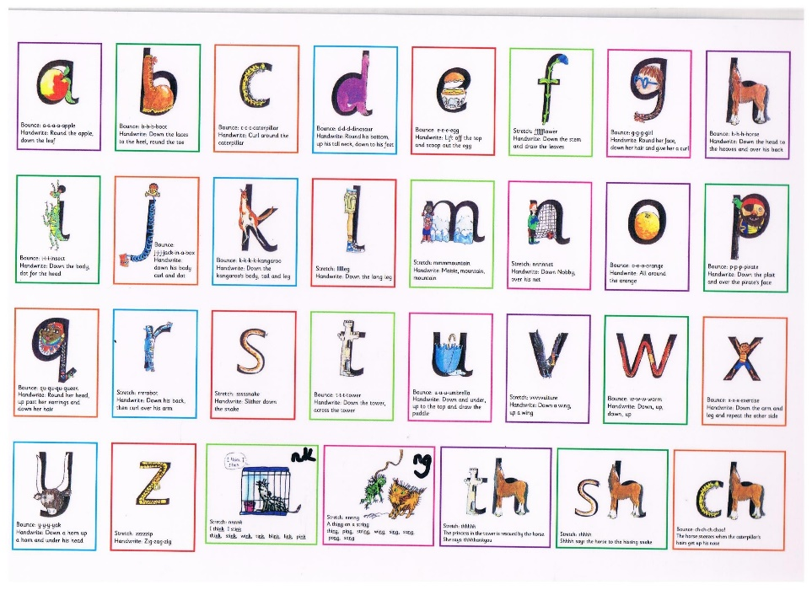
Notes:
Children model saying the sounds on the cards
Hearing the sound in a word…..identifying things starting with that sound etc..

Slide 17
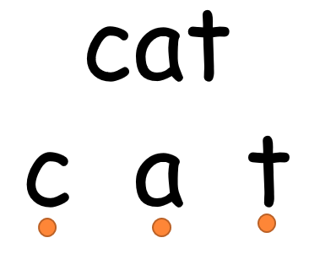
Notes:
Children model blending some sounds

Slide 18
Pure sounds
CLICK HERE: To see a video modelling the pure sounds

Slide 19
It is really important to use ‘pure’ sounds when saying letter sounds rather than adding an ‘uh’ on the end!
c a t m e n

Slide 20
Sound sets
The 44 Read Write Inc. sounds are:
Set 1 - m, a, s, d, t, i, n, p, g, o, c, k, u, b, f, e, l, h,
sh, r, j, v, y, w, th, z, ch, qu, x, ng, nk, ll, ff, ss, ck.
Set 2 - ay, ee, igh, ow, oo, oo, ar, or, air, ir, ou, oy.
Set 3 - ea, oi, a-e, i-e, o-e, u-e, aw, are, ur, er, ow,
ai, oa, ew, ire, ear, ure, tion, cious, tious.
Extra sounds taught: kn, wh, ph, ey, au, ue, ie, oe, e-e.

Slide 21
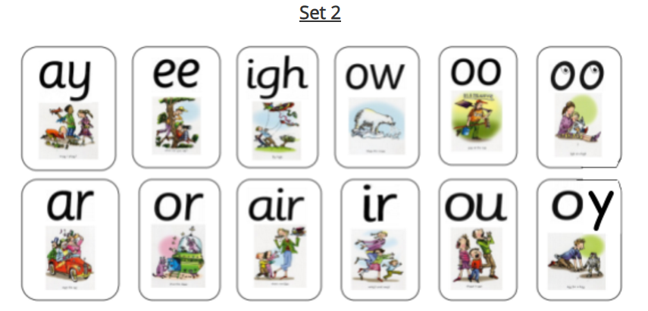
What does it look like in the classroom?
Watch this video to see what phonics teaching looks like in the classroom

Slide 22
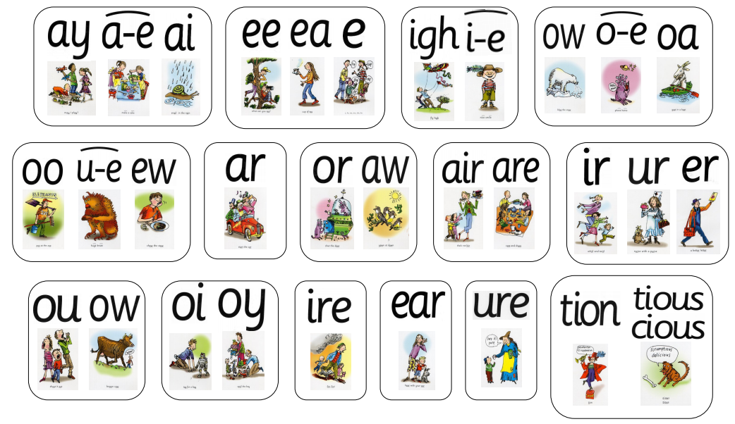
Set 3
Notes:
Child points and parents say the sound!

Slide 23
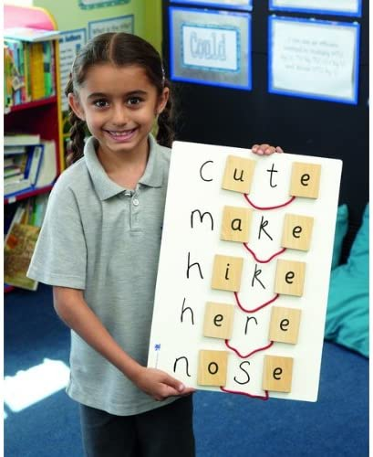
Split Diagraphs
CLICK HERE: Watch this video to see how a split diagraph is taught

Slide 24
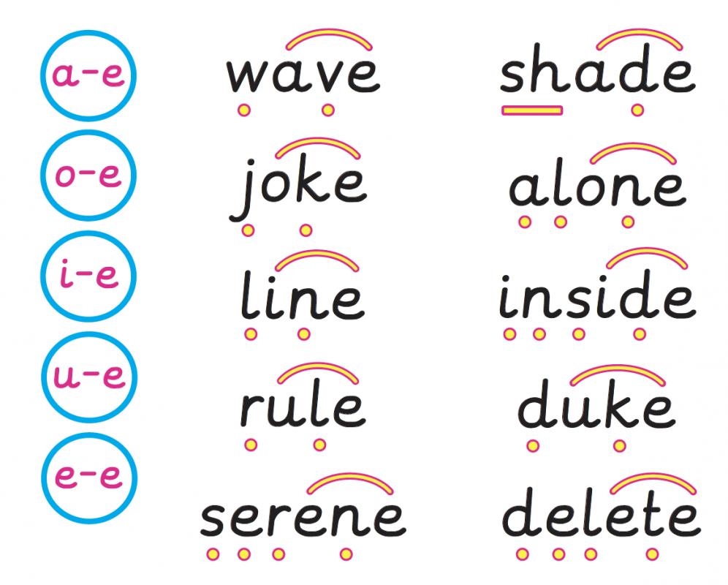

Slide 25
time

Slide 26

time

Slide 27
made

Slide 28
made

Slide 29
flute

Slide 30
flute

Slide 31
explode

Slide 32
explode

Slide 33
envelope

Slide 34
envelope

Slide 35


When you read a new word remember the 3 steps….
1. Find the special friend (s)
2. Fred talk
3. say the word
Fun with Phonics with Mr Poole!

Slide 36
Lets have a go…
braits

Slide 37
splue

Slide 38
snofe

Slide 39
invite

Slide 40

Phonics Screening Check – June
Children will be asked to read 40 words. 20 real English words and 20 nonsense alien words.
Expectation is that they can successful read 32 or more correctly without support.

Slide 41
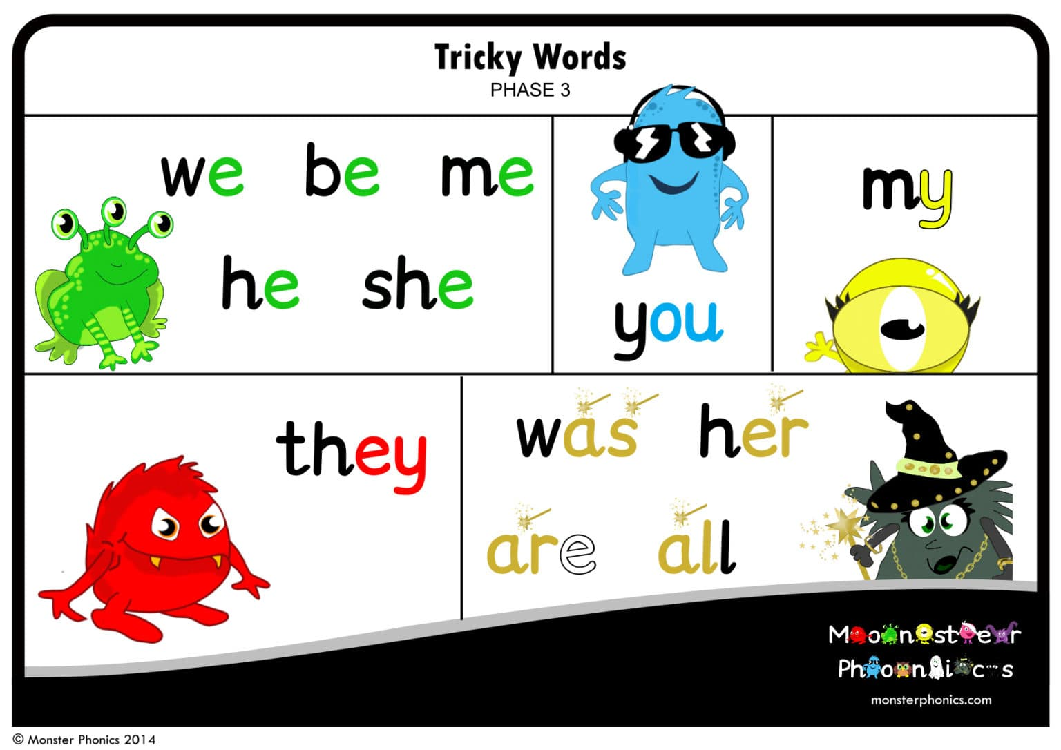
Tricky Word / Red Word
(Common Exception Words)
These are words that are not easy to sound out. The children learn that ‘it is tricky to Fred a red’.
These words need to be learnt and read by sight.

Slide 42
you

Slide 43
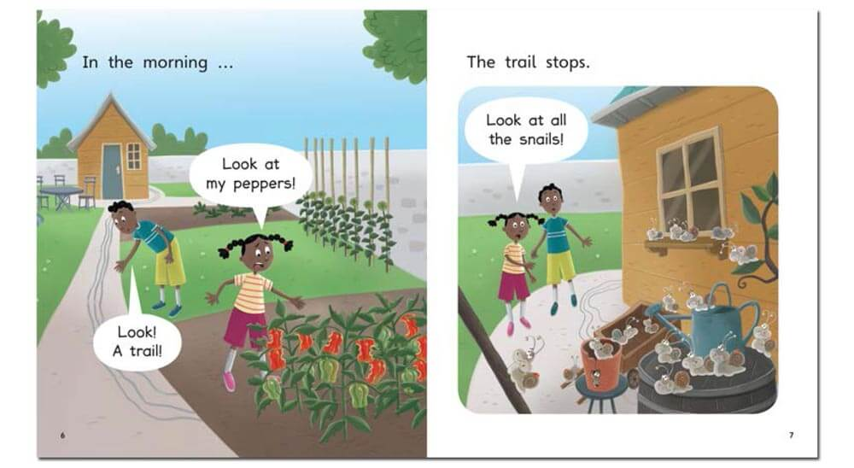
How reading with your child might look.

Slide 44

Reading is more than just phonics!
Common Exception Words
Comprehension and Understanding
Using picture and words clues to recognise what is happening even if it doesn’t say it – What is implied…
eg: The picture shows the character with an umbrella and raincoat. What is
the weather like?
The word says ‘cats’ – is there one or more?
Fluency
Repetition is really important
Tricky Words song

Slide 45
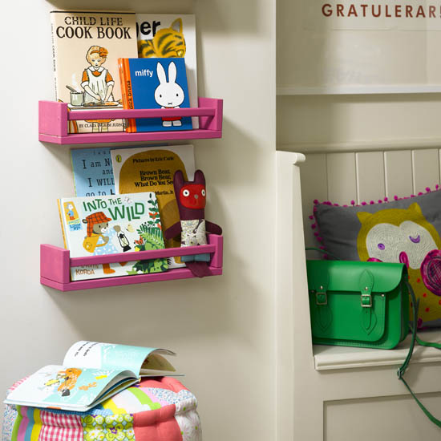
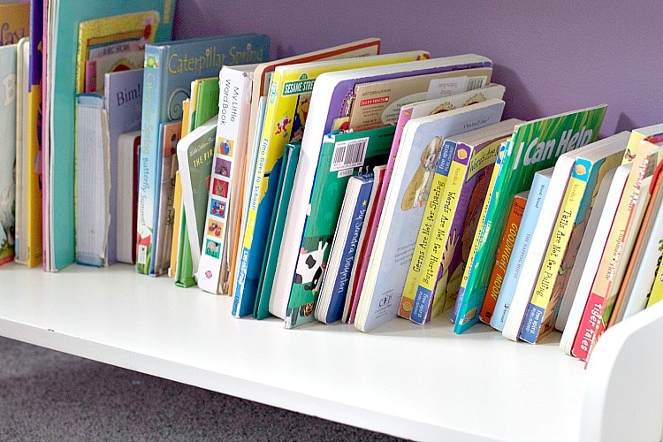

Make Reading at Home Awesome!

Slide 46

Read a bedtime story each night
Make books visible and available
Model
reading
Talk about books and stories

Slide 47
Thank you

