Slide 1
Year 2
Phonics and Reading Fun!
We welcome you all to our Phonics and Reading workshop today – Thursday 13th October 2022

Slide 2
Why is reading so important?

Slide 3
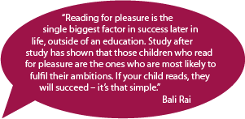

Slide 4


Slide 5
What is ‘Phonics’?

Slide 6
Phonics is a way of teaching children how to read and write.
Phonics works by breaking each word up into it’s individual sounds before blending those sounds back together to make the word.

Slide 7
Some Definitions

Slide 8

Phoneme
This is the smallest unit of sound in a word.
How many phonemes can you hear in
cat stairs

Slide 9

Grapheme
This is the letter or group of letters that represent a sound.
The same phoneme can be spelt using different graphemes
Eg: seat seen happy

Slide 10
And….
Sometimes the same grapheme can have a different phoneme/sound!
Eg: cow snow

Slide 11
Diagraph (special friends)
A Digraph is a two-letter Grapheme that makes one sound.
Where are the ‘diagraphs’ in these words?
Church stuck

Slide 12

Fred Talk
Children are taught to hear sounds and blend them together in order to make a word. We start with blending oral sounds, then progress to letters.
F-r-e-d

Slide 13

Notes:
Children model blending some sounds

Slide 14
Pure sounds
CLICK HERE: To see a video modelling the pure sounds

Slide 15
It is really important to use ‘pure’ sounds when saying letter sounds rather than adding an ‘uh’ on the end!
c a t m e n

Slide 16
Sound sets
Watch this video to see what phonics teaching looks like in the classroom
The 44 Read Write Inc. sounds are:
Set 1 - m, a, s, d, t, i, n, p, g, o, c, k, u, b, f, e, l, h,
sh, r, j, v, y, w, th, z, ch, qu, x, ng, nk, ll, ff, ss, ck.
Set 2 - ay, ee, igh, ow, oo, oo, ar, or, air, ir, ou, oy.
Set 3 - ea, oi, a-e, i-e, o-e, u-e, aw, are, ur, er, ow,
ai, oa, ew, ire, ear, ure, tion, cious, tious.
Extra sounds taught: wh, ph, ey, au, ue, ie, oe, e-e.

Slide 17
Split Diagraphs
CLICK HERE: Watch this video to see how a split diagraph is taught

Slide 18
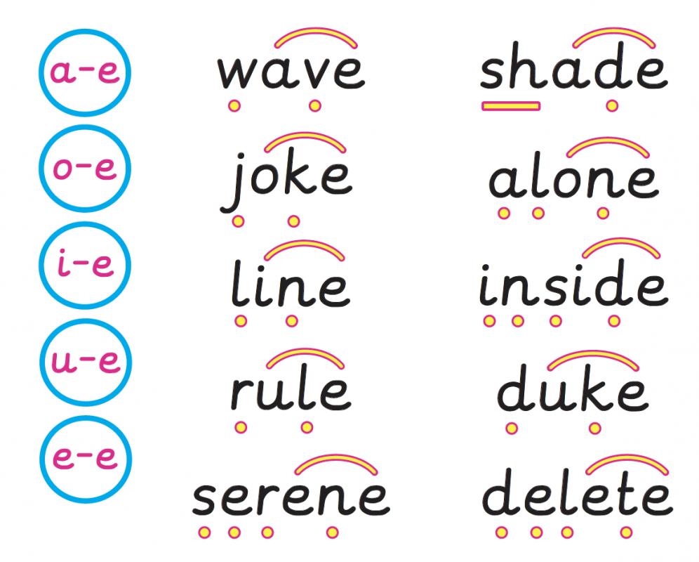

Slide 19
time

Slide 20

time

Slide 21
made

Slide 22
made

Slide 23
flute

Slide 24
flute

Slide 25
envelope

Slide 26
envelope

Slide 27
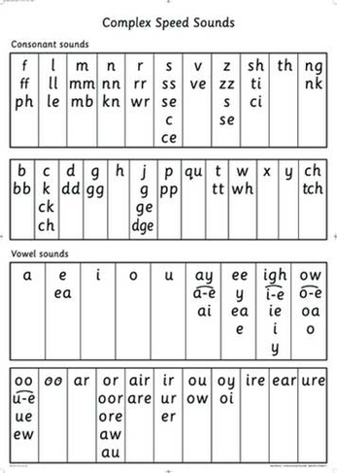

Slide 28
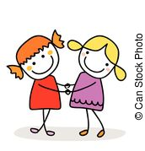

When you read a new word remember the 3 steps….
1. Find the special friend (s)
2. Fred talk
3. say the word
Fun with Phonics with Mr Poole!

Slide 29
Lets have a go…
splire

Slide 30
jephew

Slide 31
stove

Slide 32
clike

Slide 33
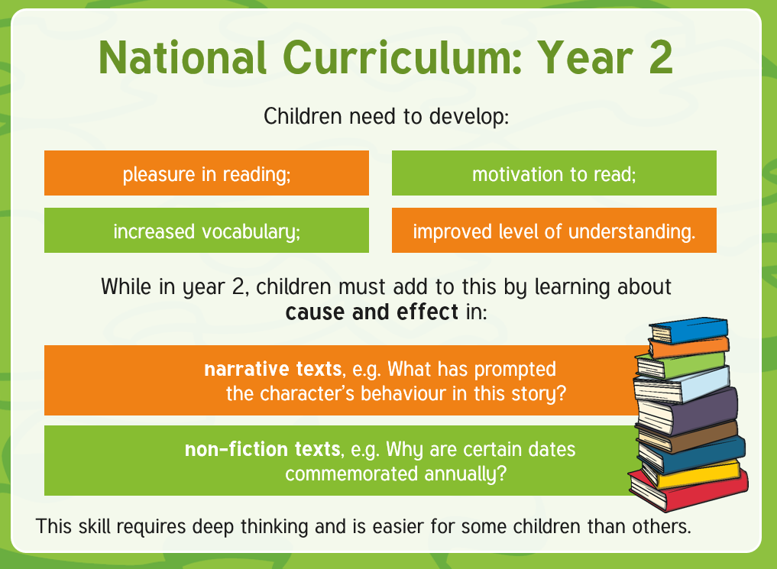

Slide 34

Year 2 Expectations
Year 2 children are expected to:
use a range of strategies to read new words, e.g. breaking the word down into chunks;
read familiar words quickly without needing to sound them out;
correct themselves when they have read a sentence incorrectly;
read words containing the common suffixes –ful (careful),
-ly (slowly), -ness (illness), -ment (treatment) and –less (helpless);
Notes:
These elements of the National Curriculum are expanded upon for parents and carers in the Reading with Your Year 2 Child Parent Advice Booklet.

Slide 35

Year 2 Expectations
Year 2 children are expected to:
continue to practise phonics until reading has become fluent;
retell a story, referring to most of the key events and characters;
decide how useful a non-fiction text is for a particular purpose;
be aware that books are set in different places;
relate what they have read to their own experiences;
Notes:
These elements of the National Curriculum are expanded upon for parents and carers in the Reading with Your Year 2 Child Parent Advice Booklet.

Slide 36

Year 2 Expectations
Year 2 children are expected to:
continue to build up a repertoire of poems learnt by heart;
recognise key themes and ideas within a text;
make simple inferences about the thoughts and feelings of characters and the reasons for their actions.
Notes:
These elements of the National Curriculum are expanded upon for parents and carers in the Reading with Your Year 2 Child Parent Advice Booklet.

Slide 37

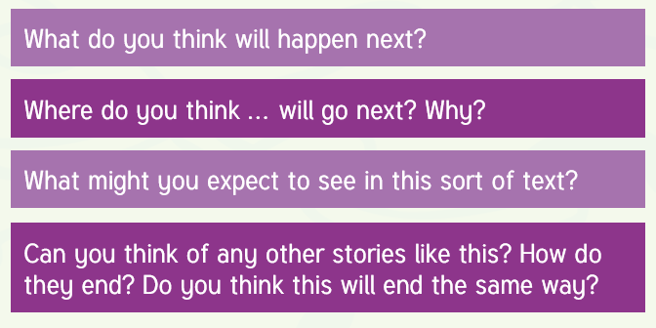

Slide 38

Reading comprehension
This is finding and picking out information from a text to answer questions.
Finding key information in a text.

Slide 39
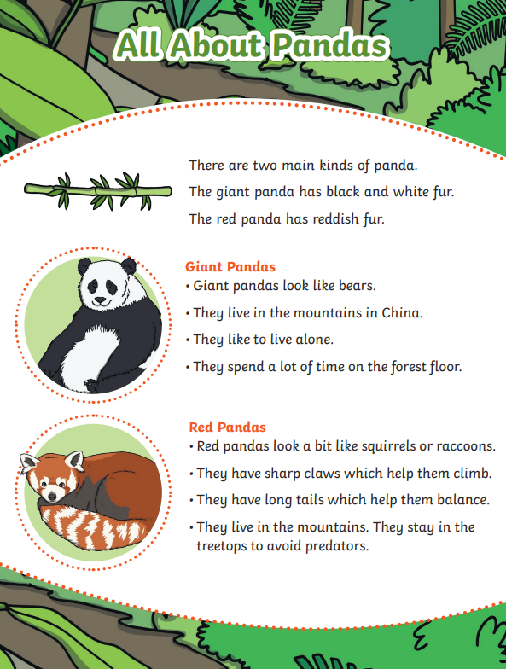
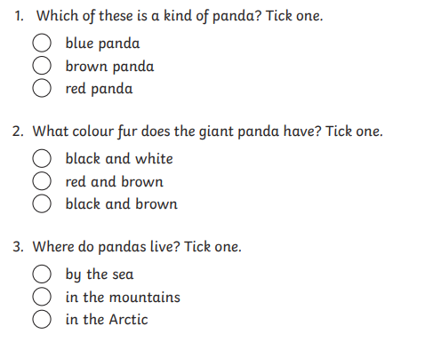

Slide 40

Reading comprehension
This is filling in what is not written on the page or working out what the author is trying to tell you using clues and evidence from the text when it is not explicitly written.

Slide 41
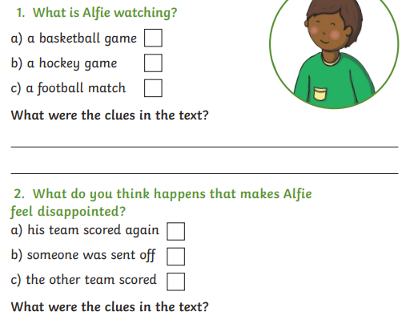
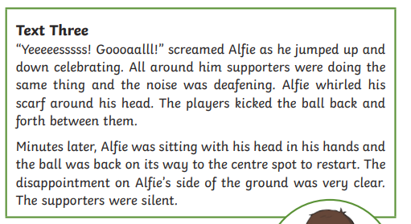

Slide 42
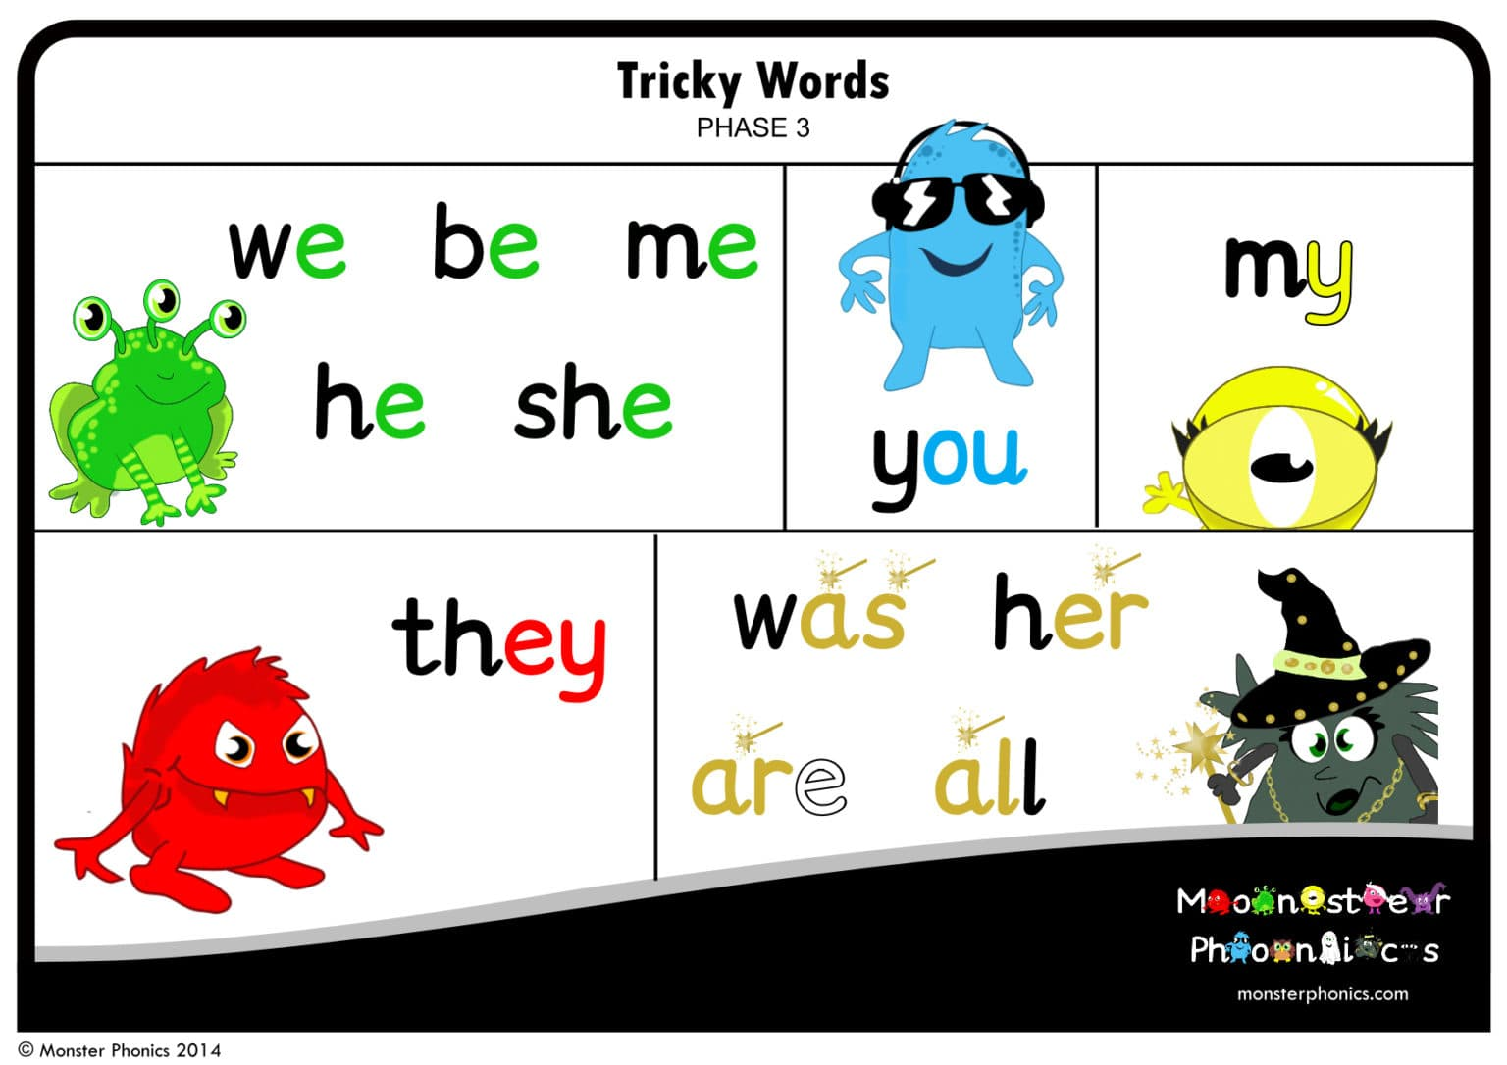
Tricky Word / Red Word
(Common Exception Words)
These are words that are not easy to sound out. The children learn that ‘it is tricky to Fred a red’.
These words need to be learnt and read by sight.

Slide 43
what

Slide 44
Year 2 End of Year Assessments
Called SATs. (Standard Assessment Tests)
Happen in May. Children must be in school during this time.
Children work through booklets with stories/non-fiction writing and answer questions.

Slide 45
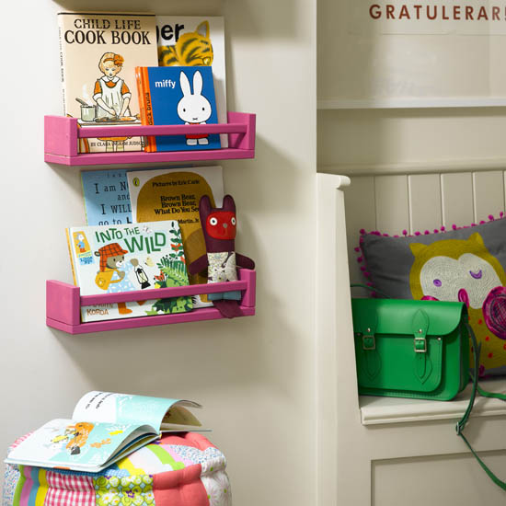
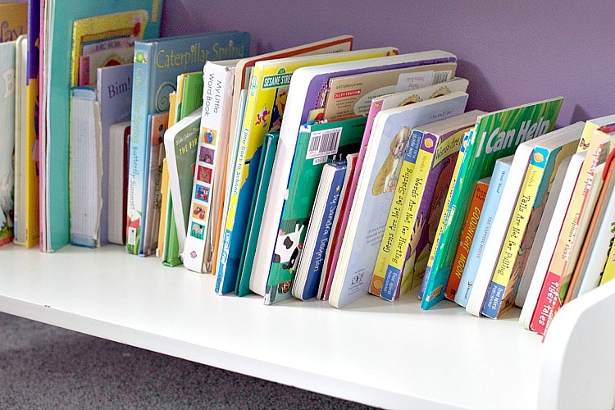

Make Reading at Home Awesome!

Slide 46

Read a bedtime story each night
Make books visible and available
Model
reading
Talk about books and stories

