Slide 2
Read each word and decide if it is a real English word or a silly alien word.
Start the timer and see if you can read it and decide before it finishes.
Then check your answer to see if you were right.
Enjoy the game…try challenging your grown-up to see if they can beat the timer!

Slide 3
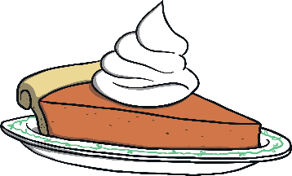

pie
Start Timer
Start Timer
Next
Use Timer
Show Answer

Slide 4
jie
Start Timer
Start Timer
Show Answer
Use Timer
Next

Slide 5
grie
Start Timer
Start Timer
Show Answer
Use Timer
Next

Slide 6
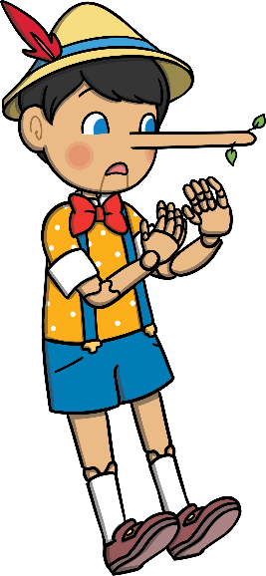
lie
Start Timer
Start Timer
Next
Use Timer
Show Answer

Slide 7
piem
Start Timer
Start Timer
Show Answer
Use Timer
Next

Slide 8

tie
Start Timer
Start Timer
Next
Use Timer
Show Answer

Slide 9
blieg
Start Timer
Start Timer
Show Answer
Use Timer
Next

Slide 10
friep
Start Timer
Start Timer
Show Answer
Use Timer
Next

Slide 11
dried
Start Timer
Start Timer
Next
Use Timer
Show Answer

Slide 12
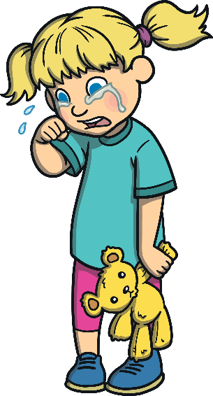
cried
Start Timer
Start Timer
Next
Use Timer
Show Answer

Slide 13
trief
Start Timer
Start Timer
Show Answer
Use Timer
Next

Slide 14

fried
Start Timer
Start Timer
Next
Use Timer
Show Answer

Slide 15
biep
Start Timer
Start Timer
Show Answer
Use Timer
Next

Slide 16
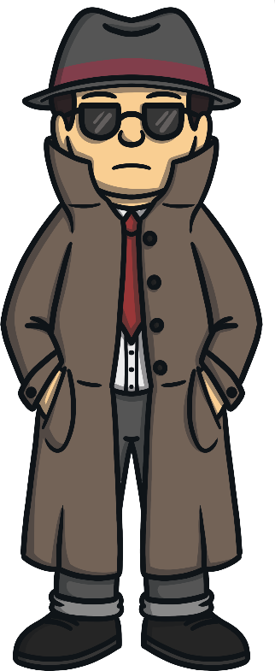
spied
Start Timer
Start Timer
Next
Use Timer
Show Answer

