Slide 2
Read each word and decide if it is a real English word or a silly alien word.
Start the timer and see if you can read it and decide before it finishes.
Then check your answer to see if you were right.
Enjoy the game…try challenging your grown-up to see if they can beat the timer!

Slide 3
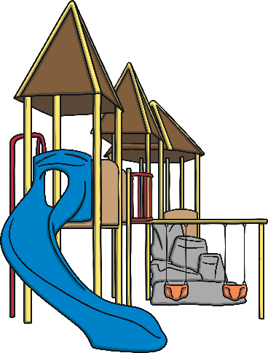

slide
Start Timer
Start Timer
Use Timer
Show Answer
Next

Slide 4
kide
Start Timer
Show Answer
Start Timer
Use Timer
Next

Slide 5
gime
Start Timer
Show Answer
Start Timer
Use Timer
Next

Slide 6
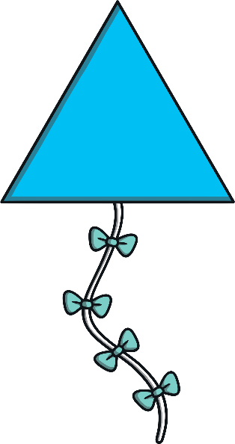
kite
Start Timer
Start Timer
Use Timer
Show Answer
Next

Slide 7
quibe
Start Timer
Show Answer
Start Timer
Use Timer
Next

Slide 8

prize
Start Timer
Start Timer
Use Timer
Show Answer
Next

Slide 9
hine
Start Timer
Show Answer
Start Timer
Use Timer
Next

Slide 10
drike
Start Timer
Show Answer
Start Timer
Use Timer
Next

Slide 11
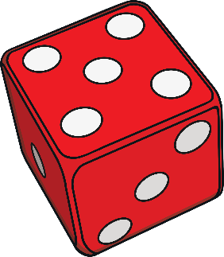
five
Start Timer
Start Timer
Use Timer
Show Answer
Next

Slide 12

time
Start Timer
Start Timer
Use Timer
Show Answer
Next

Slide 13
trife
Start Timer
Show Answer
Start Timer
Use Timer
Next

Slide 14
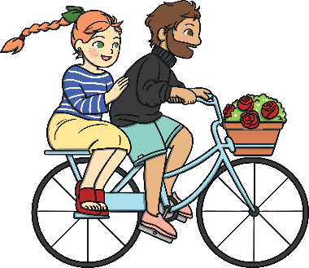
bike
Start Timer
Start Timer
Use Timer
Show Answer
Next

Slide 15
gline
Start Timer
Show Answer
Start Timer
Use Timer
Next

Slide 16
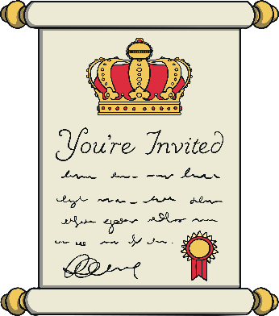
invite
Start Timer
Start Timer
Use Timer
Show Answer
Next

Slide 17

white
Start Timer
Start Timer
Use Timer
Show Answer
Next

Slide 18
krite
Start Timer
Show Answer
Start Timer
Use Timer
Next

