Slide 1
This slide for the leader or teacher
St Clement’s
10 minute class worship
Session 1
We will be thinking about our School Prayer
You will need: A laminated copy of The School Prayer
Prayer book marks to show
DB Aug 2020

Slide 2


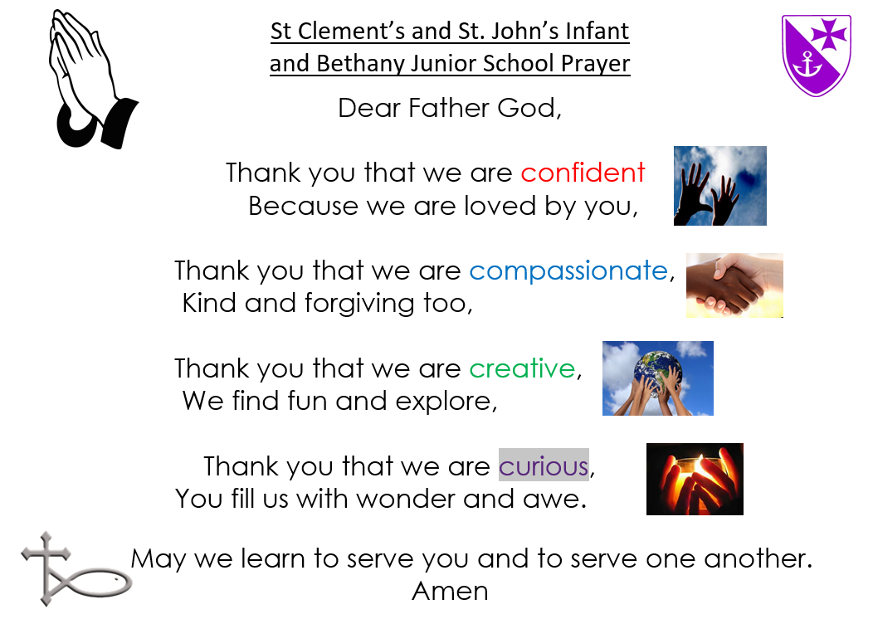


Over the next few weeks
we will be learning our school prayer.
We will think about what each
sentence means by finding
a Bible story
to help us understand.

Slide 3
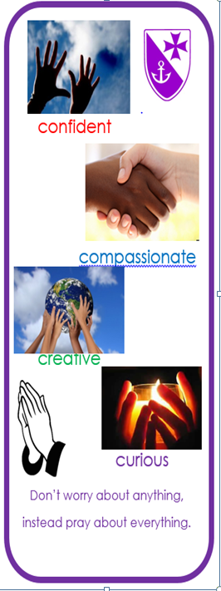
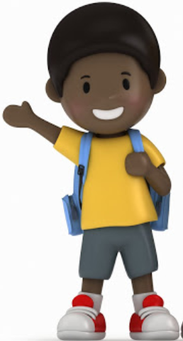
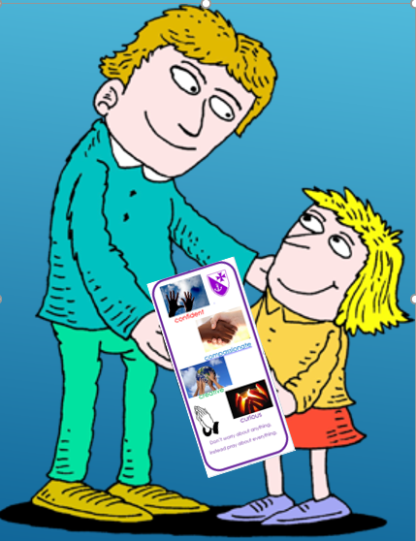
If we have learnt our school prayer and when a grown up sees us praying confidently during Worship times, we can be awarded a special Prayer book mark.

Slide 4
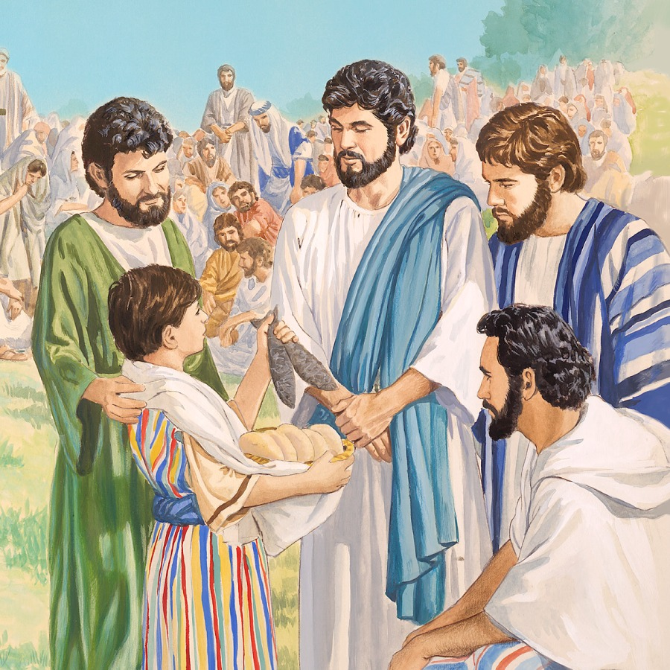
Today we are going to explore the story of a little boy who shared what he had. Jesus used this to create a miracle.
We will also think about being confident
and the difference it can make.

Slide 5

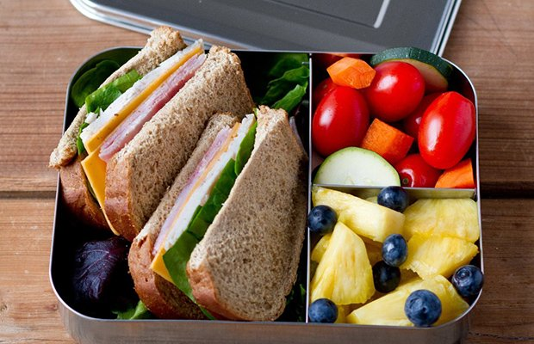
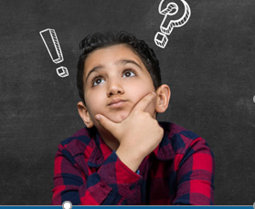
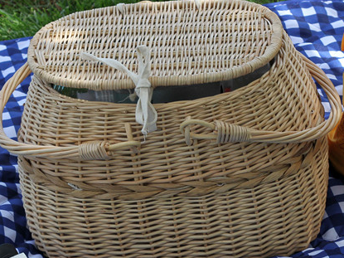
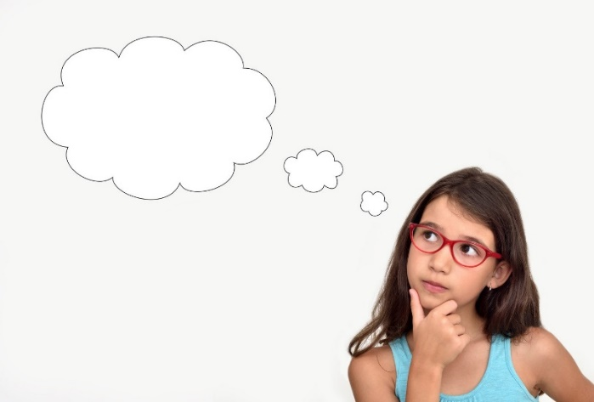
Think, then share with your friend. What would you put in a healthy lunchbox?…
This is a lunch from Jesus’ time.
Can you guess what is inside?

Slide 6
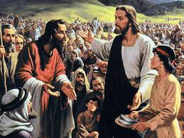
Watch the story of a miraculous lunch
https://www.youtube.com/watch?v=S6rj9cAJrWE
(2 mins.09)

Slide 7
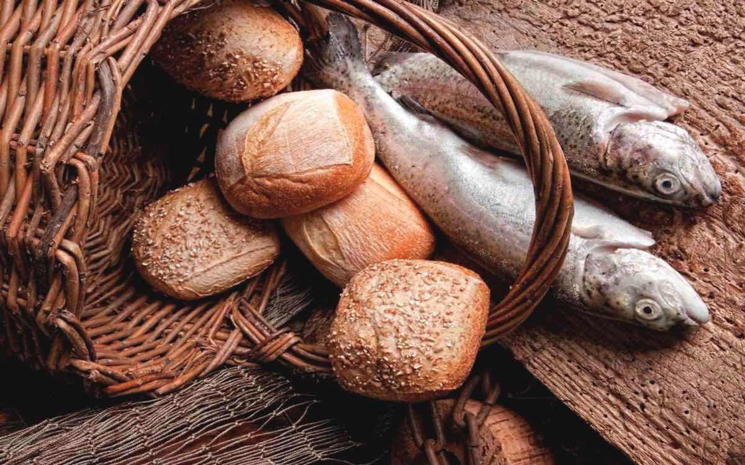
What was in this little boy’s lunch basket?
Move the basket…were you right?

Slide 8

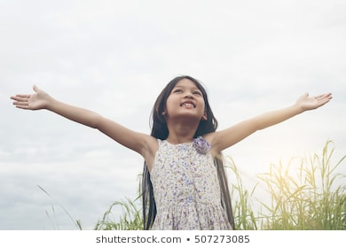
This boy was confident and compassionate, next time we will think about what this felt like for him and how God could use him to bless other people.
The first part of our school prayer for us to learn is
We say this with our hands held up to God, showing we trust his love to make us confident.

Slide 9
Let us say together
Let’s have a practice
In a squeaky voice
In a posh voice
Girls only
Boys only………..Who was the most confident?

Slide 10
This boy was able to be confident and let God’s love shine out of him. Jesus took what he gave and miraculously fed 5,000 people! WOW!!!!
Lets sing together to remind us that God can use us too
https://www.youtube.com/watch?v=2XVq2z_7TLM

