Slide 1

This slide is just for the leaders
to get the class or family worship ready
For this worship,
you will need to get ready:
Pentecost story For younger children https://www.youtube.com/watch?v=IqG_lvZhU-A
Pentecost story for older children https://www.youtube.com/watch?v=oNNZO9i1Gjc
For younger children- Fruit of the spirit song https://www.youtube.com/watch?v=JdkUb2YVWj8
Who You say I am song
https://www.youtube.com/watch?v=IcC1Bp13n_4

Slide 2


Welcome to Summer term #5
Class or Family worship
Today we will be Curious and Reflective
We will find out about
Pentecost and the Fruits of the Spirit.

Slide 3
Let’s play a P4C game
Philosophers fruit salad.
For school… Make a circle. Cross the circle if you love strawberries… apples… grapes…pineapples… bananas… sausages...wait…that’s not a fruit!
OK, make up your own!
For home… If you are at home with a small family, jump up and dance for each fruit that you love!

Slide 4

Last week,
we read about
Jesus saying
goodbye to his friends.
He made a promise.
Can you remember
what it was?

Slide 5
Jesus said he would
give a helper,
the Holy Spirit.

Slide 6
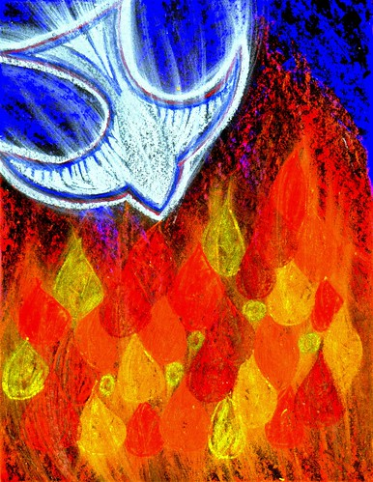
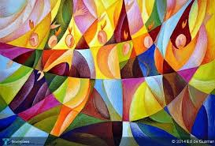
The Bible tells us about Pentecost, when the Holy Spirit comes.
Pentecost story For younger children https://www.youtube.com/watch?v=IqG_lvZhU-A
Pentecost story for older children https://www.youtube.com/watch?v=oNNZO9i1Gjc
It’s all about the gifts of the
Holy Spirit.

Slide 7
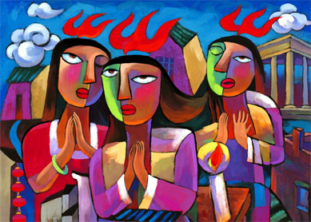
.That’s
great
but
what
does it
mean?

Slide 8

It means
people all over
the world can
have the Fruits of the Spirit…
What are they?

Slide 9
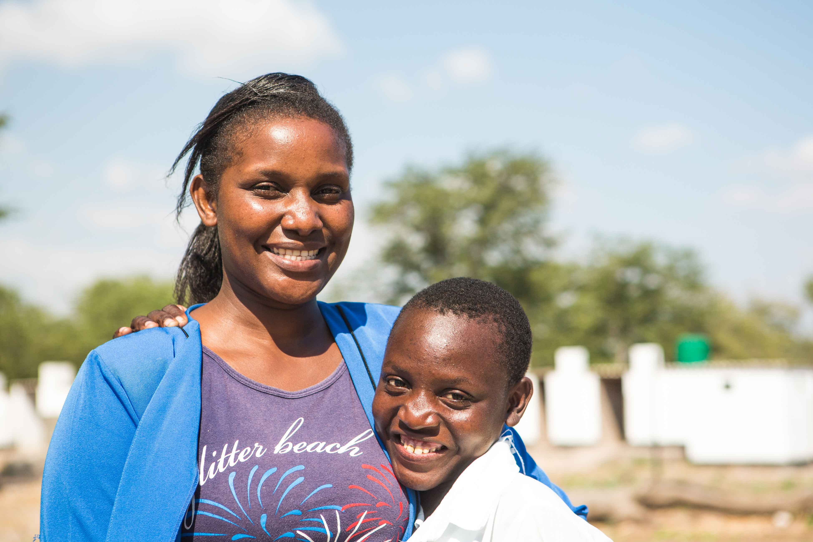

Notes:
Background information: Memory (left) is the health club teacher at Simatelele Secondary School in Zimbabwe. She teaches the children which foods are good for their health and helps them understand the importance of eating a varied diet. The school has a CAFOD-funded vegetable garden where the children learn to plant fruit and vegetables. The students then take this knowledge home and share it with their parents.
Photo credit: Thom Flint | CAFOD (2017)

Slide 10

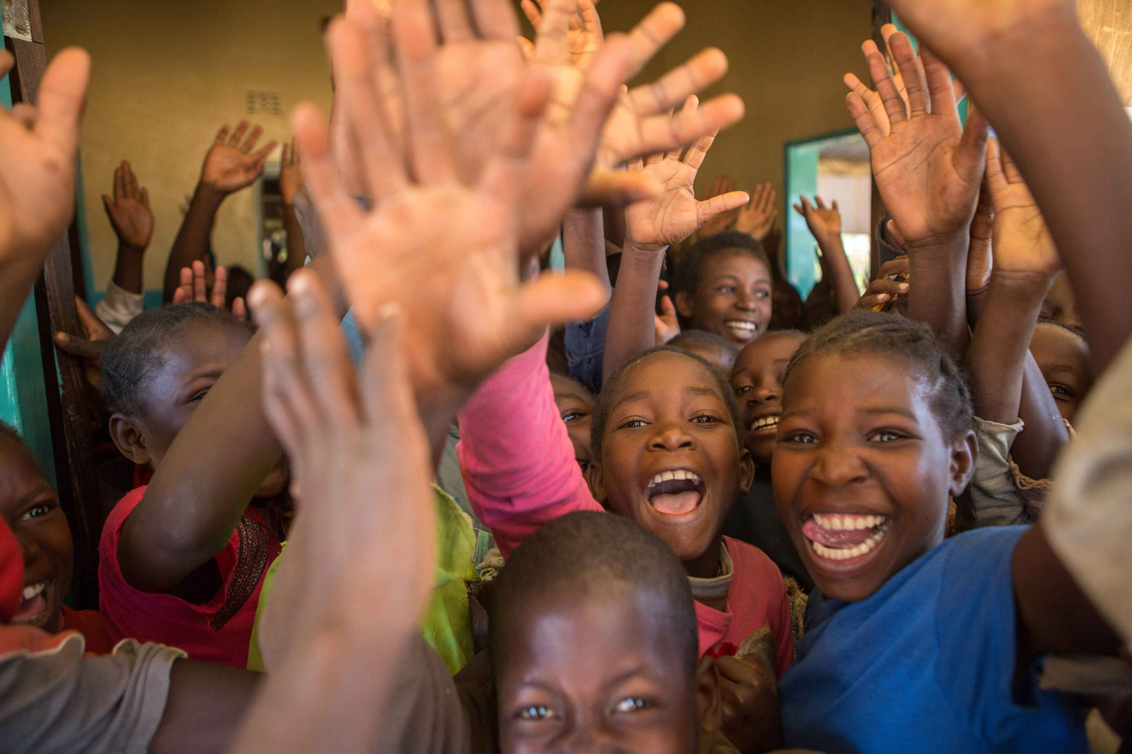
Notes:
Children in a classroom in Zambia
Photo credit: Ben White | CAFOD (2016)

Slide 11
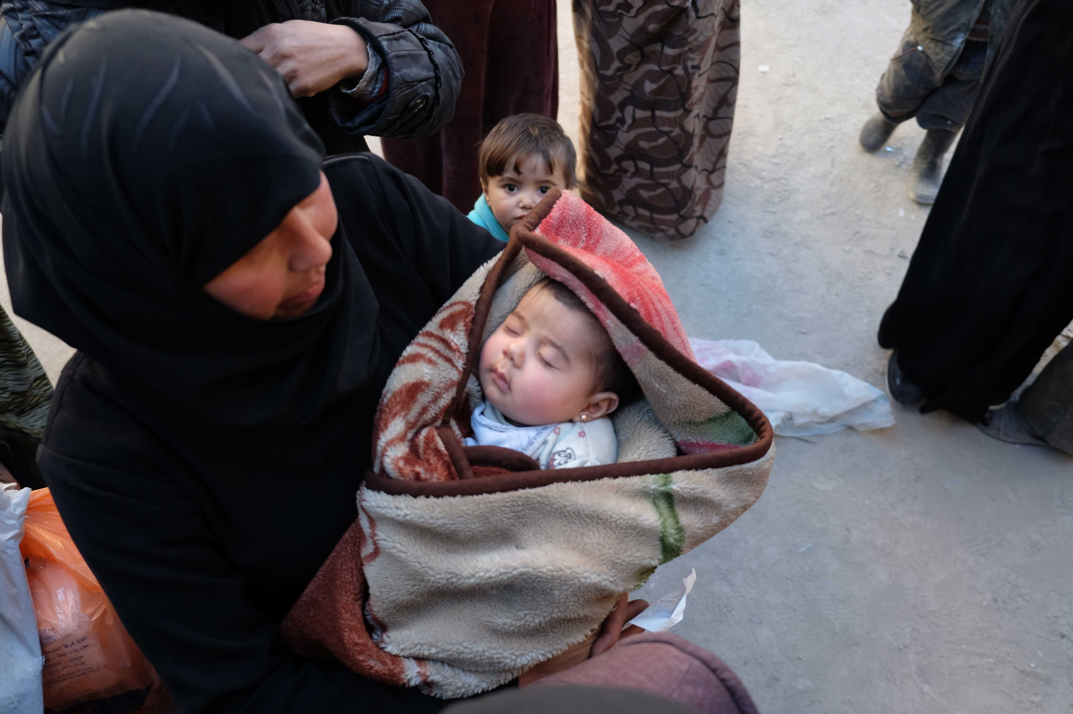

Notes:
Background information: A woman with her small baby, at a recently opened centre in Eastern Aleppo, CAFOD partner Caritas Syria distributes blankets, hygiene items and nappies.
Photo credit: Patrick Nicholson | Caritas (2017)

Slide 12
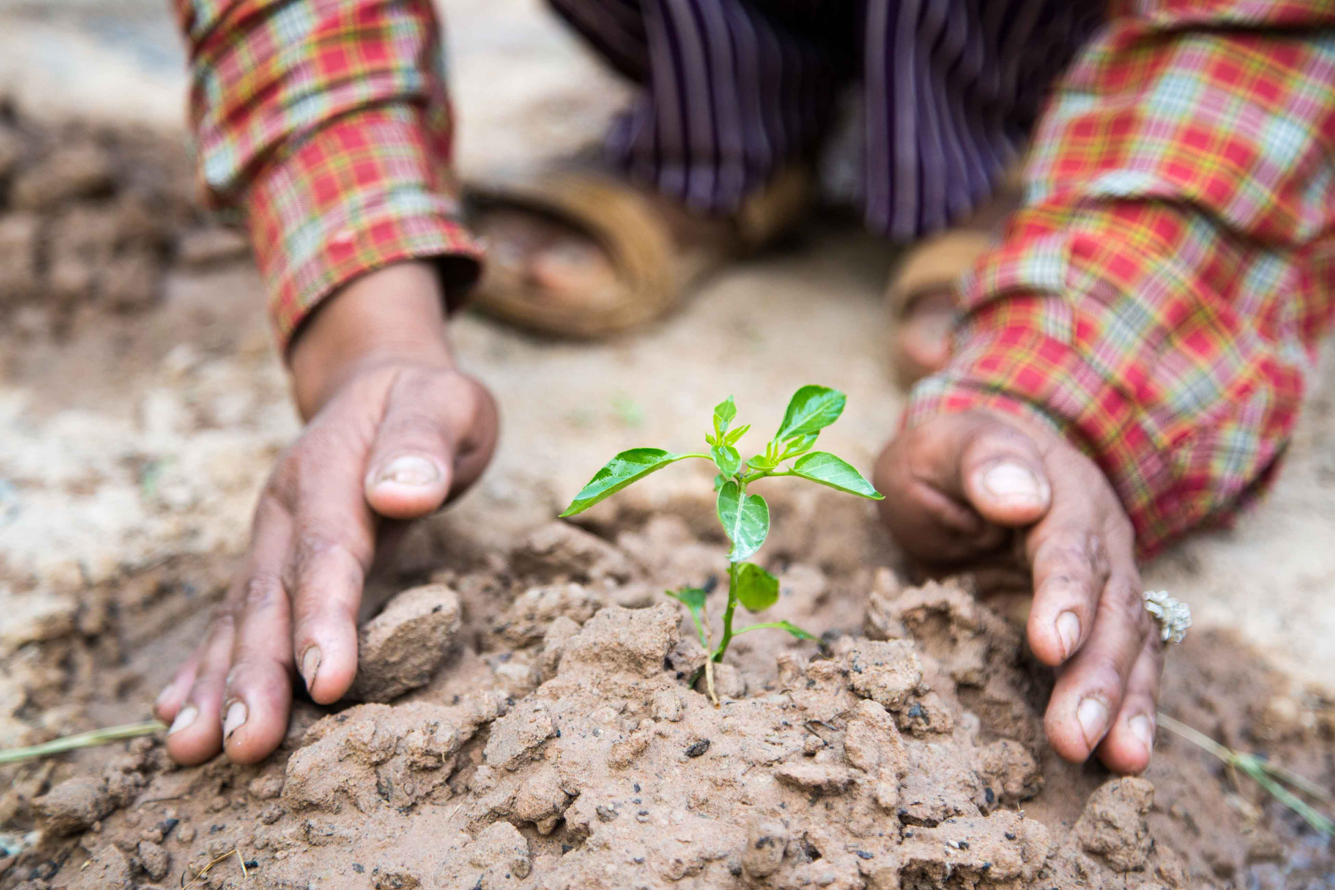

Notes:
Background information: A CAFOD livelihood project in Cambodia
Photo credit: Chin Panhavion | CAFOD (2017)

Slide 13
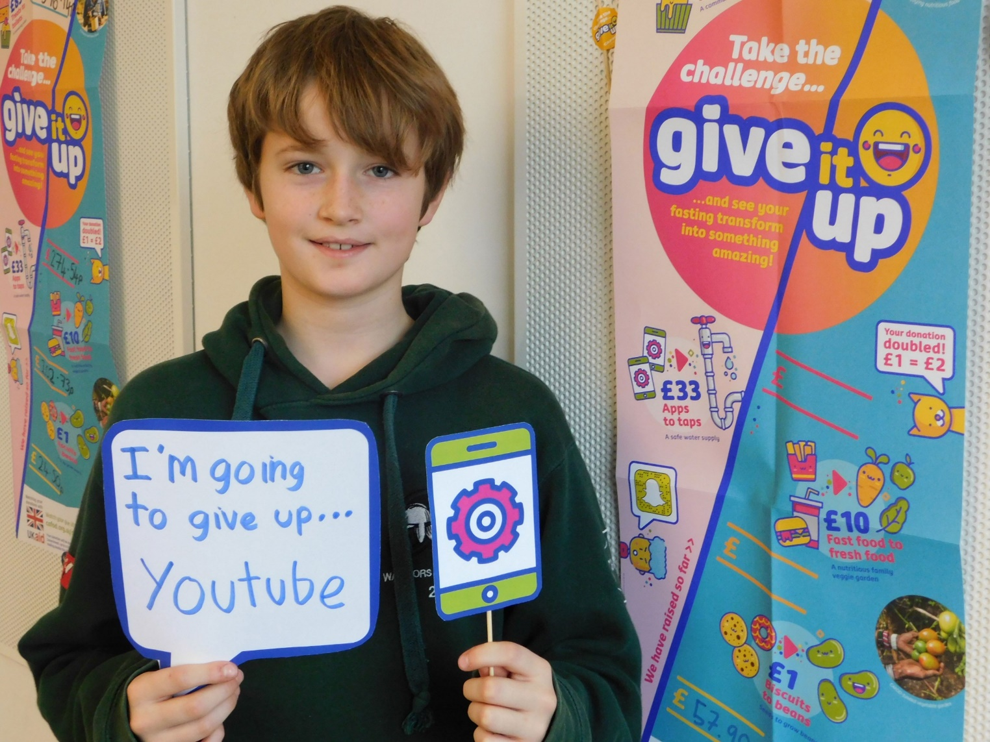

Notes:
Background information: A pupil is giving up YouTube for the CAFOD Lent Give It Up challenge.
Photo credit: Sarah Barber | CAFOD (2017)

Slide 14
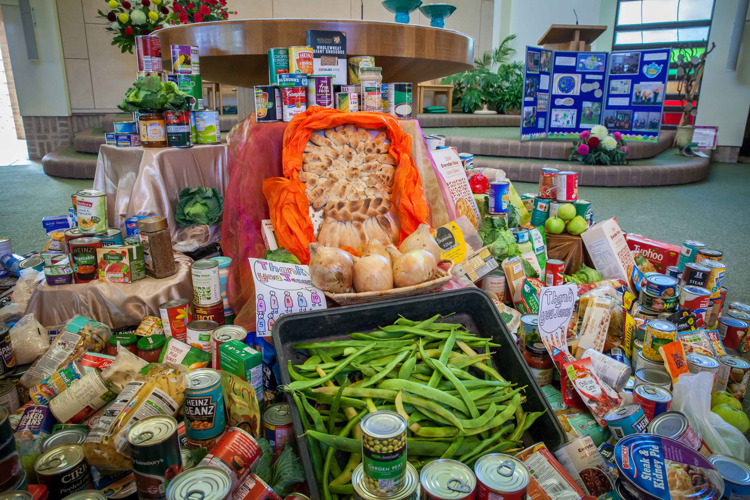
Goodness
Notes:
Background information: CAFOD Live Simply Award celebration, St Benedict’s Garforth, Leeds diocese.
Photo credit: Louise Norton | CAFOD (2016)

Slide 15
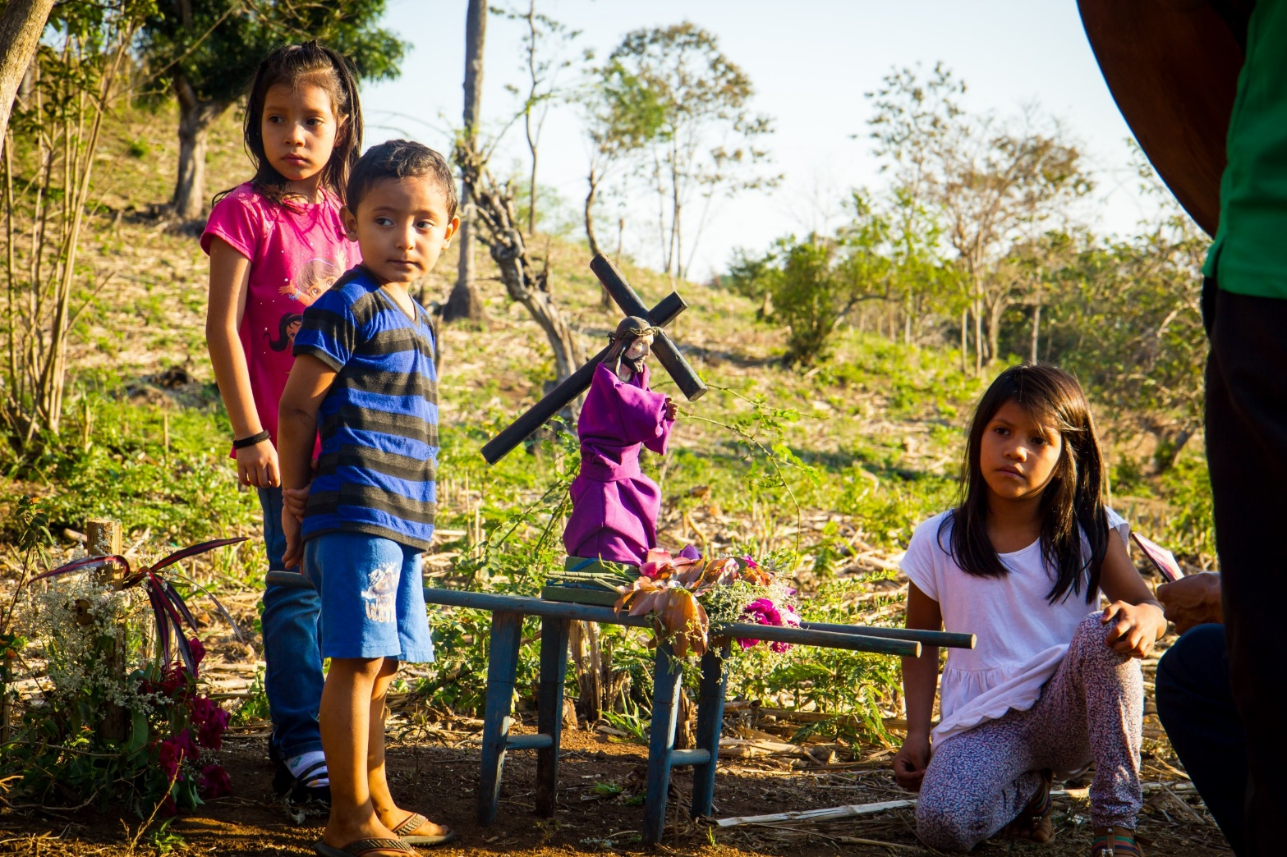
Faithfulness
Notes:
Background information: Children taking part in Stations of the Cross in El Salvador
Photo credit: Mark Chamberlain | CAFOD (2017)

Slide 16
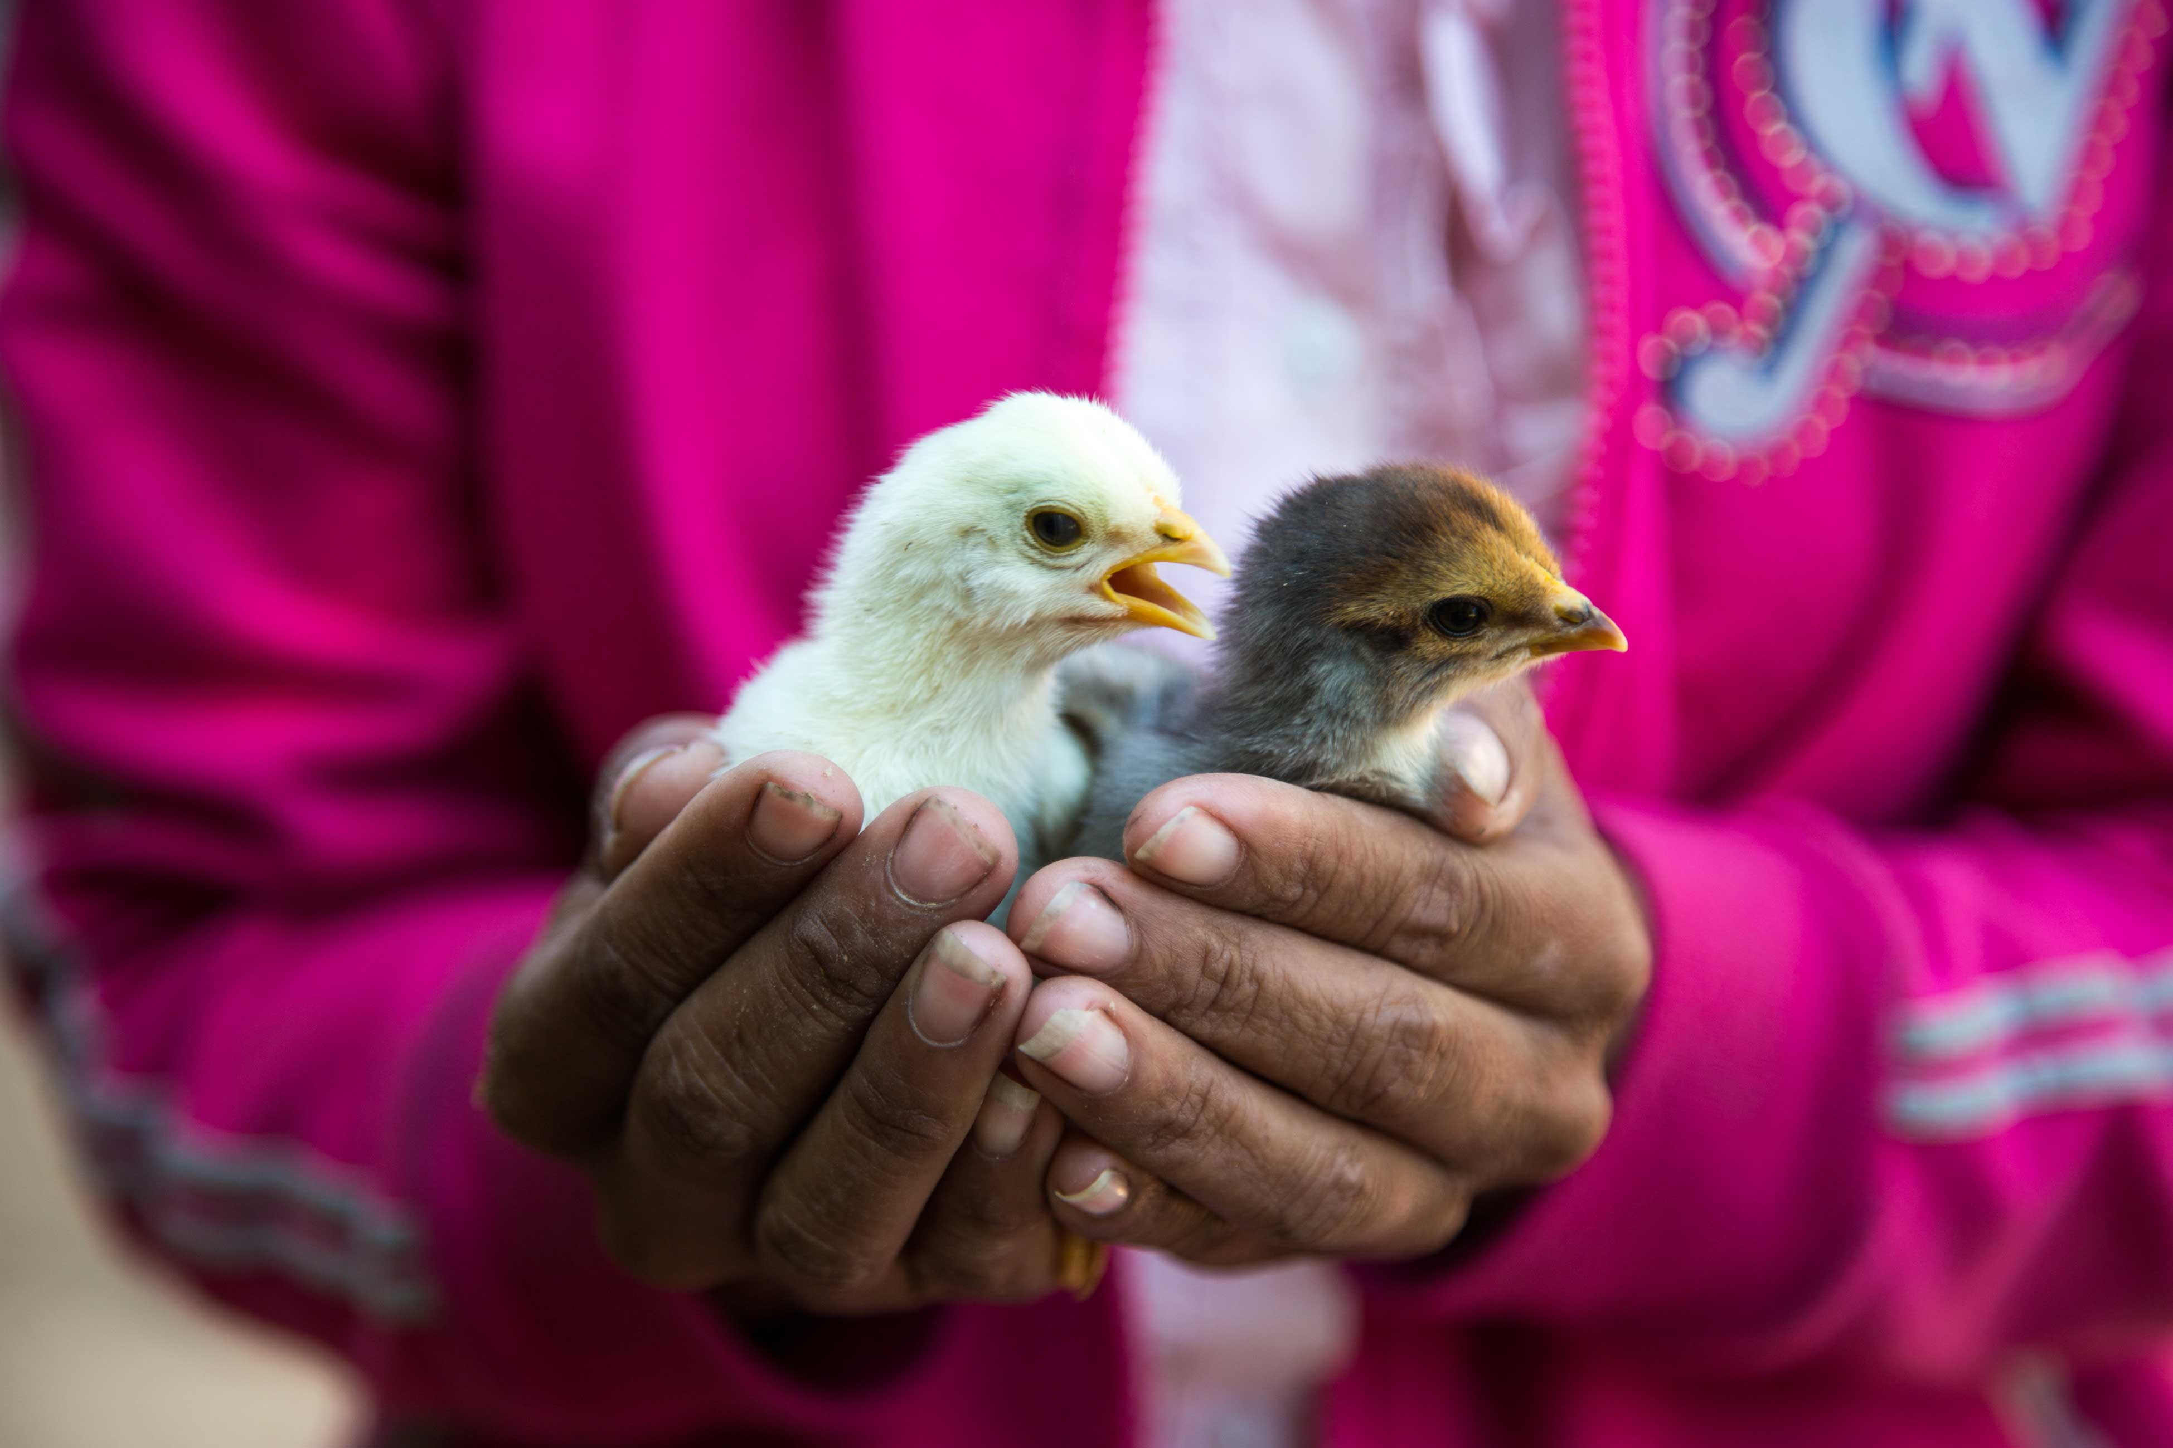

Notes:
Background information: A CAFOD project in Cambodia which aims to improve resilient livelihoods of the poorest rural farmers through sustainably increasing production and diversity of food, income, and increase their access to hygiene and sanitation.
Photo credit: Chin Panhavion | CAFOD (2017)

Slide 17
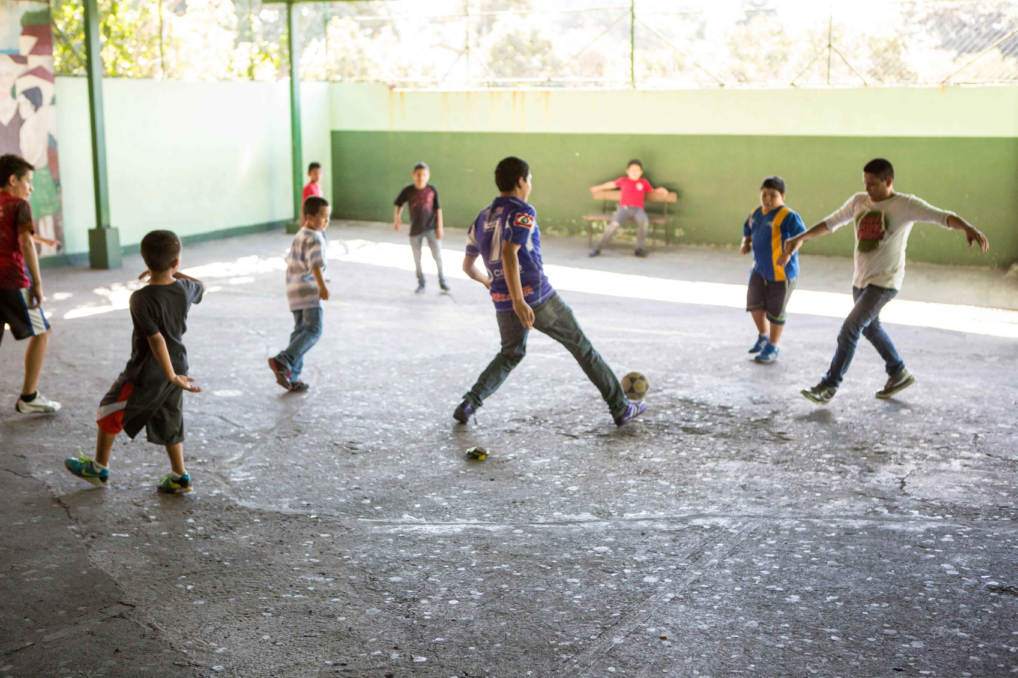

Notes:
Background information: Young people and non-violent communities building a peaceful society in El Salvador. Pavel (middle) is teaching young people to play football.
Photo credit: Ben White | CAFOD (2015)

Slide 18


If you have time…
Here is a song
For younger children- Fruit of the spirit song https://www.youtube.com/watch?v=JdkUb2YVWj8
For older- Who You say I am song https://www.youtube.com/watch?v=IcC1Bp13n_4

Slide 19

Let’s pray.
Dear Father God,
Thank you for sending your Holy Spirit to help us have…
Amen.

