Slide 1

This slide is just for the leaders
to get the class or family worship ready
For this worship,
you will need to get ready:
Youtube song: This is amazing Grace
https://www.google.co.uk/webhp?sourceid=chrome-instant&ion=1&espv=2&ie=UTF-8#q=youtube+this+is+amazing+grace+youtube
The Youtube story of when Jesus says goodbye
and makes a promise to his friends.
https://www.youtube.com/watch?v=UcFw8pLBSIo

Slide 2
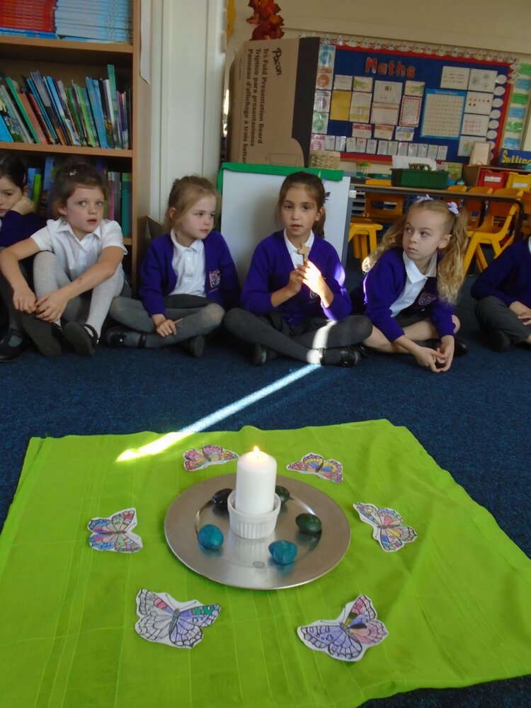

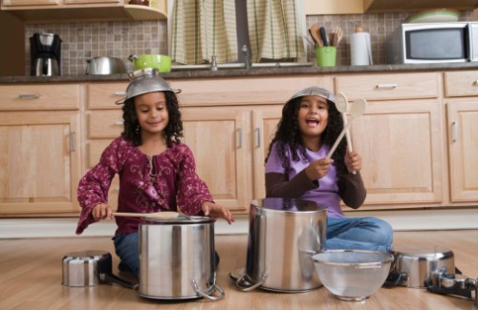
Welcome to our second Summer term
class or family
worship time!
Lets sing together
This is amazing Grace
https://www.google.co.uk/webhp?sourceid=chrome-instant&ion=1&espv=2&ie=UTF-8#q=youtube+this+is+amazing+grace+youtube

Slide 3

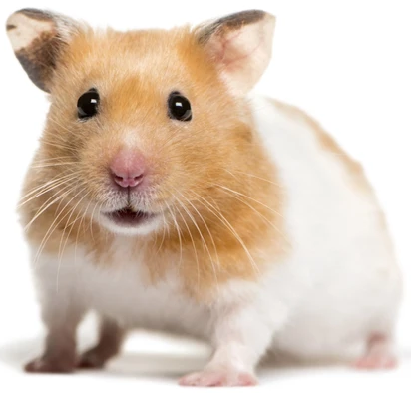
Children: Have a chat with your teacher or grown-up about your teacher from last year.
Say three things about them.
Grown-ups: Remember a teacher from your childhood. Say three things about them.
Now talk about a favourite relative or a pet that you don’t see any more.
Here is a video about Jesus when He went to heaven
and said good bye to His friends.
See if you can spot the promise He made.
https://www.youtube.com/watch?v=UcFw8pLBSIo

Slide 4
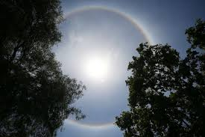

Did you spot what Jesus promised?
Jesus said
“You can be
sure that I will
be with you always.
I will stay with you
until the end
of the world
.”

Slide 5
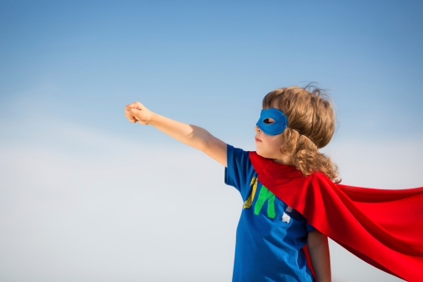
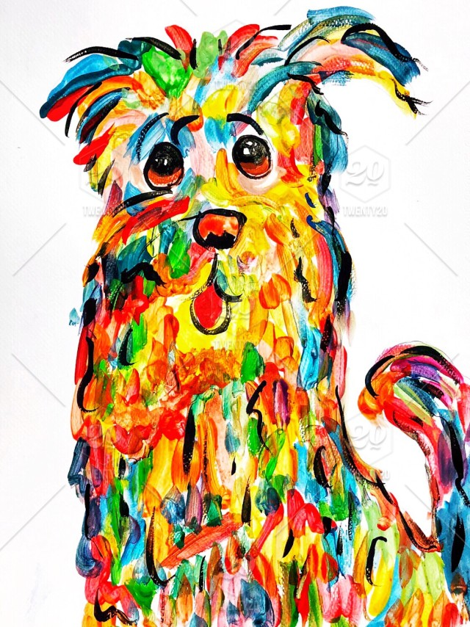


Most of us are being super heroes at home, keeping everyone safe!
There may be friends and relatives we cannot visit right now.
Talk about how you feel now you cannot see someone you love.
Talk about how you feel when you had to say goodbye to someone you love.
Think about the special things you remember about them.
Create a picture to remember someone special.
Talk about it with others if you would like to.
Reflective
Action!

Slide 6
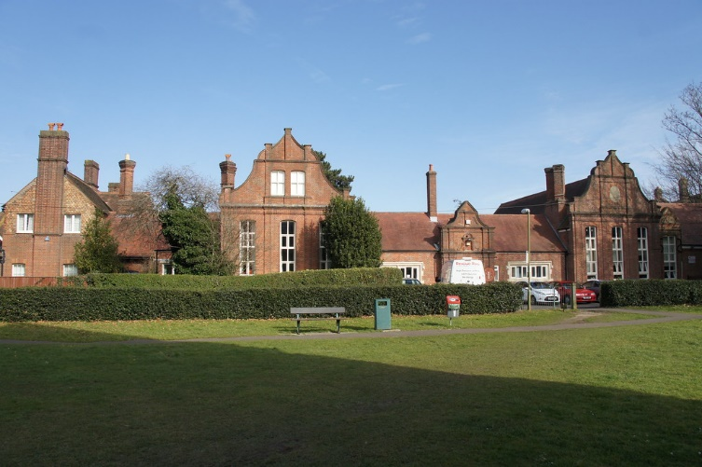
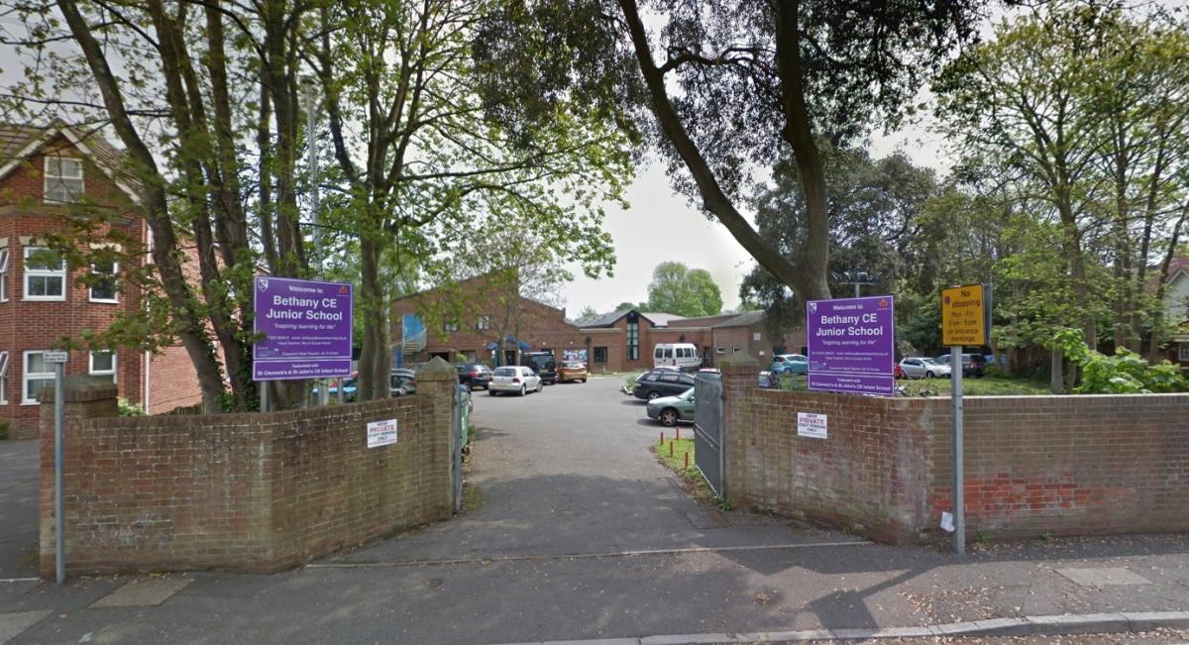
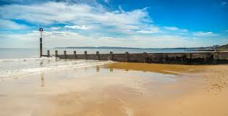
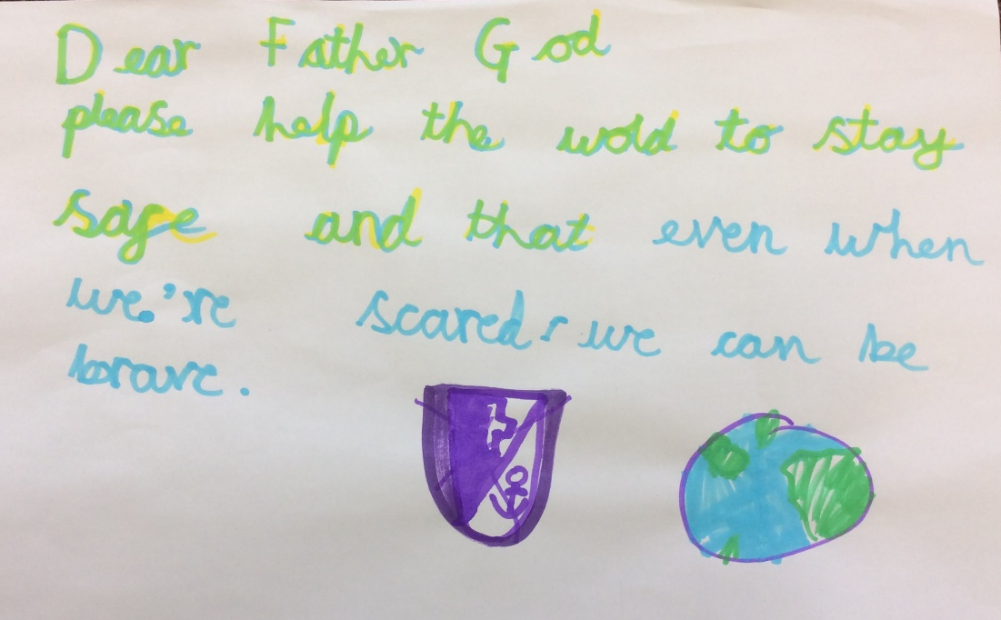
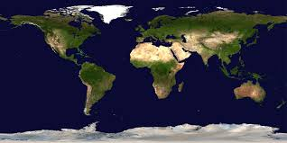
Choose someone to pray:
For our schools,
For our families and community,
And for our world.

