Slide 1
This slide for the leader or teacher
St Clement’s
15 minute class worship
Session 2
We will be thinking about our School Prayer
You will need: A school picture bible pg 296
A laminated copy of The School Prayer
Prayer book marks to show
DB Aug 2020

Slide 2
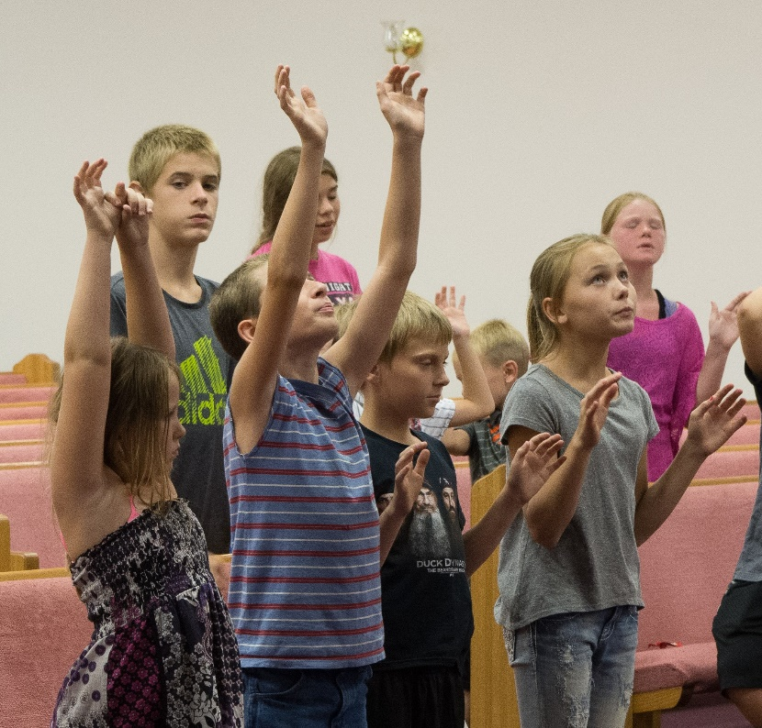
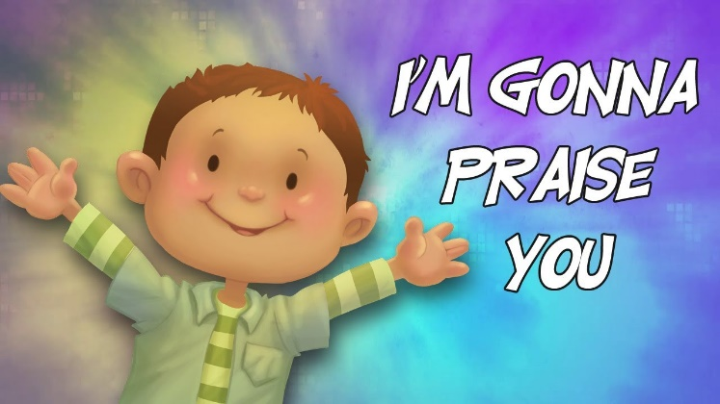

Let’s begin our worship by
singing the SHINE song
https://www.youtube.com/watch?v=W2xc-w8Zcbo
Can you confidently sing and remember the actions?
Can we practise the first part of our school prayer?

Slide 3


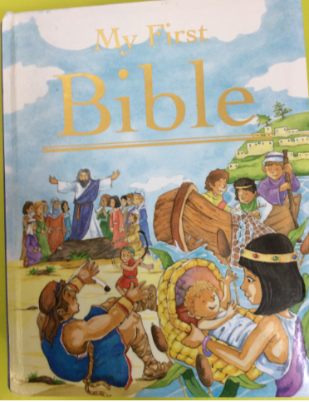


Please read the story of the confident boy and the miraculous lunch.
A miracle is something extraordinary that happens through God’s special power.
A miracle is something extraordinary that happens through God’s power!

Slide 4
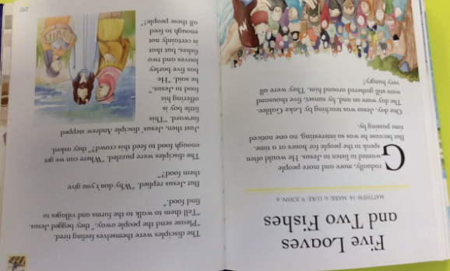

Slide 5
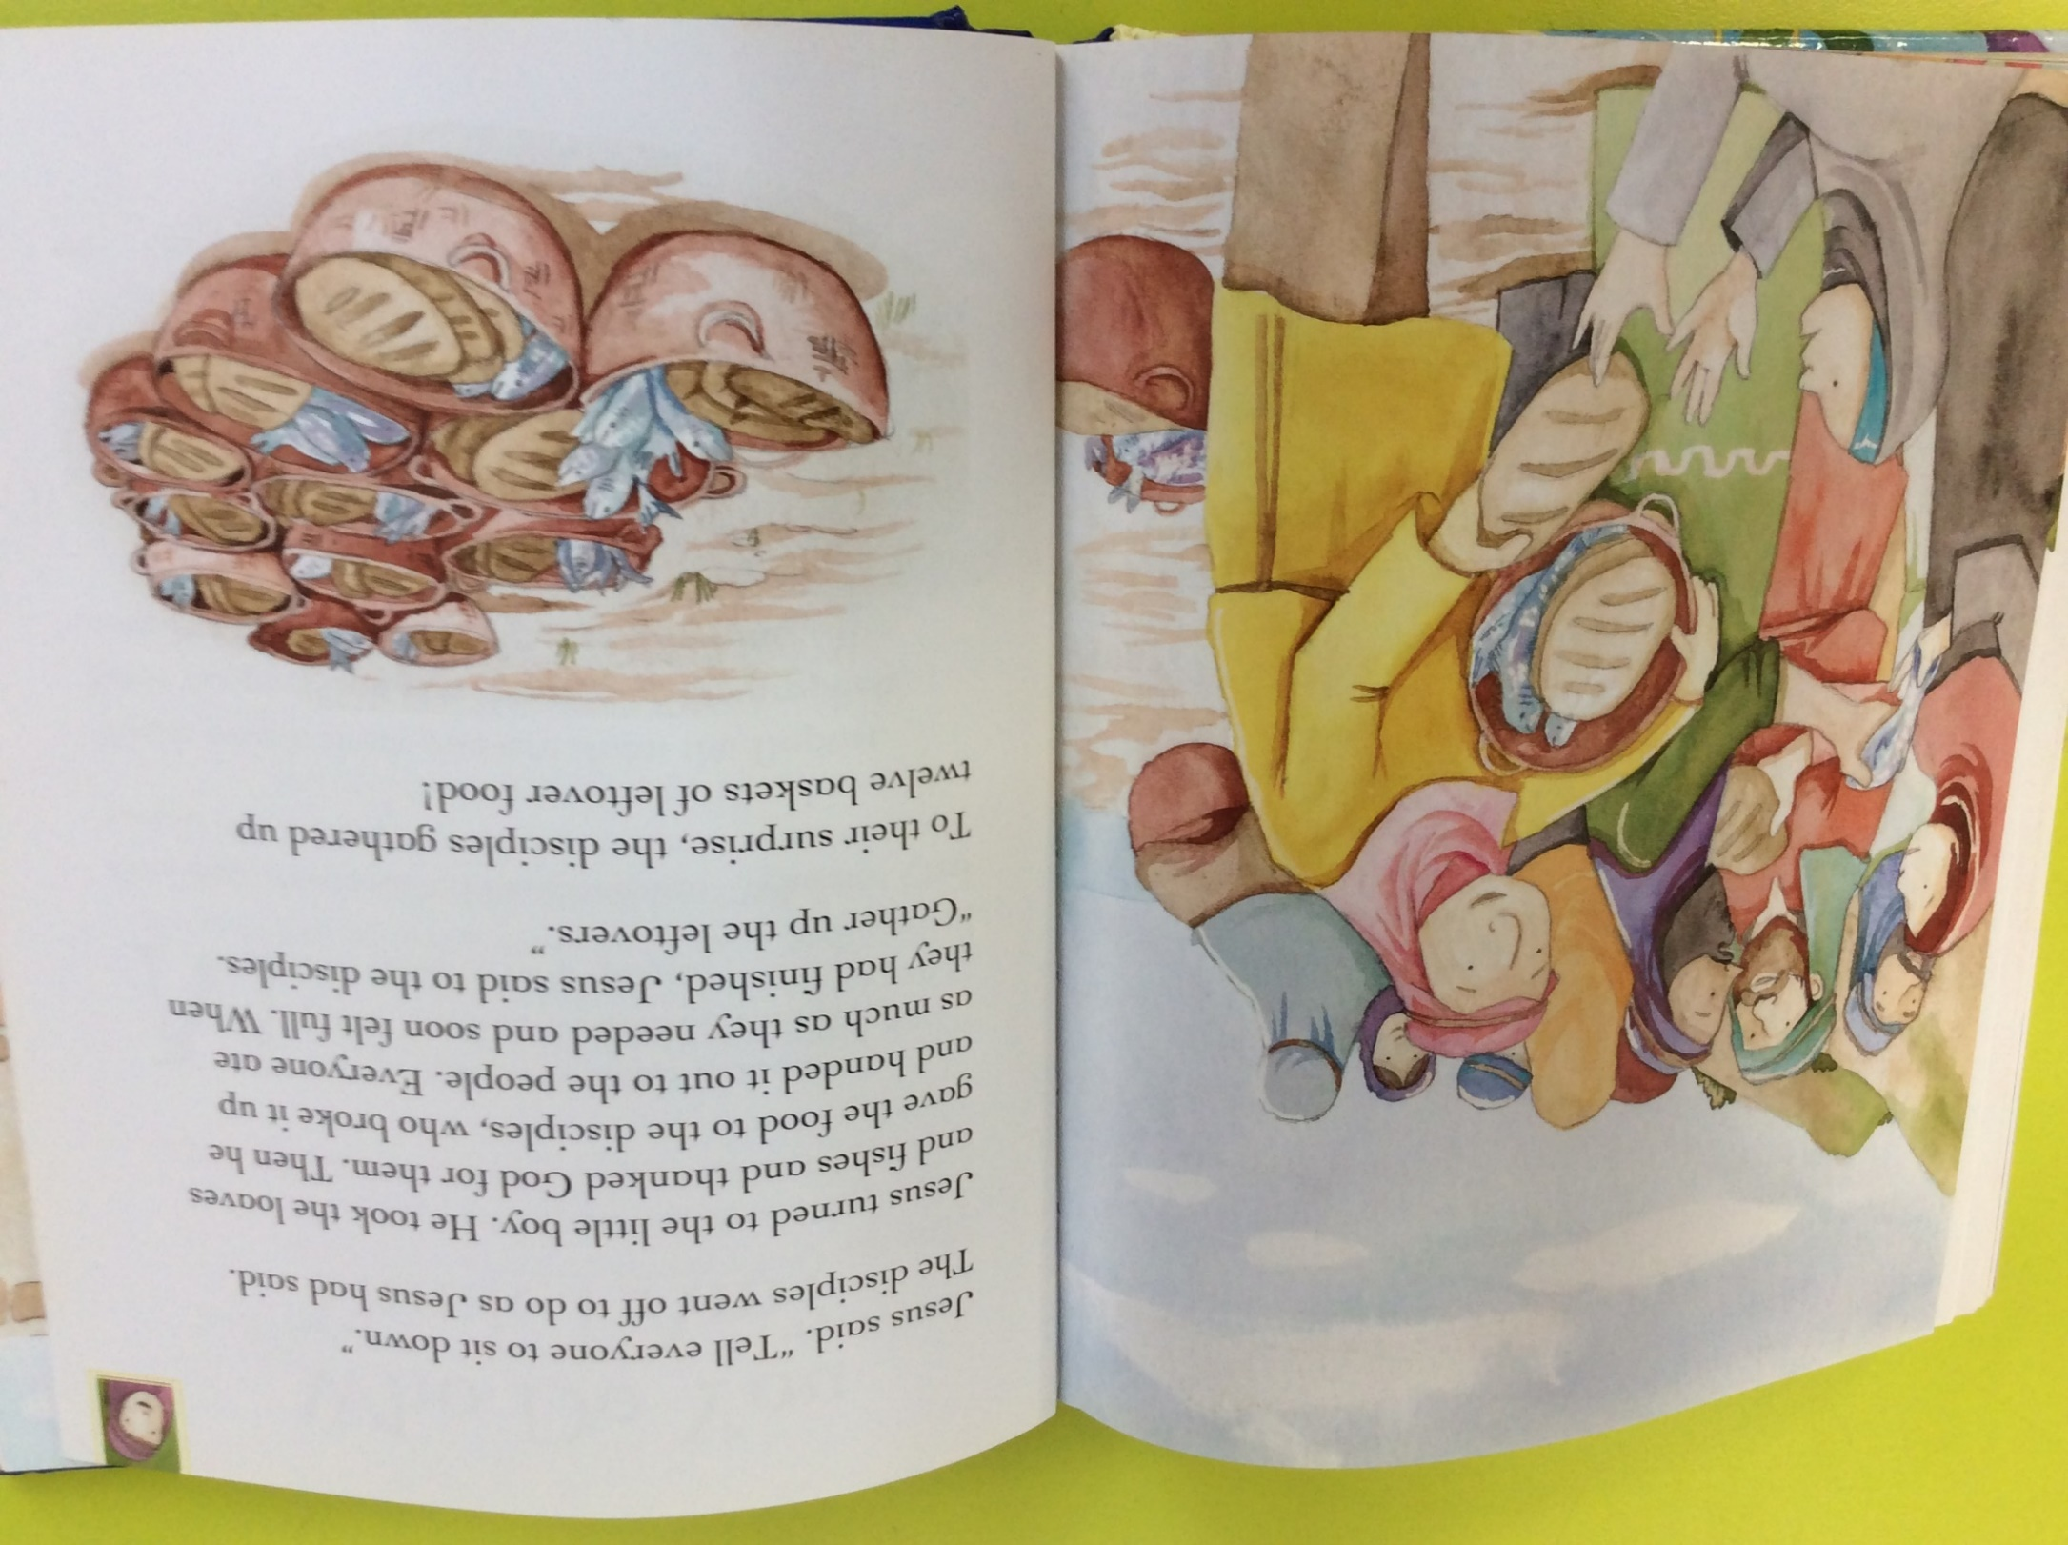

Slide 6
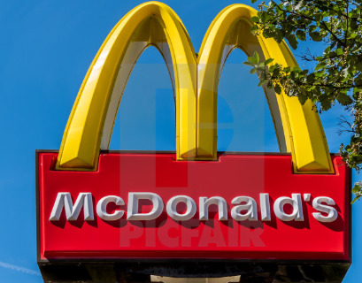
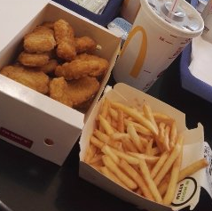
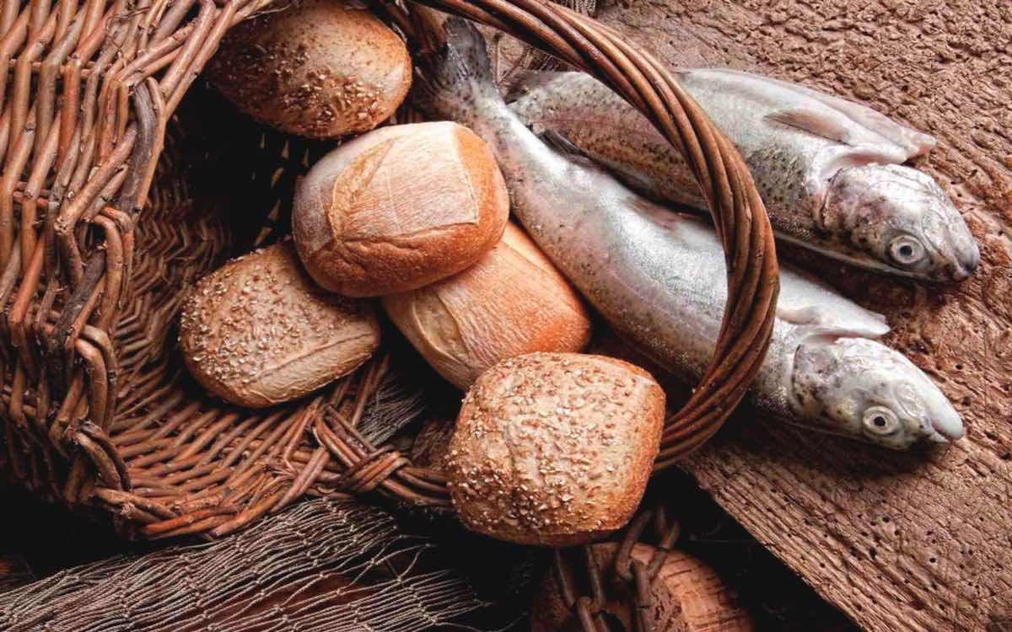
This boy was an ordinary boy. He listened to Jesus and was happy
to offer what he had.
What did Jesus say to his disciples when he realised that everyone was hungry?
Was it… pop down to Aldi / go and get a Happy Meal / or something else.
What had his Mum packed for his lunch?
Chicken nuggets and fries / 2 fish and 5 small loaves
How may the boy have felt when he offered his lunch?

Slide 7
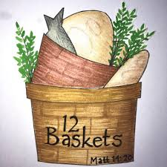
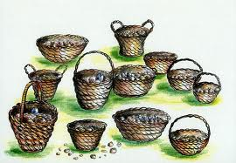
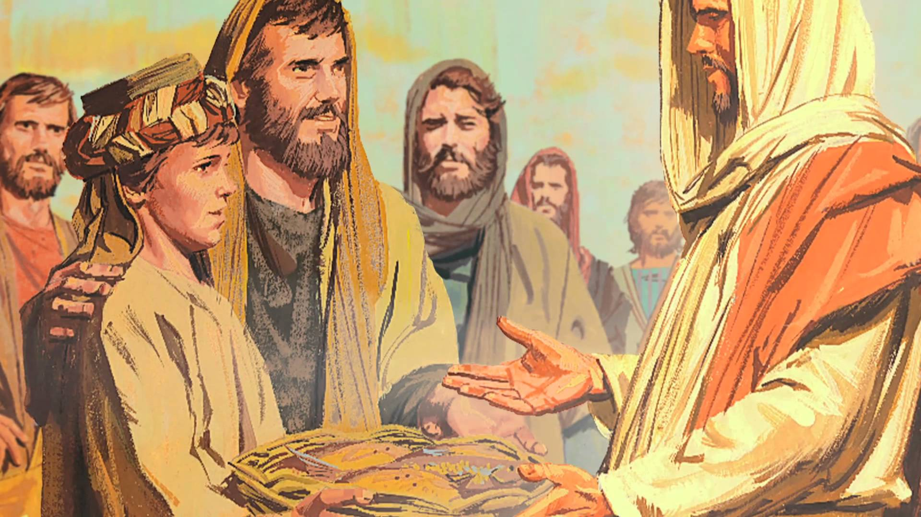
What did Jesus do with the food?
Was there enough to feed everyone?
How much was left over?
?
How did this boy feel
when he understood
that Jesus had fed everyone with his lunch?

Slide 8
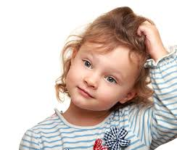
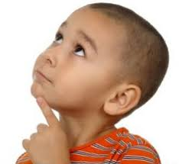
We say we are confident because of God’s love for us
Do you think that it is true?
There is nothing you can do to make God love you more! ?
There is nothing you can do that can make Him love you less!
?
? WOW!

Slide 9
God knows when you are awake or when you go to sleep.
He sings over you because you are so special to Him
God planned you before He created the world.
He wants to be your loving Father
He understands what you are thinking and feeling.
He knows what you will say before you begin to speak it.
We know this is true because God has told us this in his book the Bible. We can rely on it being trust worthy.

Slide 10
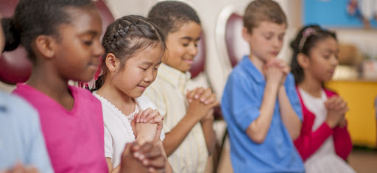
Choose some children to pray and
thank God for His love for us
Thank you God for ………. It makes me feel confident.
I know God loves me all the time, whatever I do.
It gives me confidence
We can end by singing about how great it feels to be loved by God
https://www.youtube.com/watch?v=1qZWK8ZE2Pk

