Slide 1
This slide for the leader or teacher
St Clement’s
15 minute class worship
Session 3
We will be thinking about our School Prayer
Focussing on compassion.
You will need: A laminated copy of The School Prayer
Prayer book marks to show
DB Aug 2020

Slide 2


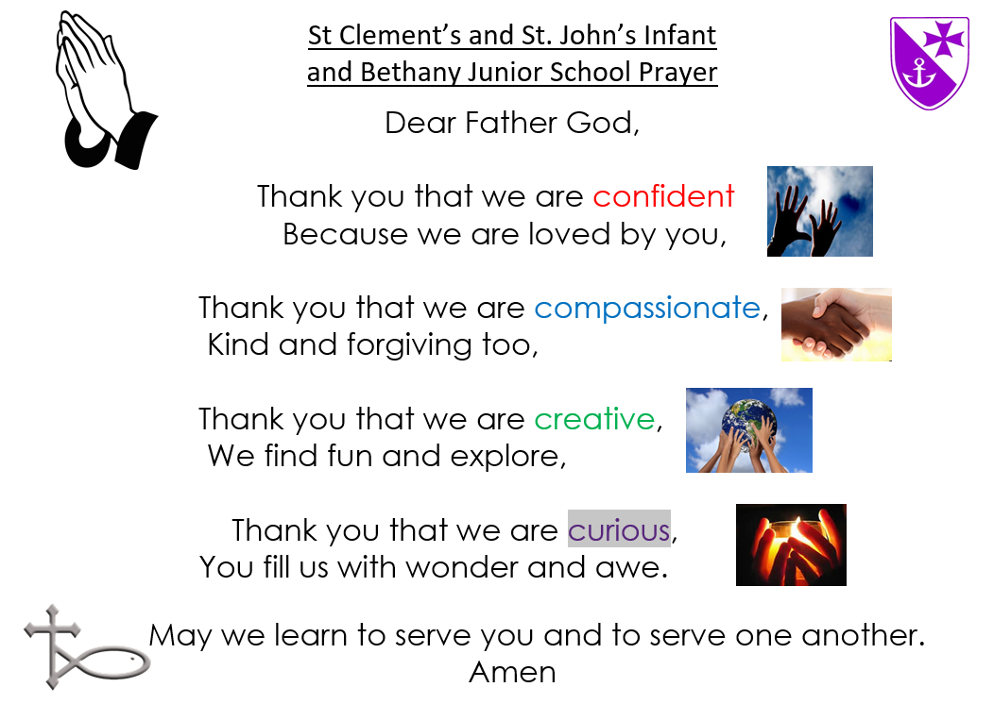


This week we will be thinking about the next part of our school prayer

Slide 3

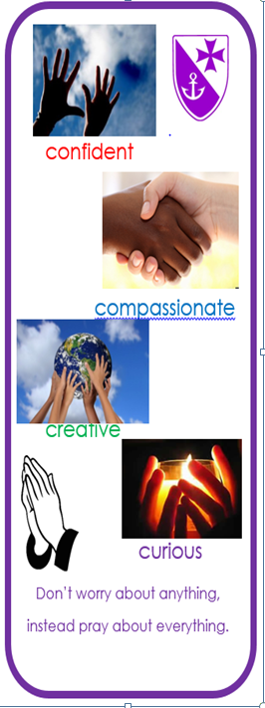
When we say this part we shake hands with ourselves to show friendliness.
Can you practice saying this:
Slowly, whispering and in a low voice
Now can you say it joined onto the first part?
Now with confidence and actions, remember your grown up would love to award you a bookmark to celebrate your learning.

Slide 4
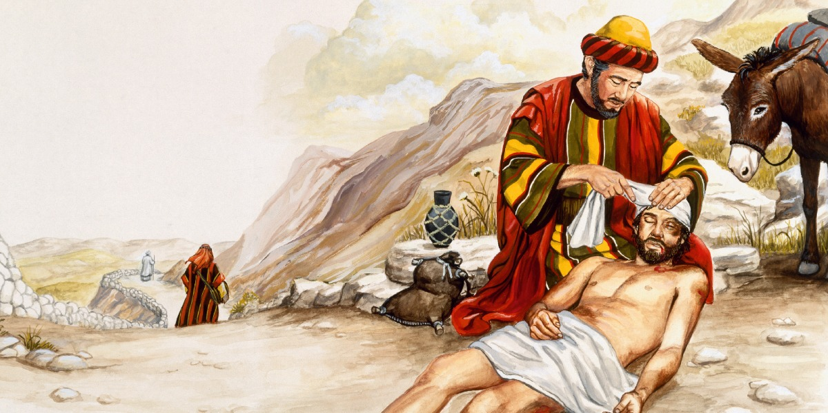
Our story this week is actually called a parable. This is a story Jesus told to help people understand something about what God is like or how they should behave.
https://www.youtube.com/watch?v=fO4qSAhI1sI

Slide 5

We are going to play a True or False Quiz
Thumbs up for True and down for False (which means it is a lie)
The man was travelling from Boscombe to Jericho.
The man was attacked by a Big Bad Wolf.
The Priest stopped and kindly helped the hurt man.
The rich man gave him a bag of money
The Jewish people listening to the
story really liked the Samaritan people.
The Samaritan man helped because
the hurt man was his friend.

Slide 6
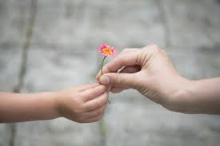
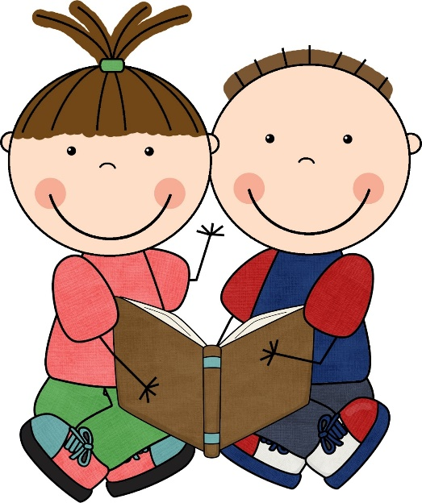
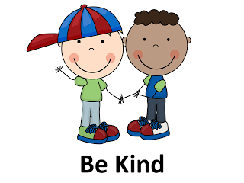
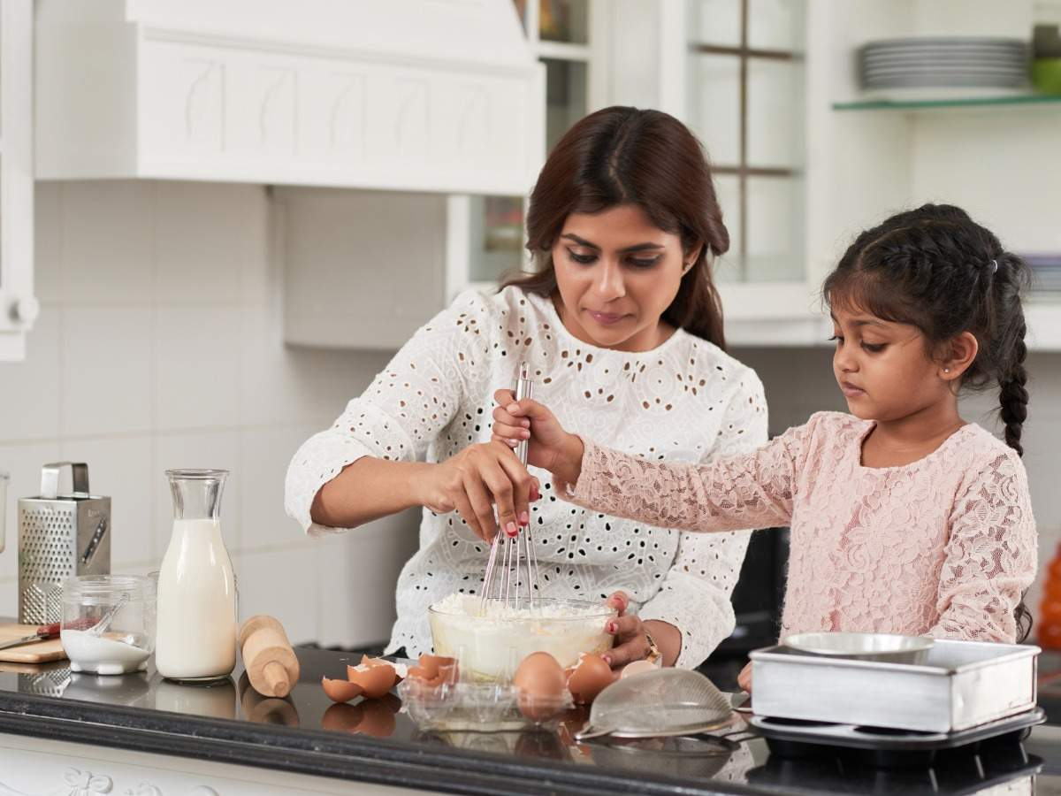
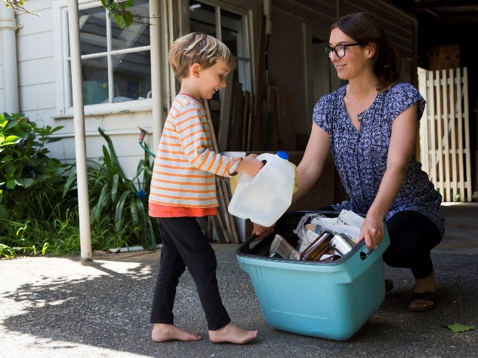
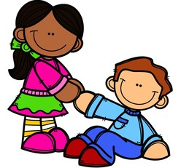
Think about ways you can help in your home and in your class to be kind to someone.

Slide 7
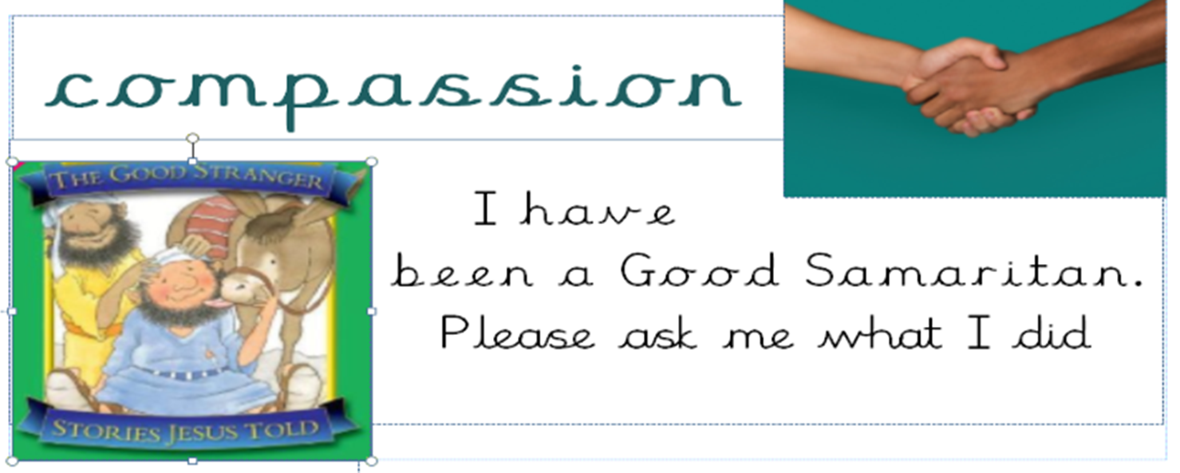
This week the grown ups around the school will be looking for acts of kindness.
If they see you being kind and compassionate they will give you a special ‘Good Samaritan’ sticker.

Slide 8
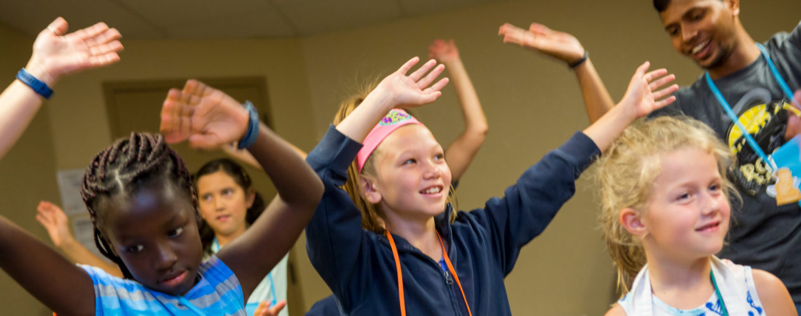
Lets finish worship by singing about being compassionate and building one another up by what we do and say.
https://www.youtube.com/watch?v=7nir_CJH2Bc

