Slide 1
This slide for the leader or teacher
St Clement’s
15 minute class worship
Session 4
We will be thinking about our School Prayer, particularly forgiveness as part of compassion.
You will need: A laminated copy of The School Prayer
Prayer book marks to show
A mirror or 2 for next worship
DB Aug 2020

Slide 2


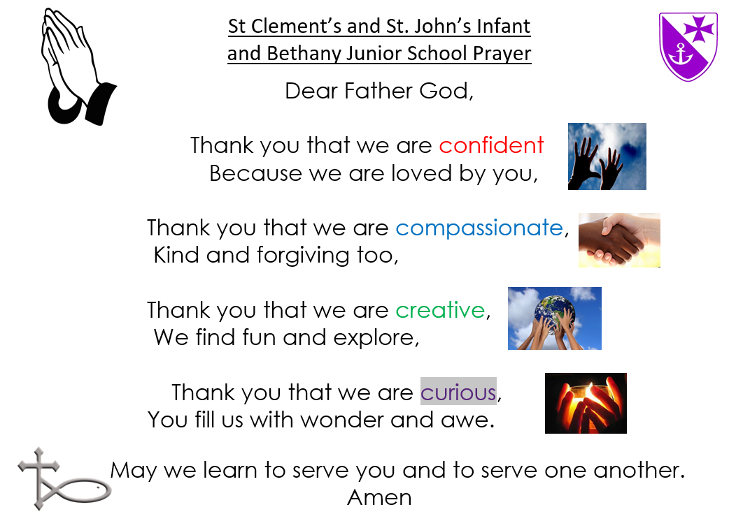


Lets practise saying
our School Prayer confidently
Today we will think about
what being forgiving means

Slide 3

Last time we thought about being compassionate and trying to build each other up. By showing kindness and using words that encourage and support each other.
Today we will hear about two friends and what happened when one of them let his friend down.

Slide 4
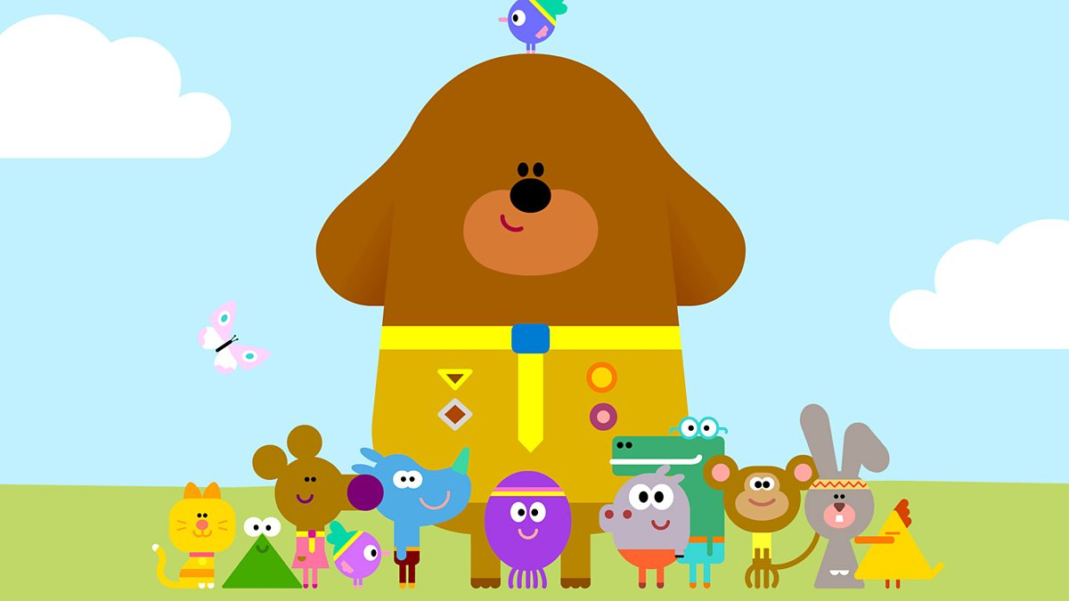
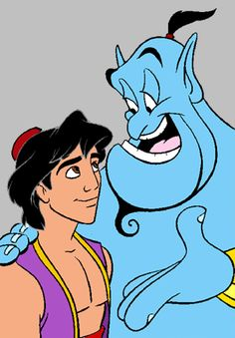
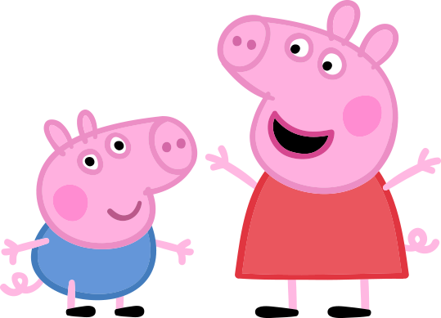
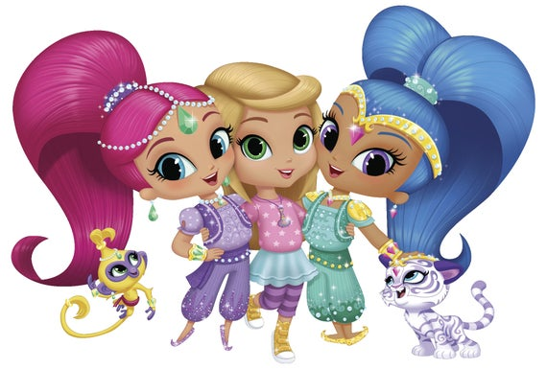
What do you think
makes a good friend?
Do you know any of these friends?

Slide 5
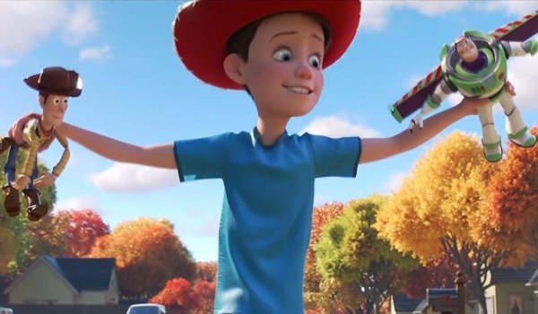
Are friends always kind to each other?
Listen to this song and think about
your friends.
https://www.youtube.com/watch?v=CNi02gxTI1M
What would you do if you had
upset your friend?

Slide 6
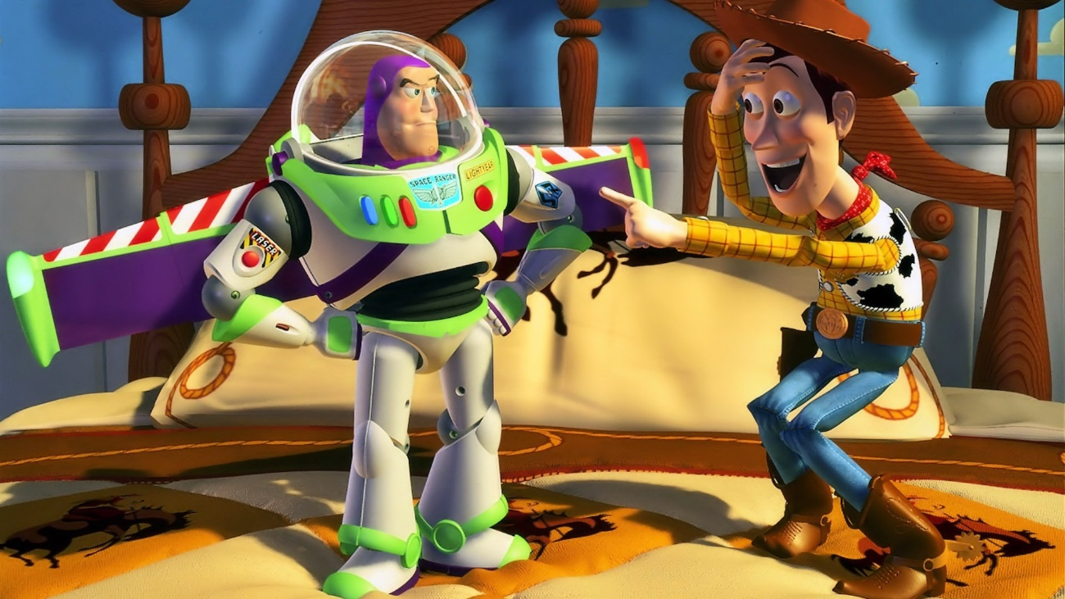
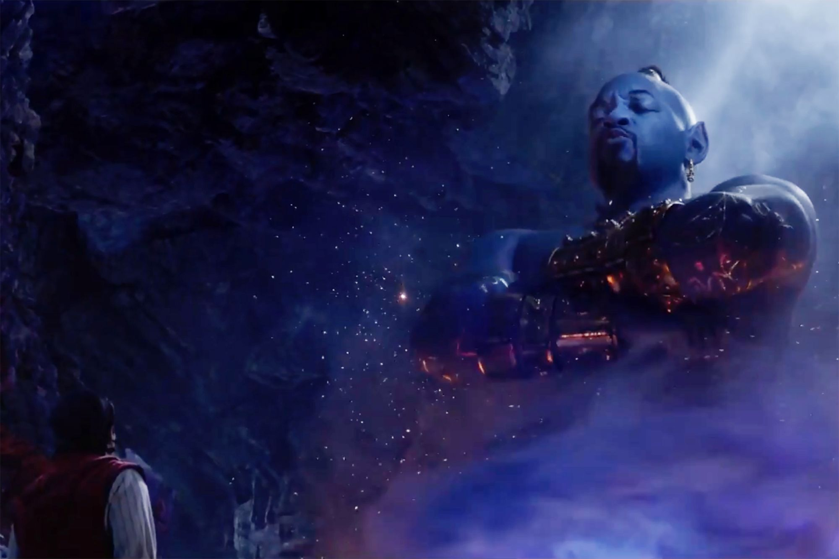
Woody becomes jealous of Buzz and is unkind to him.
The Genie in Aladdin is sad when Aladdin breaks his promise to use a wish to set the Genie free.

Slide 7
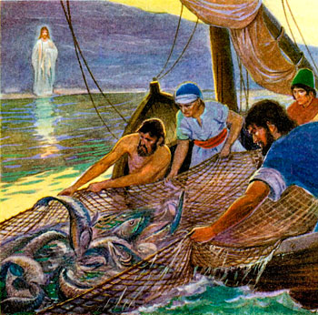
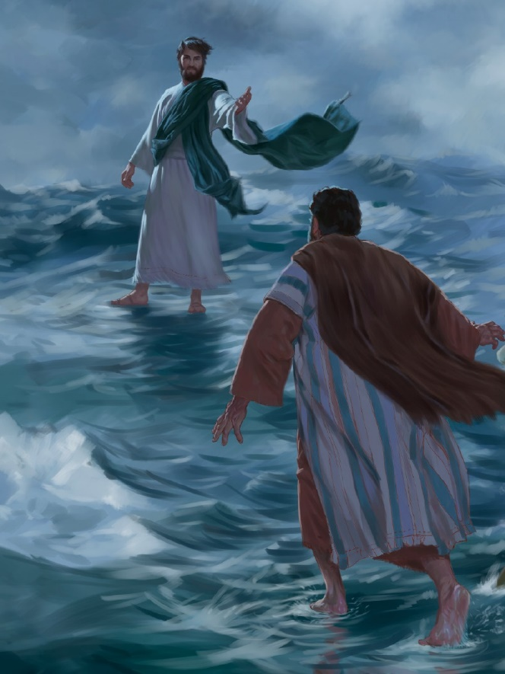
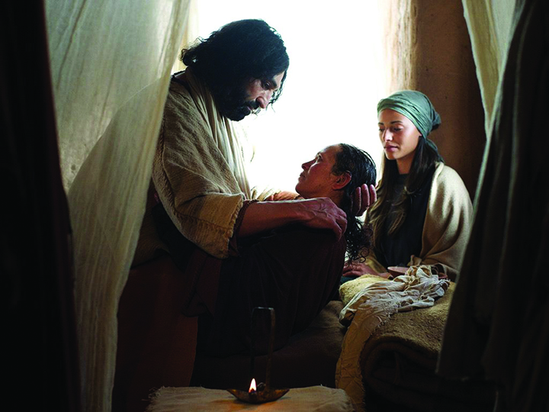
Jesus had 12 special friends, they are called his disciples.
They did lots of cool things together, Jesus helped Peter
catch a HUGE lot of fish it nearly sunk the boat!!!!
He helped Peter to walk on the sea!!!!
He made someone in Peter’s family better when the were very sick.

Slide 8


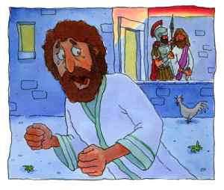

Peter was a special friend but sadly he let Jesus down.
Peter was scared and so he pretended he wasn’t Jesus’ friend. He lied about even knowing Jesus.
This must have
hurt Jesus’ feelings.

Slide 9
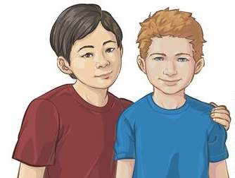

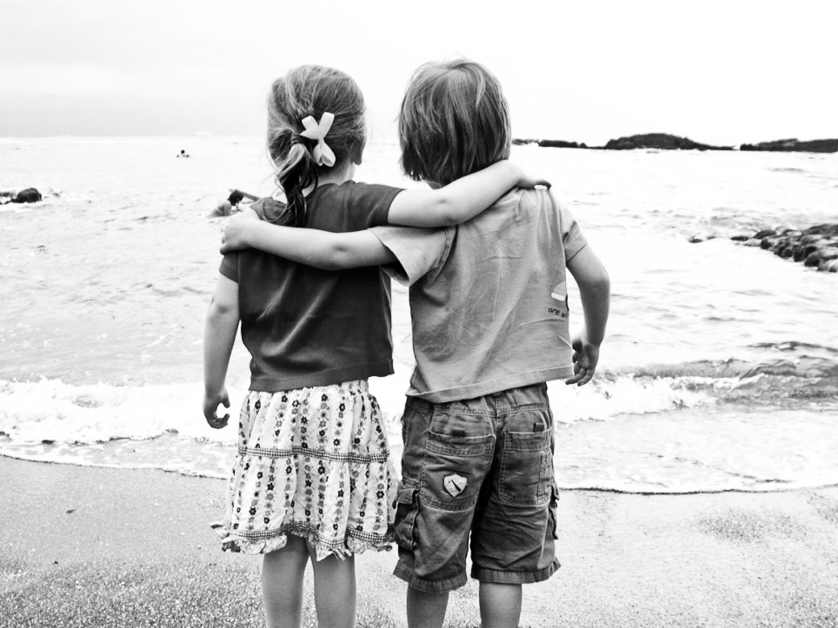
In the special prayer Jesus taught us it says
Forgive us our sins ,
As we forgive those who sin against us.
This means that Jesus understands that sometimes we make mistakes that hurt other people.
He told us that we need to say sorry if we have been unkind. The person who feels hurt needs to say ‘It’s ok, I forgive you.’

Slide 10
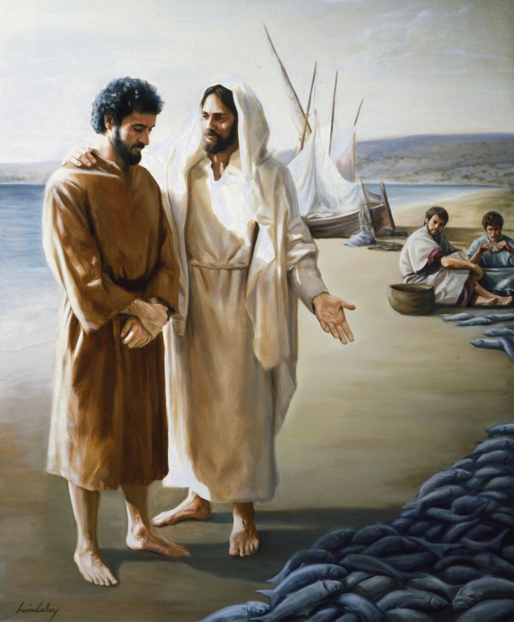
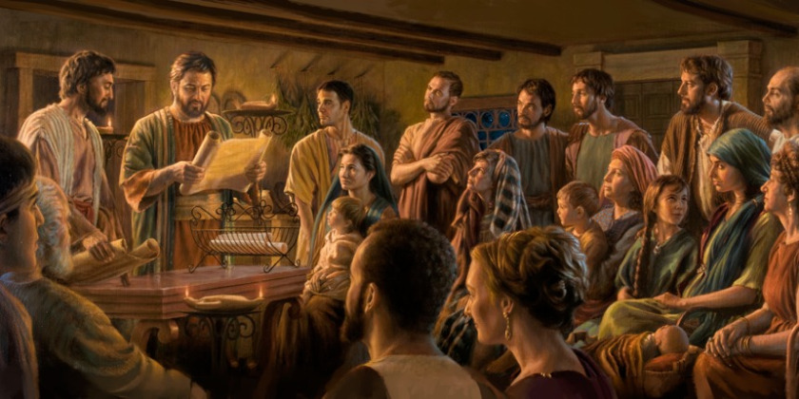
Jesus gave Peter a chance to say sorry and he forgave him.
Jesus trusted his friend enough to give him the really important job of starting Jesus’ Christian church.
I expect that Peter still made mistakes but he had learned how to say sorry and put things right again.
That is why forgiveness is in our School Prayer because it is value that is an important part of our School life together.

Slide 11
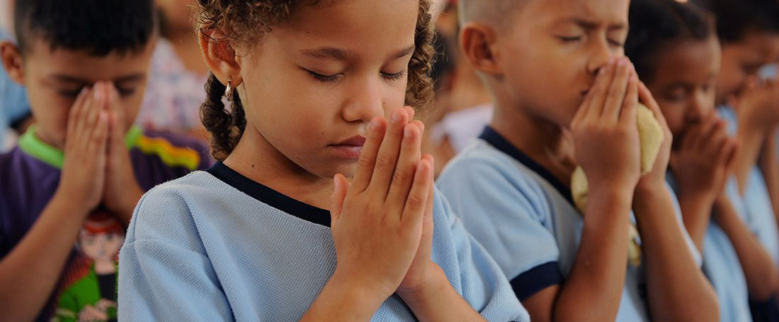
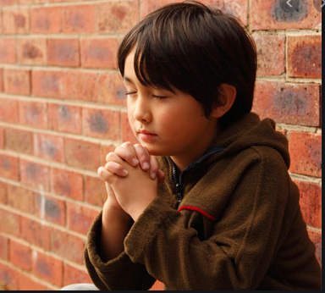
Can we choose someone to pray for us?
Or our teacher could pray
Thank you Jesus that you were compassionate and showed us how to forgive people.
Thank you that you forgive us too when we say sorry and never stop loving us whatever we do or say or even when we make bad choices
Amen

