Slide 1
This slide for the leader or teacher
St Clement’s
15 minute class worship
Session 5
We will be thinking about our School Prayer, particularly creativity.
You will need: A mirror
DB Aug 2020

Slide 2


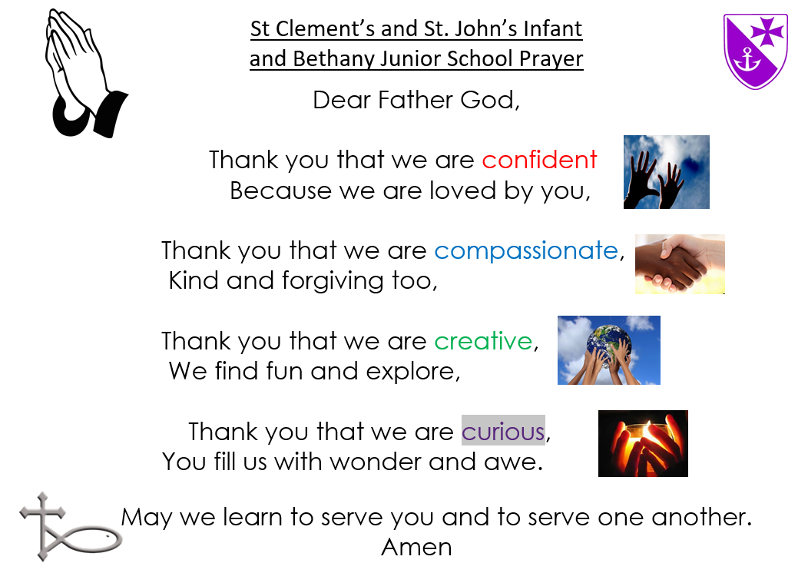


Lets practise saying
our School Prayer confidently
Today we will think about
what being creative means.
When we pray this bit we make
a shape of the world
with our hands.

Slide 3
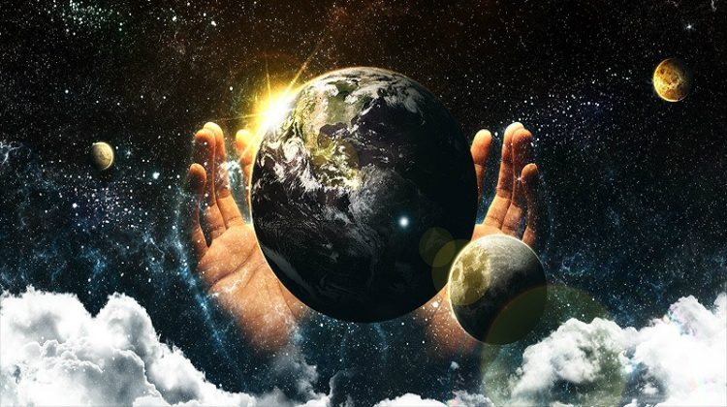
Lets see what the Bible says about how our world was made.
https://www.youtube.com/watch?v=teu7BCZTgDs
Did you notice that God said people were made in his image?
What can this mean?

Slide 4
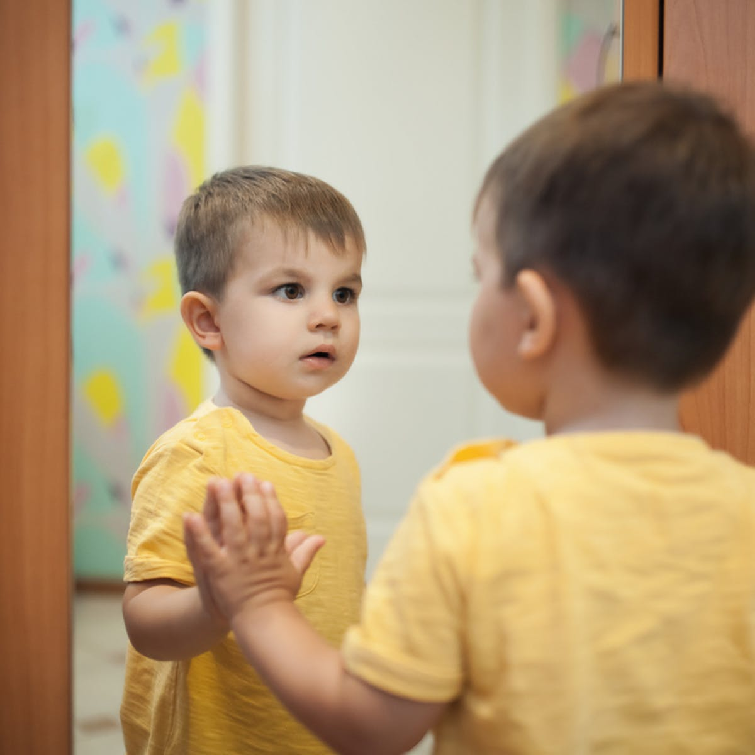
As we pass round the mirror look at yourself and think what makes you a bit like God.
Is it because……….
…..you can be kind?
……you can be creative?
……you want to take care of the world?
……you enjoy being friendly?
…you like to think about and ask tricky questions?
WOW we are reflecting something of God
Made in His image!
WOW!

Slide 5
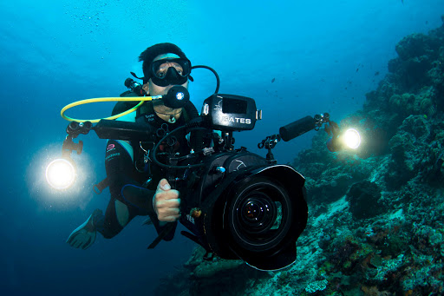

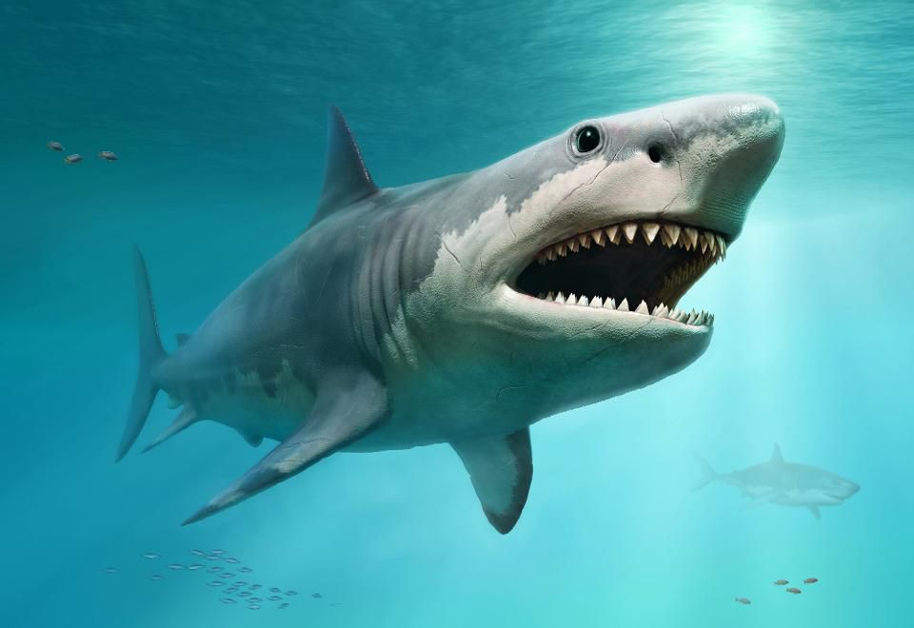
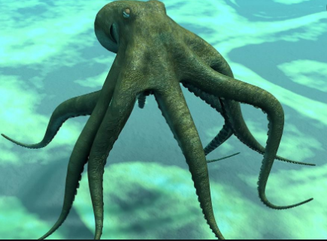
Let us play a ‘would I rather’ game about exploring this amazing world that God has created.
Share your ideas with a friend.
If I were a deep sea diver, would I rather film a shark or an octopus? WHY?

Slide 6
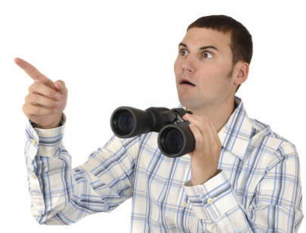
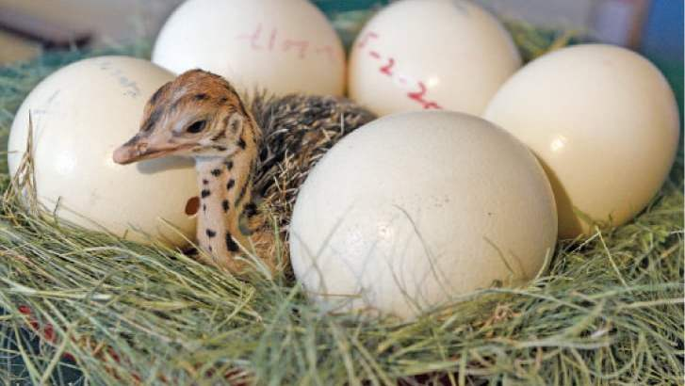
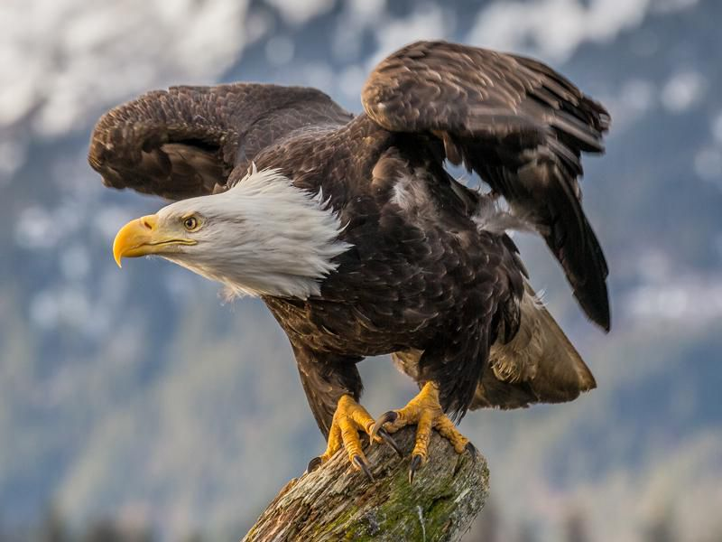
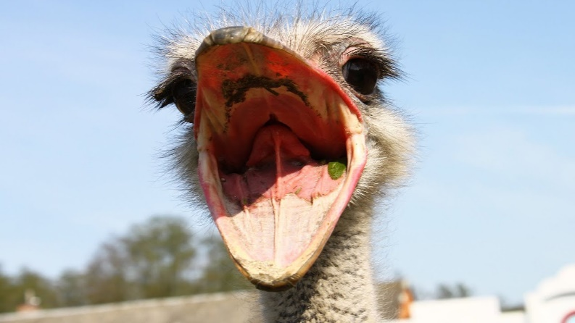
If I were a bird watcher, would I rather hatch an ostrich egg or an eagle egg? WHY?

Slide 7
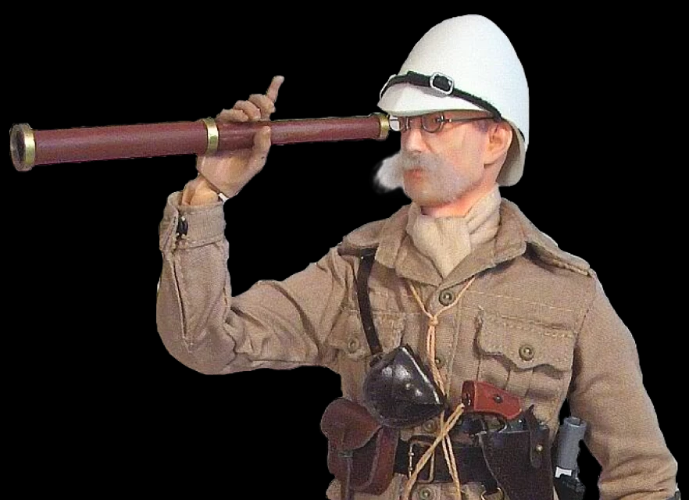
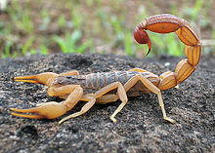
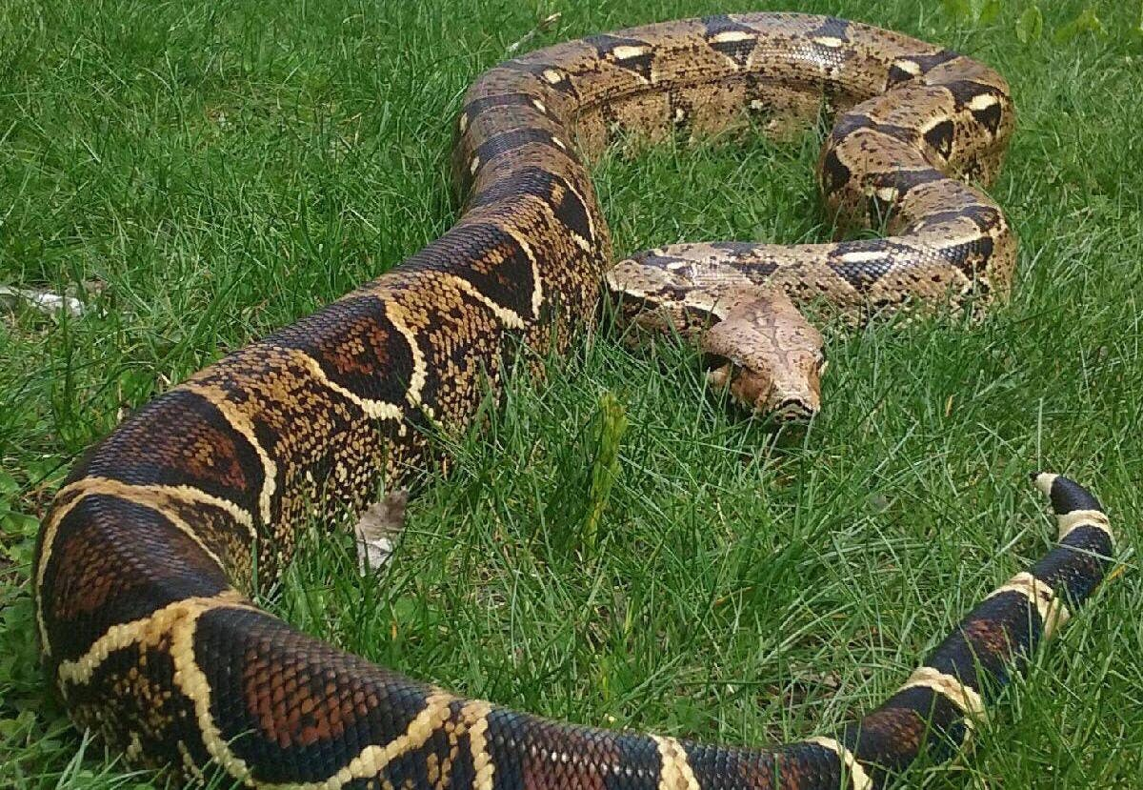
If I were a jungle explorer, would I rather find a scorpion or a boa constrictor? WHY?

Slide 8
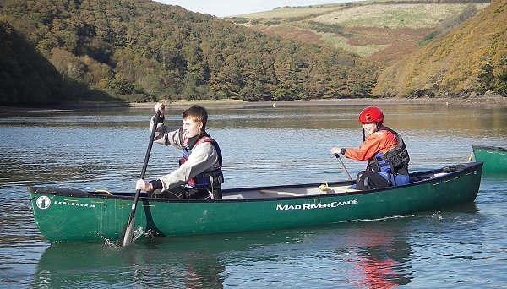
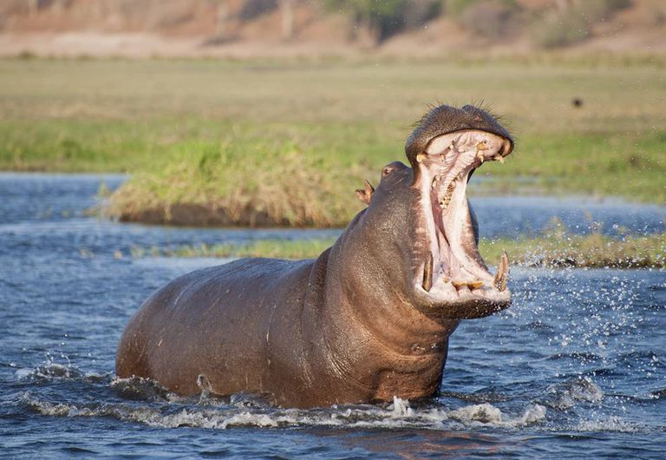
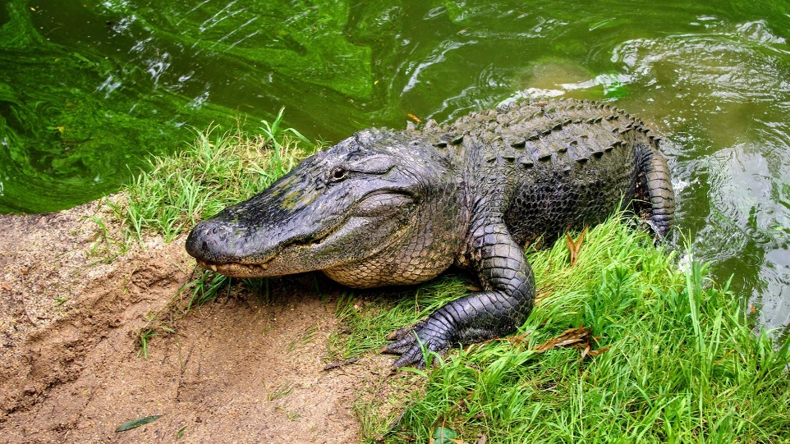
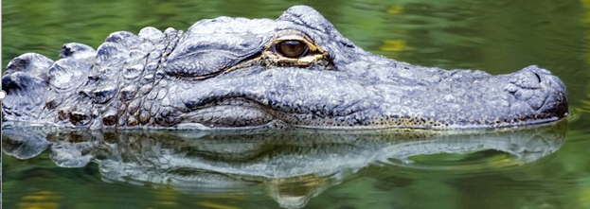
If I were in a canoe on safari down the Nile, would I rather spot a hippo or an alligator? WHY?

Slide 9
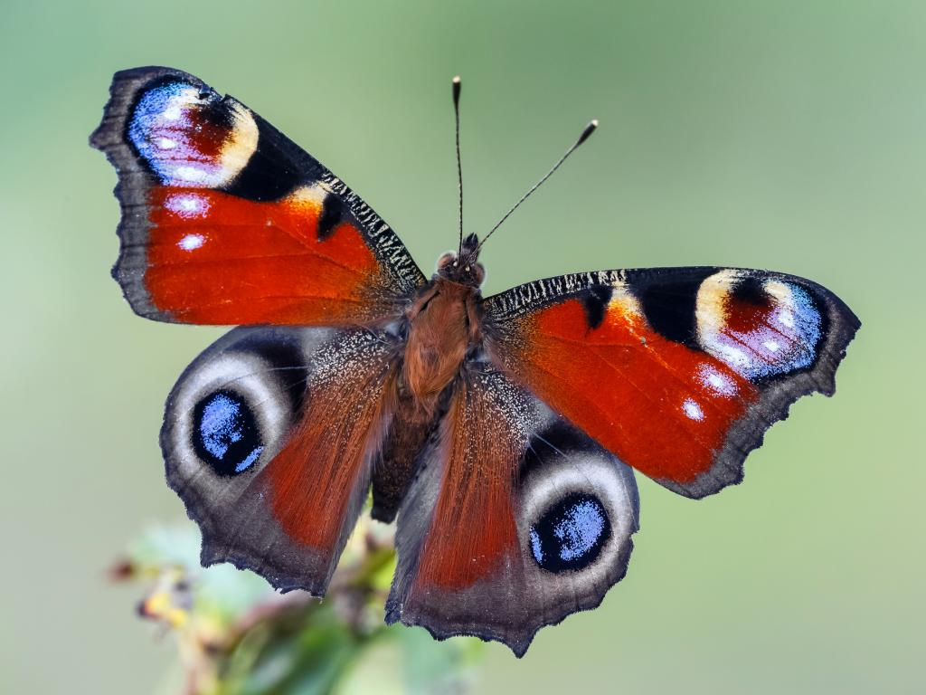
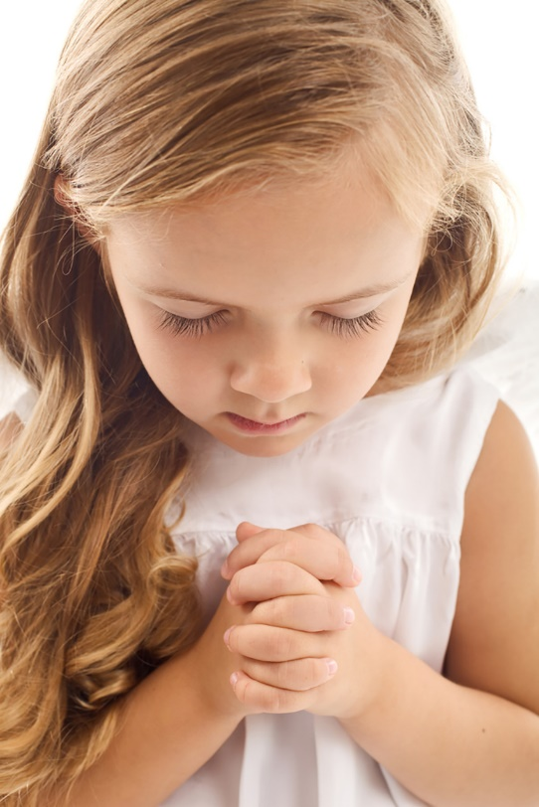
To end our worship today let us be thankful for the amazing world that God has created for us to enjoy.
https://www.youtube.com/watch?v=p4WVCZe0Fko
There was a mistake with one of those creatures can you be observant and see which one it was.
Let’s end with a prayer, choose a few people who would like to thank God for the beautiful world He has made for us to enjoy.

