Slide 1
This slide for the leader or teacher
St Clement’s
15 minute class worship
Session 6
We will be thinking about our School Prayer, particularly creativity.
You will need: Creativity stickers
DB Aug 2020

Slide 2
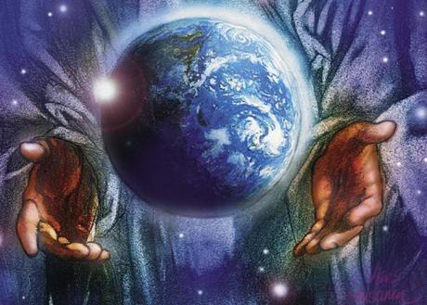
Today in our worship we will think some more about God’s creation and how we can be imaginative and resourceful .
Enjoy this song and dance as the children are being creative.
https://www.youtube.com/watch?v=ddLd0QRf7Vg

Slide 3

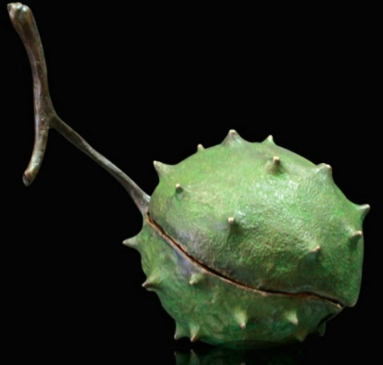

Today in our worship we will think some more about God’s creation and how we can be creative.
What could be inside here?
Is it an alien creature?

Slide 4

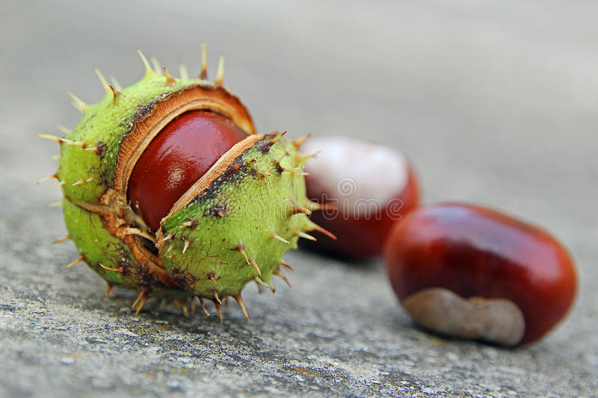
NO! It is a conker, this is what is inside

Slide 5
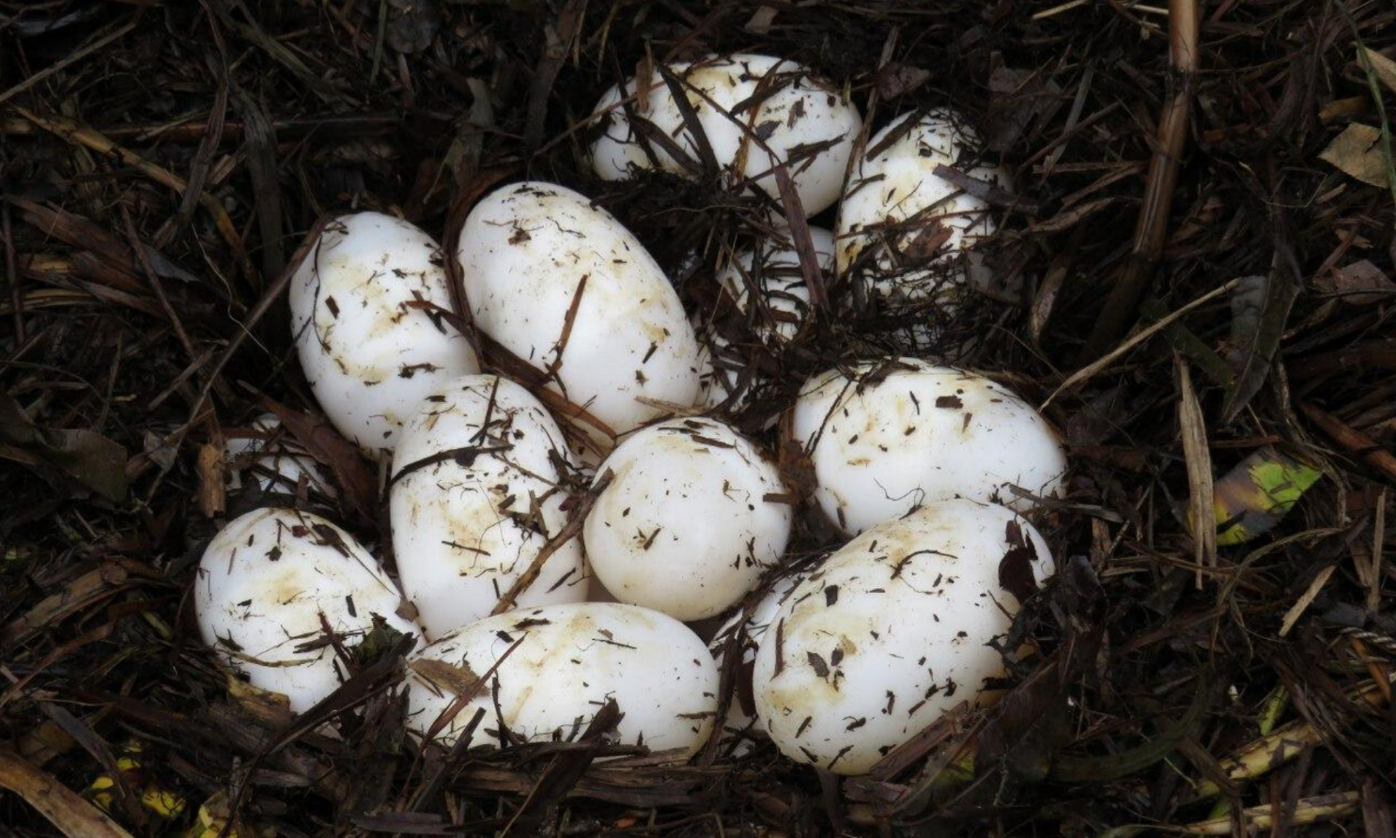
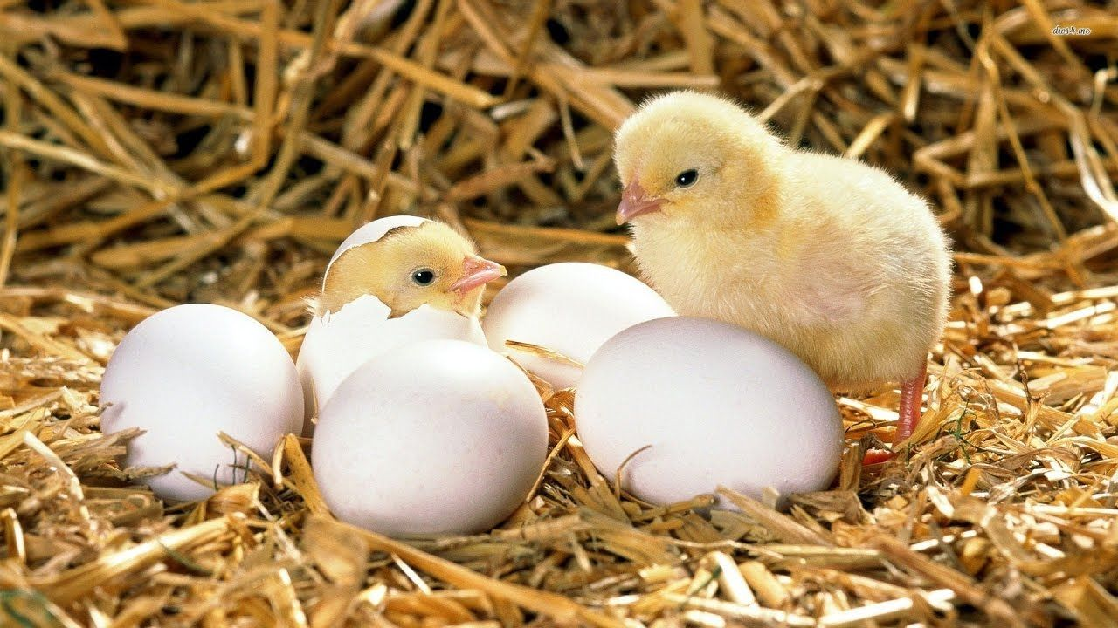
What could be inside here?
Is it some cute chicks?

Slide 6
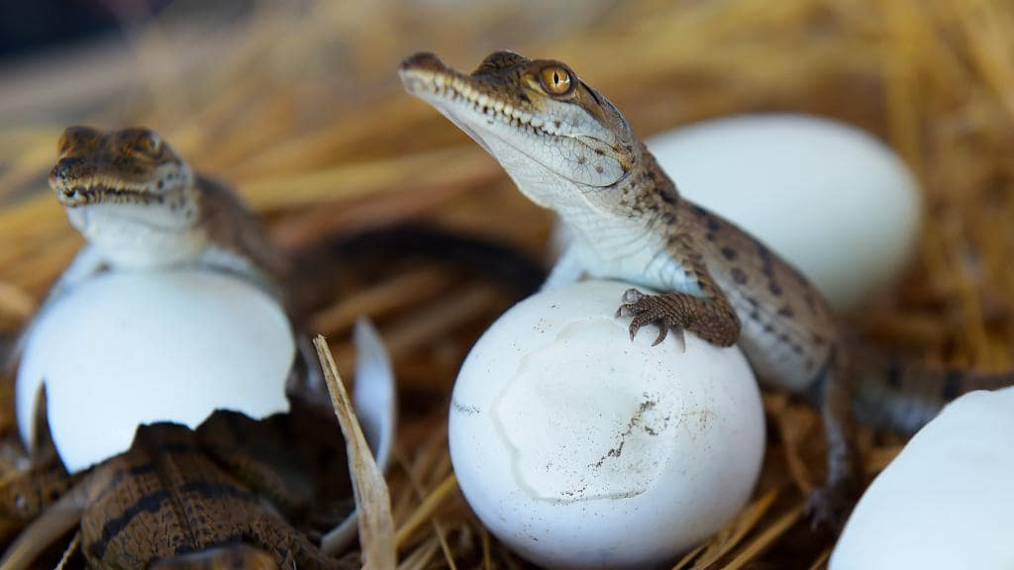
NO! It is some baby crocodiles!

Slide 7
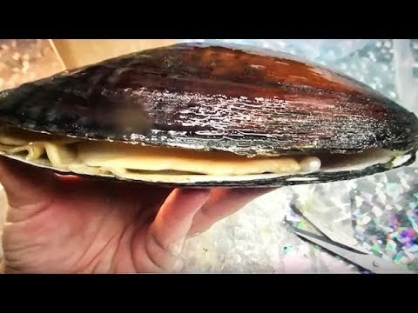
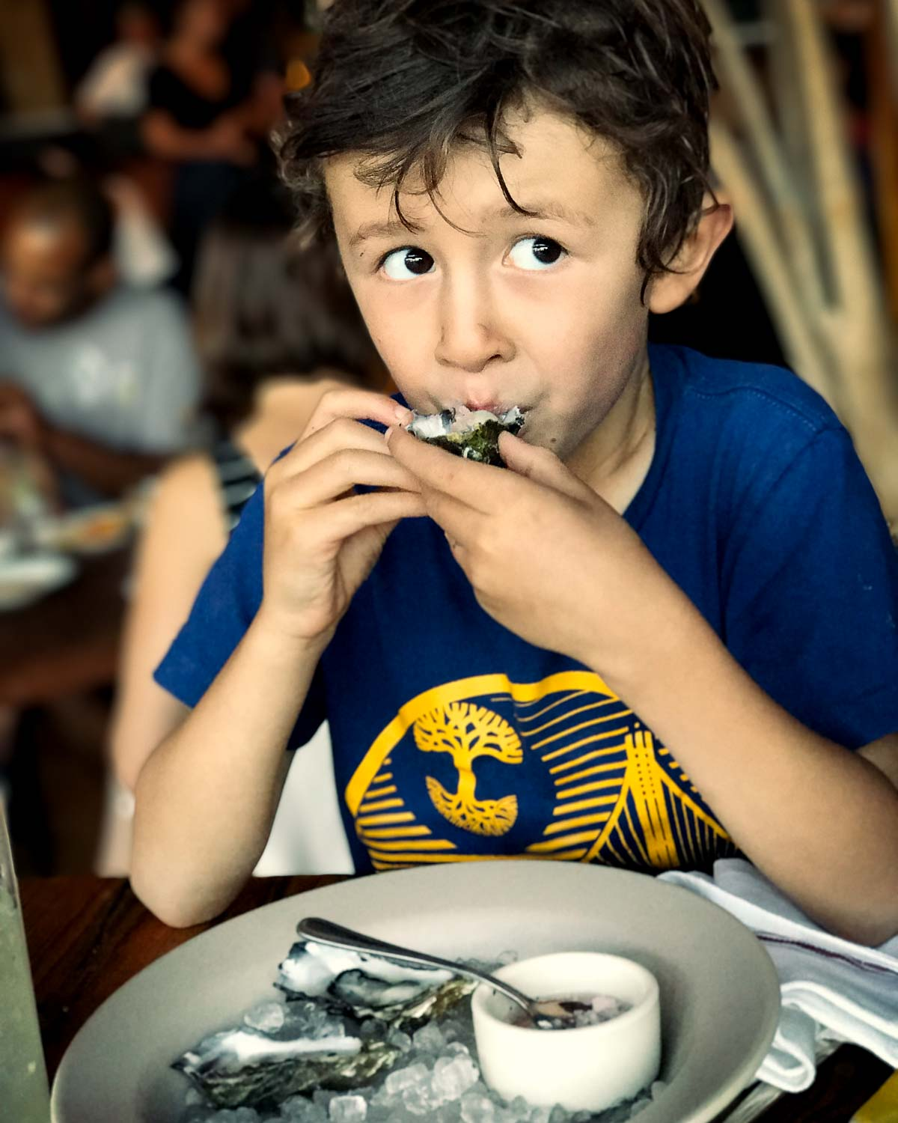
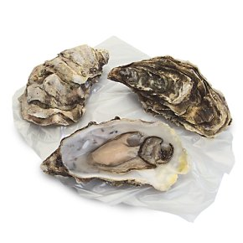
What could be inside here?
Is it some oysters to eat?

Slide 8


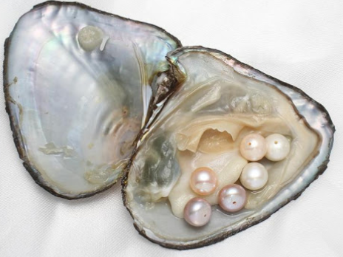


Watch to find out
https://www.youtube.com/watch?v=X56cpfVevk8
NO! it held some valuable pearls

Slide 9
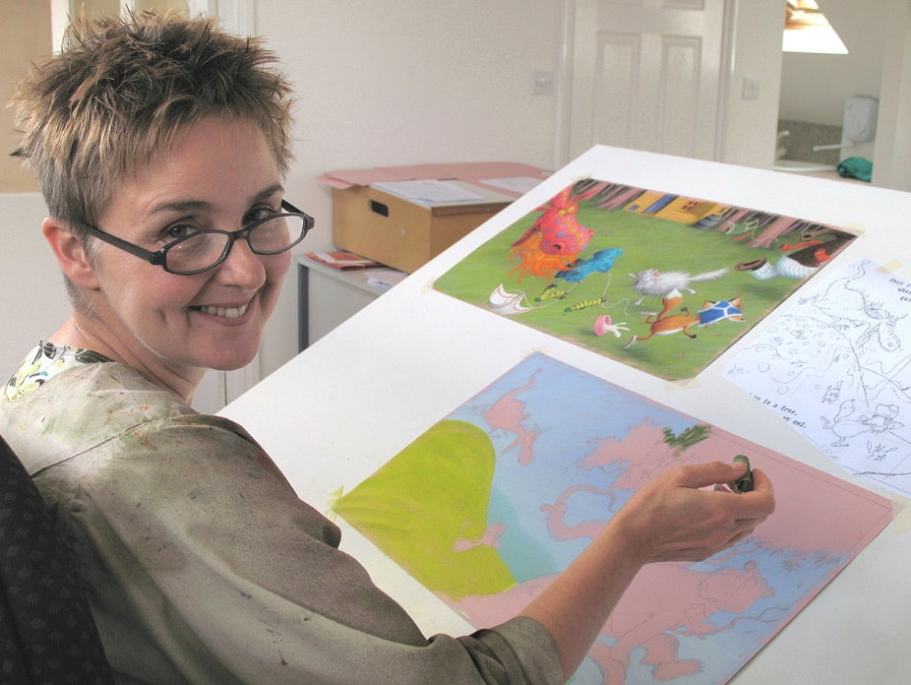
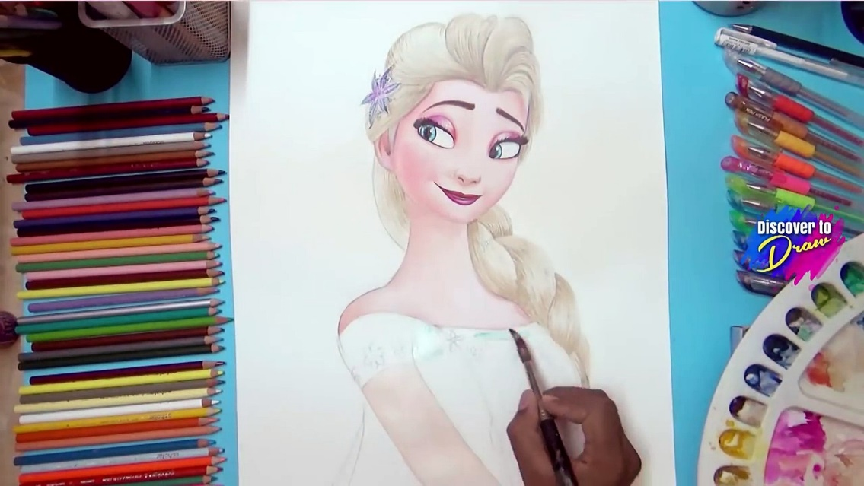
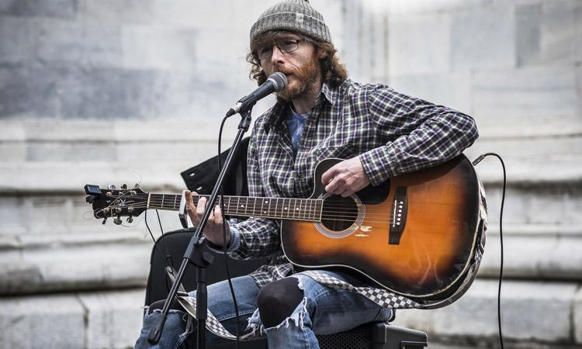

Did you know that every book you enjoy was written and illustrated because God has made people to be creative?
.
Each time you watch your favourite film be thankful that God partners with people to help them be artistic.
God designed us to compose and love listening to music.

Slide 10
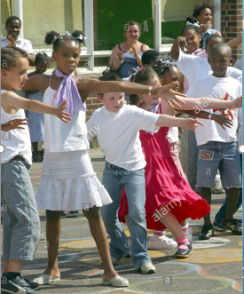
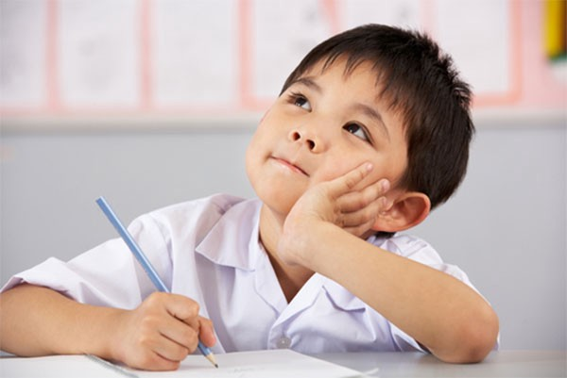
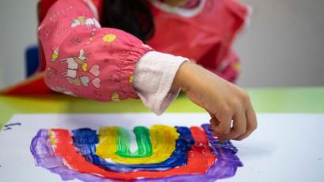
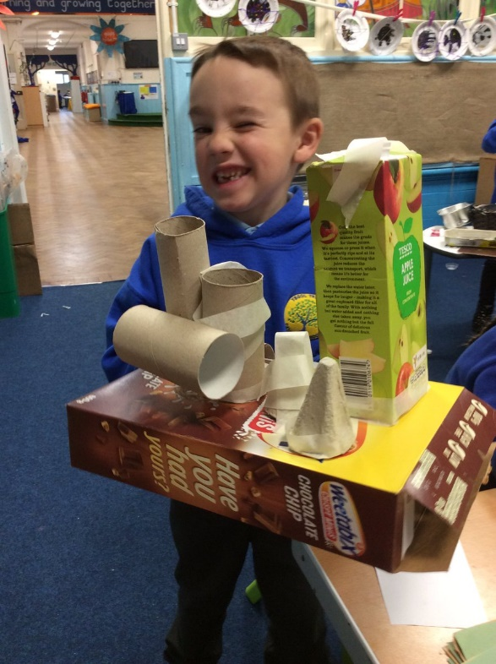
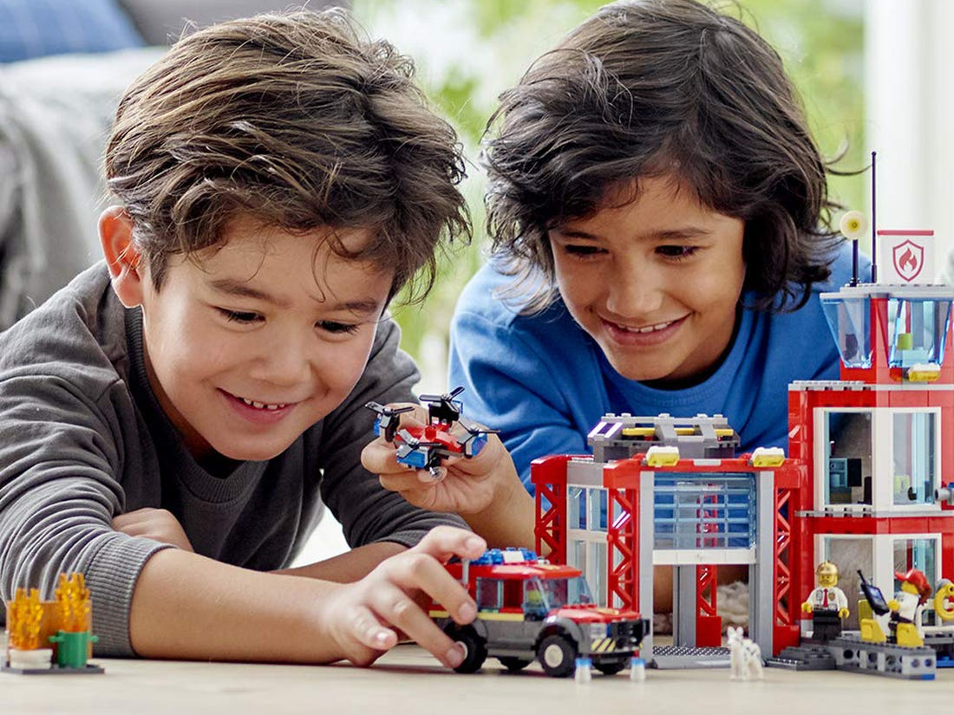
This week your grown up’s will be looking for times when you are creative.
You may get awarded a sticker to remind you to tell your family what you’ve been up to.
Perhaps you might…….
Make up a dance in the in the playground
Write a great story
Design and make an amazing model
Paint a beautiful picture
Use recycled junk to create something new

Slide 11
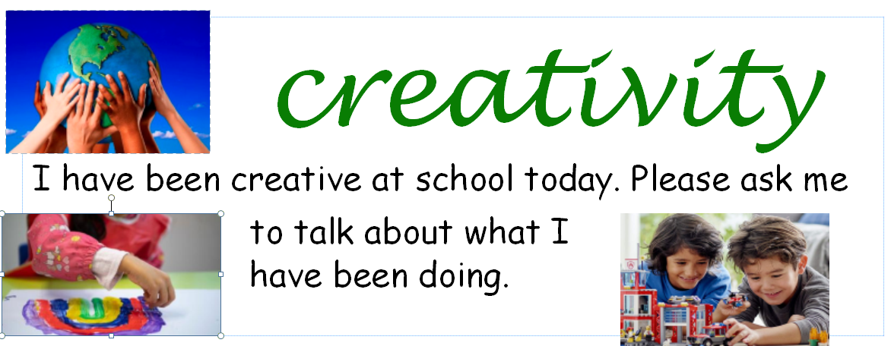
This week look out for children wearing these stickers.
Can you ask them what they have created?

Slide 12
We will finish our worship by watching and listening to a lovely song about the world we live in.
As you listen quietly be thanking God in your hearts.
https://www.youtube.com/watch?v=DKOPBjKm0k0
Let’s say a prayer
Dear Father God,
Thank you that we are made to be creative like you. Help us to enjoy drawing, writing and making things.
Thank you for all our favourite books, games, exciting films and great music we enjoy.
Amen

