Slide 1
This slide for the leader or teacher
St Clement’s
15 minute class worship
Session 7
We will be thinking about our School Prayer, particularly curiosity
You will need: A laminated copy of The School Prayer
Prayer book marks to show
DB Aug 2020

Slide 2

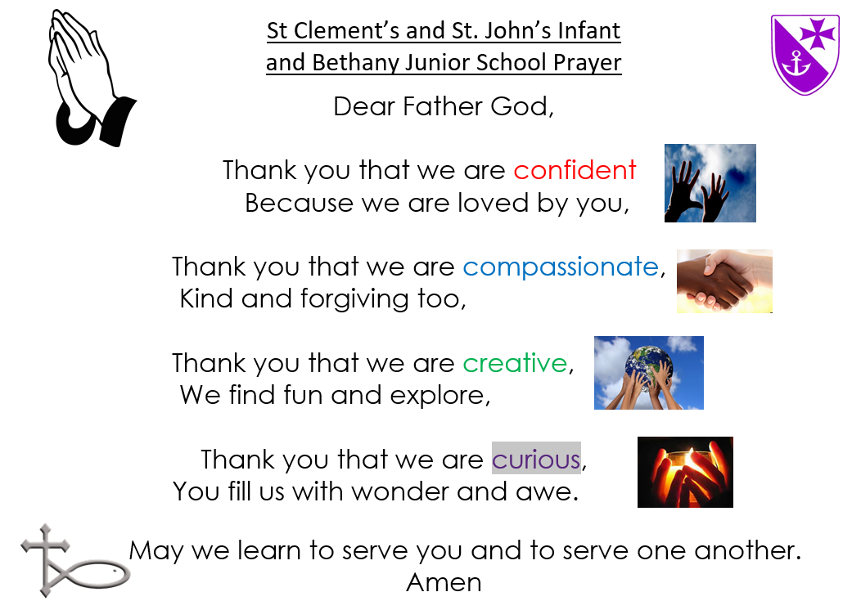

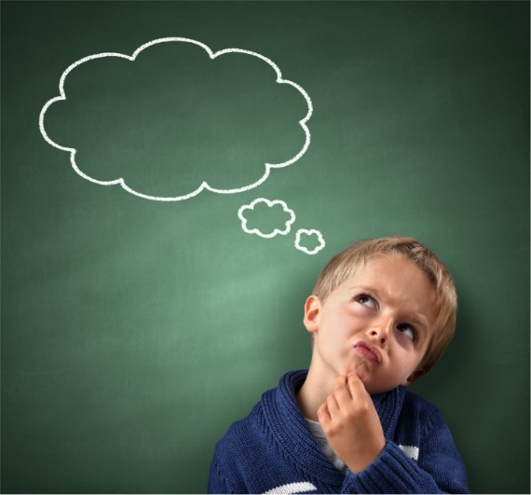


Lets begin by saying
our School Prayer confidently
Today we will think about
what being curious means.
When we pray this part
we make our fingers flutter
like a flame.
Can you tell your friend
what you think the word ‘curious’ means?

Slide 3



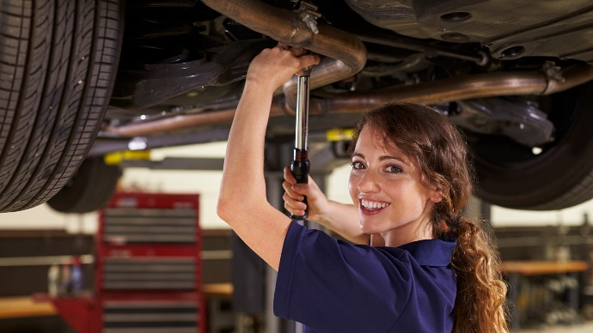
I think curious means wanting to understand and
know more about all sorts of things.
Doctors may ask questions to see if they can find out why someone is poorly.
Detectives look for clues to try and understand what has happened.
Scientists do experiments to understand
more about the world around them.
Mechanics test engines to check the car will run smoothly.
Mum’s and Dad’s will ask us questions about what sort of day we‘ve had.

Slide 4

?
?
?
?
We need to ask questions to help us understand and think about the world we live in.
It’s the best way to learn and make strong new pathways in our brains.
? ?

Slide 5
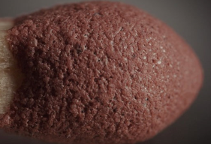

We are going to have a quiz,
Let us practise being curious and ask ‘what is this ?......’
Clue,
These need to be kept safe in a box
Clue,
Be careful when you pick these, don’t get prickled.

Slide 6
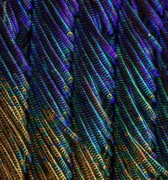
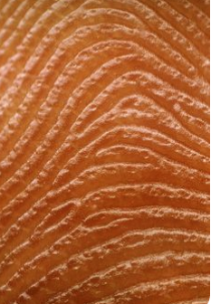
Clue
The male (Dad) is more of a show off than the female (Mum).
Clue
You have 10 of these

Slide 7
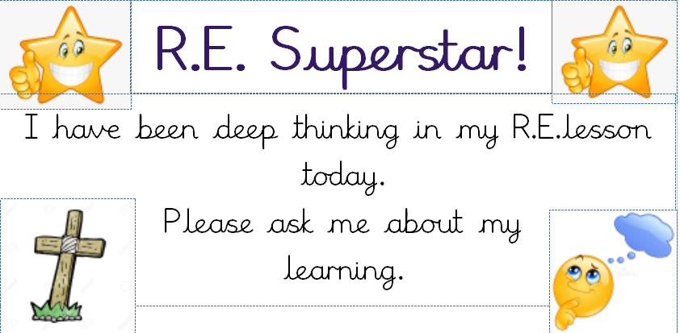
In our RE learning and in worship, we want you to be curious, asking lots of questions, especially tricky ones.
If you show this we call it ‘Deeper Thinking’ and your teacher would love to write about it in your RE book.
You can wear a sticker that shows people you’ve been asking interesting questions.

Slide 8
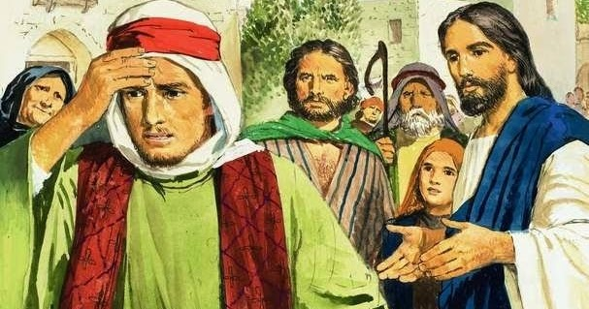
Lots of people came to Jesus and asked him some ‘deep questions’ about God.
A rich, good man asked a really interesting question.
‘Jesus, what must I do to go to heaven?’
Let’s find out what Jesus said
https://www.youtube.com/watch?v=vsHTvUo8k0Q
?
What stopped this man from being Jesus’ friend and follower?

Slide 9
I am so glad God wants us to find out about him by asking questions. The Bible, His special book is a great place to find out some answers.
It is good news that Jesus wants to be our friend and the most important thing in our lives.
We will finish by singing
The Blessing
https://www.youtube.com/watch?v=uiWZXLsdE9w
Maybe your teacher can show you the story of
The Camel and the eye of the Needle, during story time this week.
https://www.youtube.com/watch?v=tb_xIIkW148

