Slide 1
This slide for the leader or teacher
St Clement’s
15 minute class worship
Session 8
We will be thinking about our School Prayer, particularly curiosity
The answer to the 20 questions is Mr. P
You will need: A laminated copy of The School Prayer
Prayer book marks to show
DB Aug 2020

Slide 2
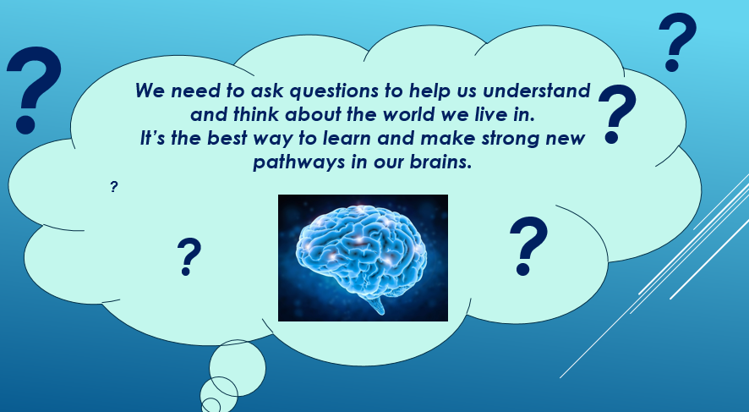



Last time we thought about how being curious is about asking questions.
We are going to play a question game trying to find out which person our teacher is thinking about.
You need to ask questions and your teacher will give a ‘yes’ or ‘no’ answer.

Slide 3


I will ask some questions to help start you off
Is the person a lady?
Can I read about this person in a book?
Is this person real?
Does this person play an instrument?
Maybe your T.A. could help you to think of some more questions
Can you guess who the person is??????????

Slide 4
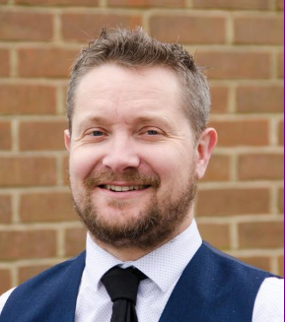
Did you guess?
It was………. Mr Poole
Perhaps you could play this game again sometime, maybe you could choose a character from a book or a film.

Slide 5


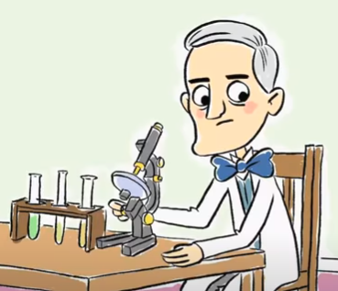
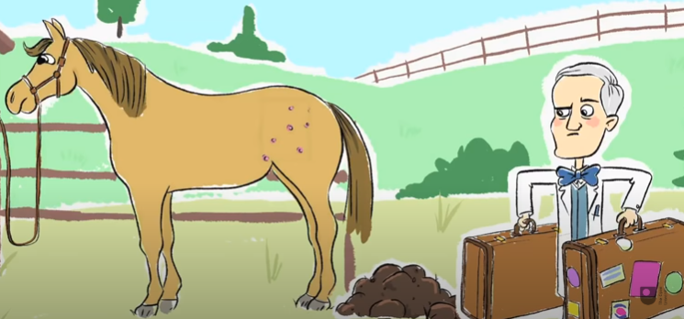
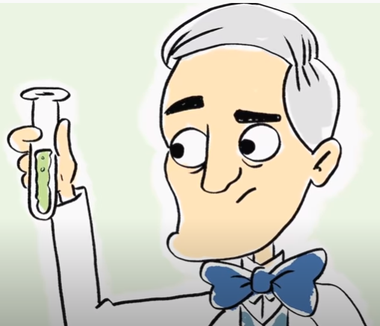
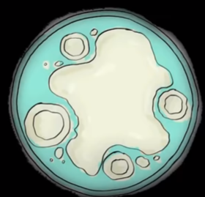


Scientist are great at asking questions.
Many years ago a man called Alexander Fleming grew up on a farm. As well as taking care of the horses he was very curious in finding out about the world.
He became a scientist.
One day when he came back from holiday he noticed something strange had happened in his laboratory.
Some of the cultures of bad bacteria he was growing had died. He realised that a fungus had killed them.

Slide 6
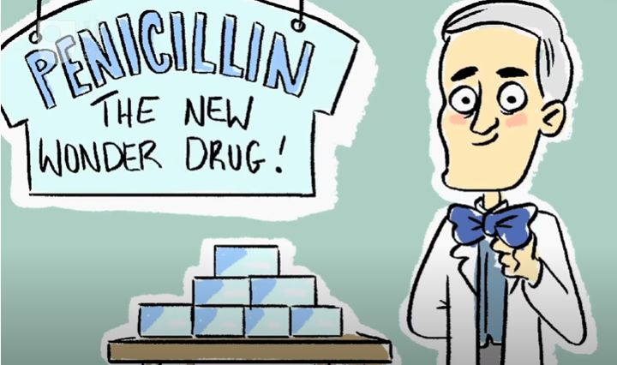
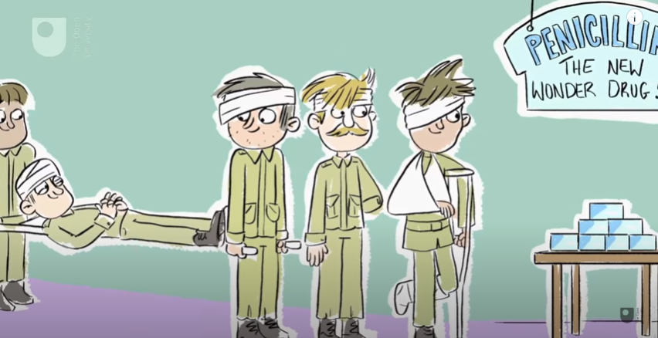
He asked lots of questions and did some experiments and managed to grow this fungus in his lab so that it could kill bad bacteria.
This wonderful discovery was called penicillin and helped to treat lots of poorly men in the next war.
We still use penicillin today to help sick people get better , it has saved millions of lives of people (and horses)
Watch and find out how amazing this discovery was.
https://www.youtube.com/watch?v=0ZWjzcsTd5M

Slide 7
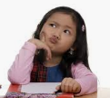
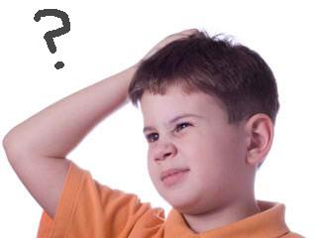
Last time we heard about a curious man who asked Jesus how he could get to heaven.
What questions would you like to ask Jesus if you met him?
Maybe we could ask our family or teachers or someone from the church to help answer your questions.
What God looks like?
I wonder…
Did God really make the earth in just 7 days?
Where does God live?
Why doesn’t God make everyone better?
It is ok if people don’t know the answer or disagree. Having lots of different ideas is really good.

Slide 8


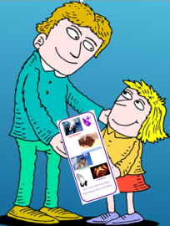
Now we have thought about all the values we have in our school prayer, confidence, compassion, creativity and curiosity.
We hope it has helped you to understand a bit more
about what they mean, maybe you can think about
them sometimes when you are praying.
Also remember that we are all looking out for children who confidently join in using the actions.
Perhaps you may notice a
child in your class, just tell your grown up and we would love to present them with that special prayer book mark.

Slide 9
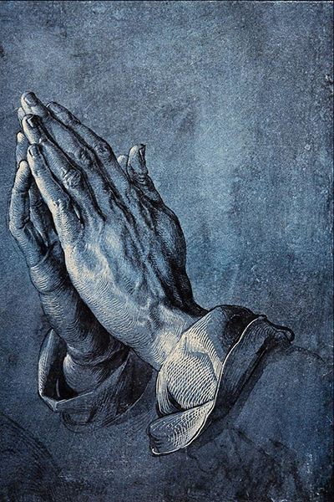
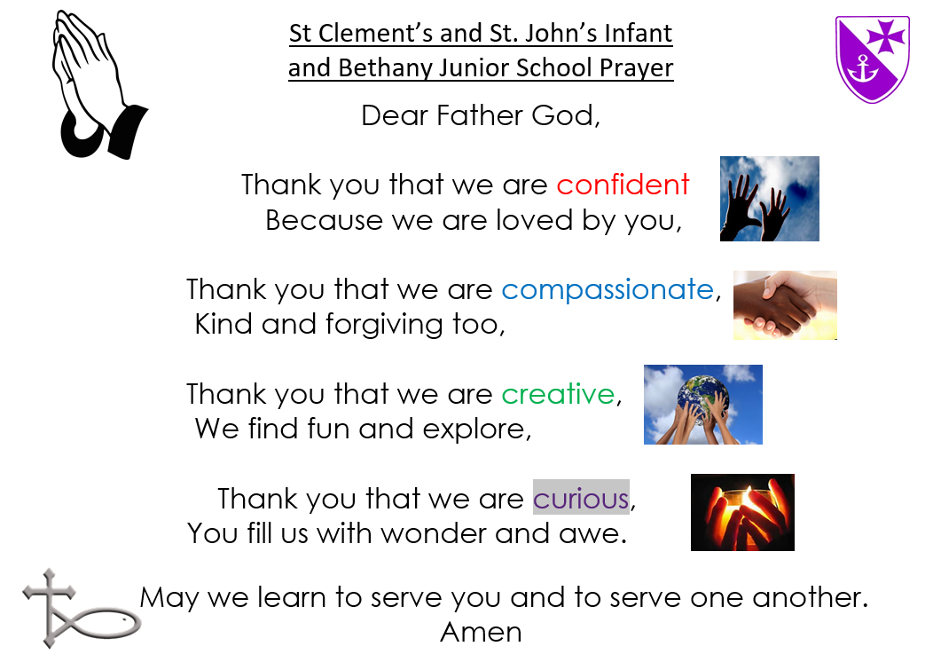
Let us pray
Dear Lord,
Thank you that you have given us good brains and the ability to think.
Thank you for scientists who have made great discoveries that help to keep us healthy.
Please help those men and women who are working so hard to discover a vaccine for the Corona virus.
Amen
Let us all pray our School Prayer

