Slide 1
This slide is just for the leaders
to get the class or family worship ready
For this worship,
you will need to get ready
The blessing song
ttps://www.youtube.com/watch?v=uiWZXLsdE9w
Your favourite limerick if you know any.
A small tied plastic bag to throw later with bits of paper in.
:

Slide 2
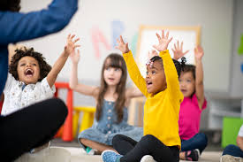
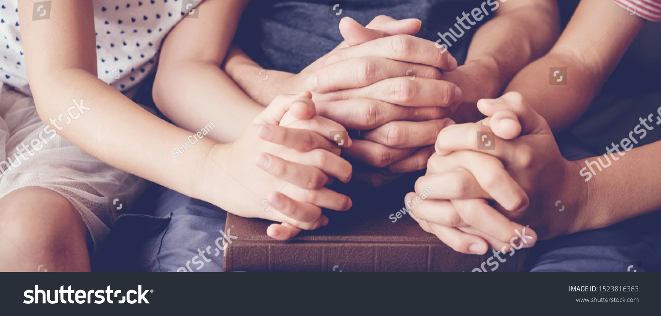
Welcome to Summer term #6
Class or Family worship
Today we will be Curious and Reflective.
We will find out how we are helping God to change lives.
Let’s sing a blessing with children around the world…
https://www.youtube.com/watch?v=uiWZXLsdE9w

Slide 3
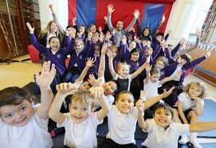
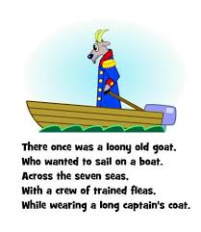
Let’s start with a limerick
For National Limerick day!
.
There once was a boy from Boscombe,
Who said, “To school I will not come.”
Five weeks without mates,
He thought school would be great,
He said, I think school is awesome!
Make one for someone in your family!

Slide 4
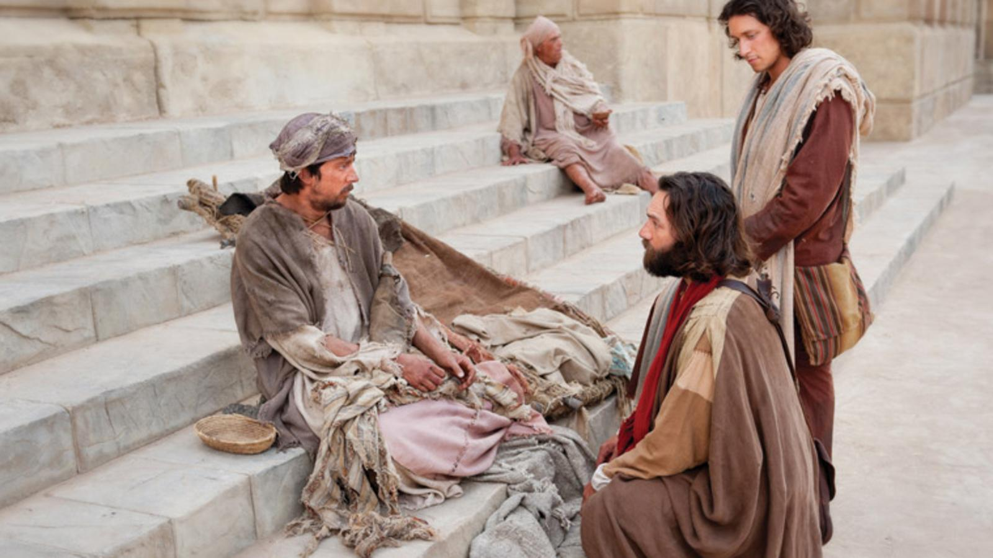
In Acts 3 in the Bible, two of Jesus’ friends, Peter and John met a man.
The man had not walked since he was a child.
Peter and John had no money to give him but they prayed he would be able to walk.
He walked
because they prayed!
Hooray!
Wouldn’t it be great
to make a difference
to someone else… well we did!

Slide 5



Toilet troubles
Thank you to Christian Aid for this information.

Slide 6
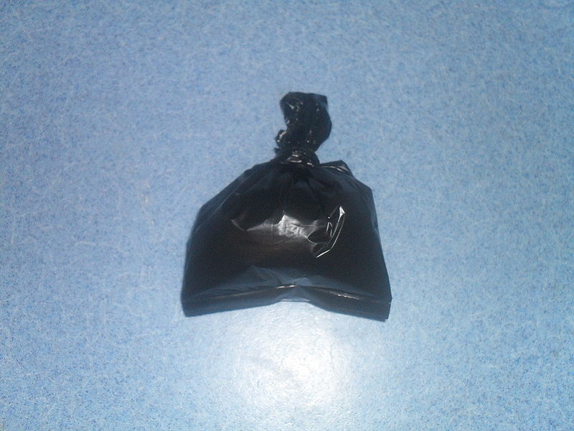
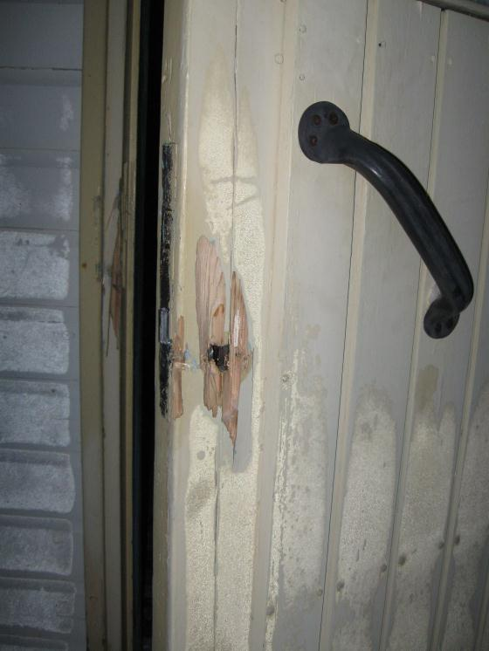
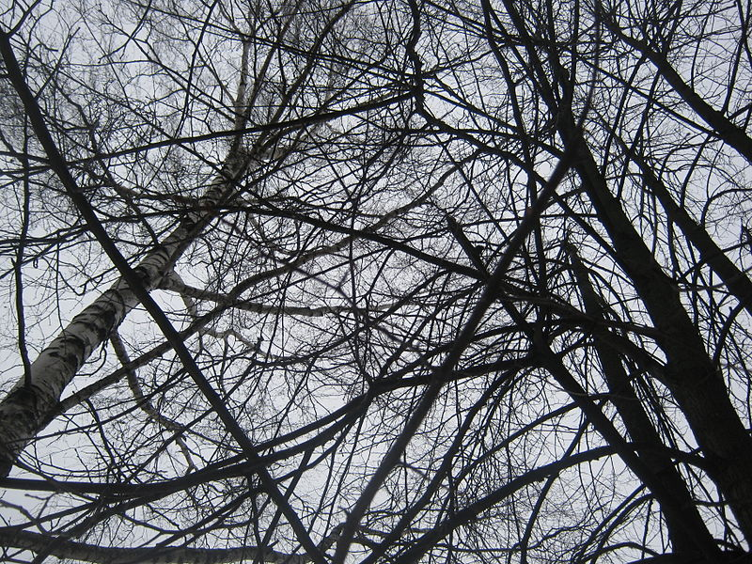
Images:Wikimedia Commons
What do you think these pictures are all about?

Slide 7
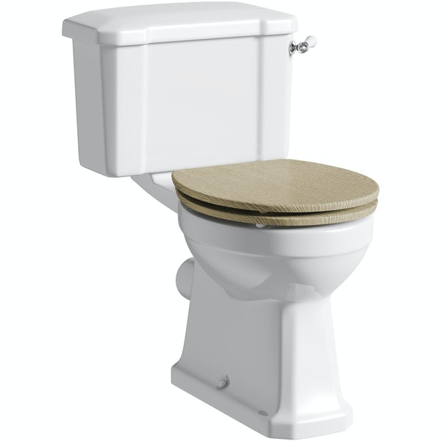
They are all about something we use every day…
A toilet!
Let’s learn a bit about how it was invented and discover how we have made a difference in the world.

Slide 8
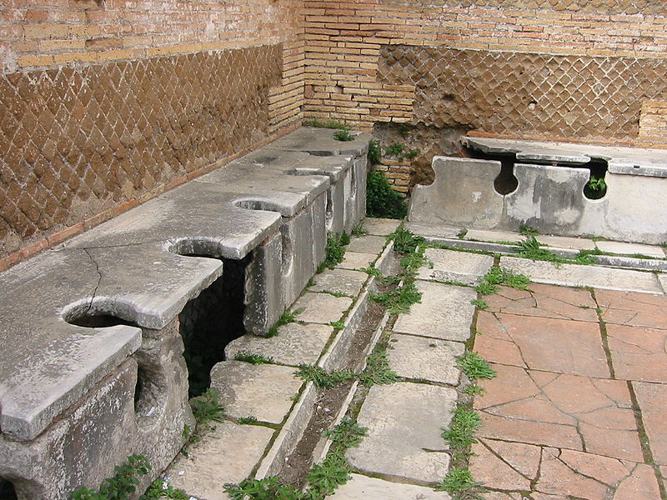
Ancient Roman toilets
Romans invented the toilet. which
We are very glad about it.
What did people do
before then,
do you think?
Image:Wikimedia Commons

Slide 9
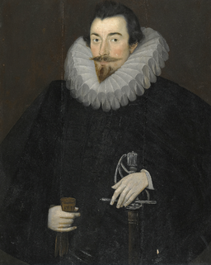
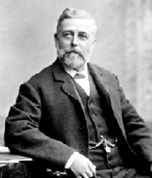
Her are two famous toilet inventors
Sir John Harrington
Thomas Crapper
Images:Wikimedia.org

Slide 10
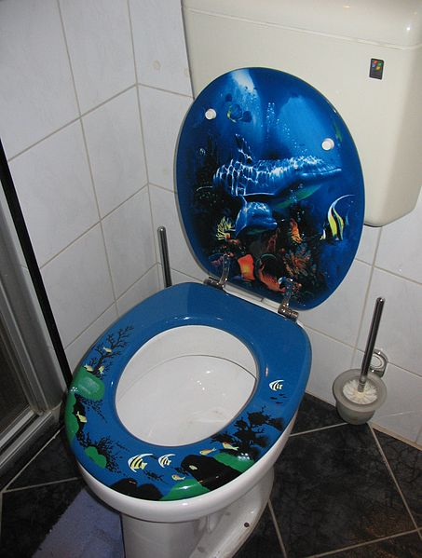
Toilets can be very different. There are lots to choose from, but what we all want is that it is clean, private and safe, like our school loos, because we look after them.
Image:Wikimedia Commons

Slide 11
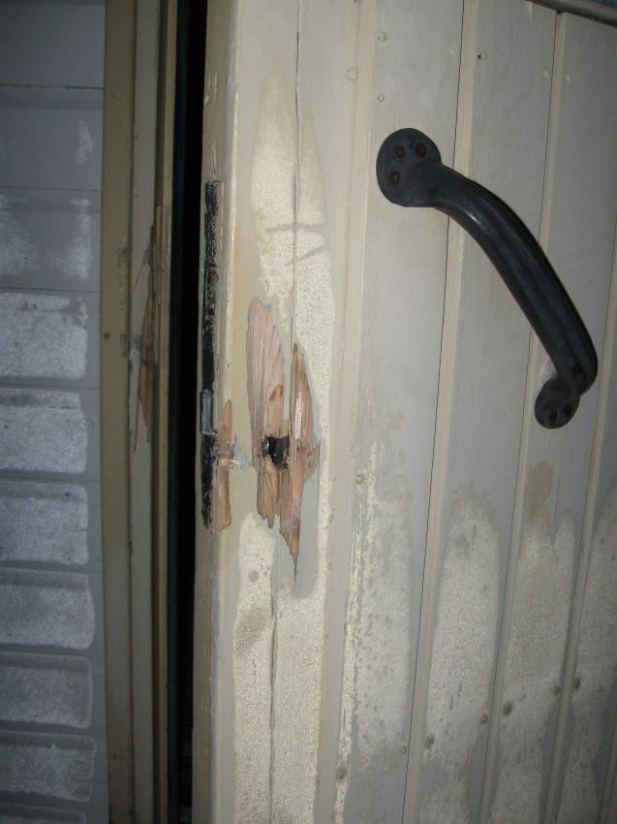
In some countries school toilets can often be dirty or smelly and have no toilet paper or soap. Sometimes the locks might be broken.
Wikimedia Commonsc

Slide 12
Did you know toilet paper is made of trees? About 27,000 trees are cut down to make the toilet paper we use everyday.
Image:Wikimedia Commons

Slide 13
How does the plastic bag relate to toilets?
BIG number coming up…
2.6 billion people (like 1 in every
3 three people)
live in towns, villages and cities
in the world where there are
no safe, clean toilets
or safe water to drink.
That’s a BIG problem!

Slide 14
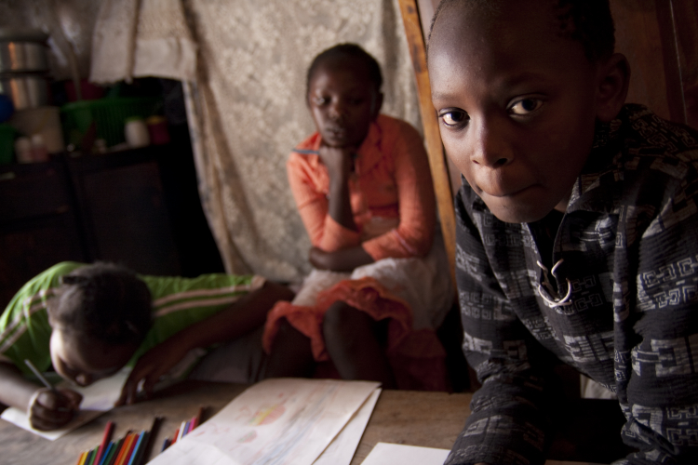
This is Jeremiah (on the right). He lives in Africa, in Kenya’s capital city, Nairobi. It is a very poor area.
Christian Aid/Antoinette Powell

Slide 15
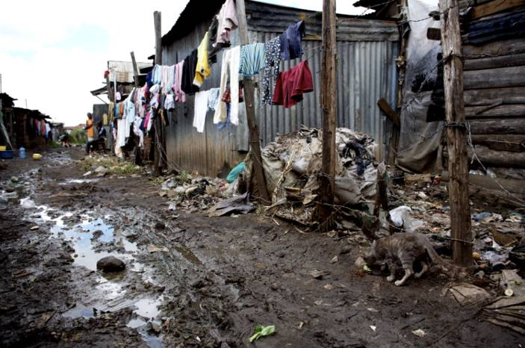
When it rains it is like living in mud. When Jeremiah was younger, there were no toilets or safe clean water. Jeremiah and his friends had to use ‘flying toilets’- a plastic bag instead of a toilet. They would throw it away which made a smell.
Christian Aid/Elaine Duigenan

Slide 16
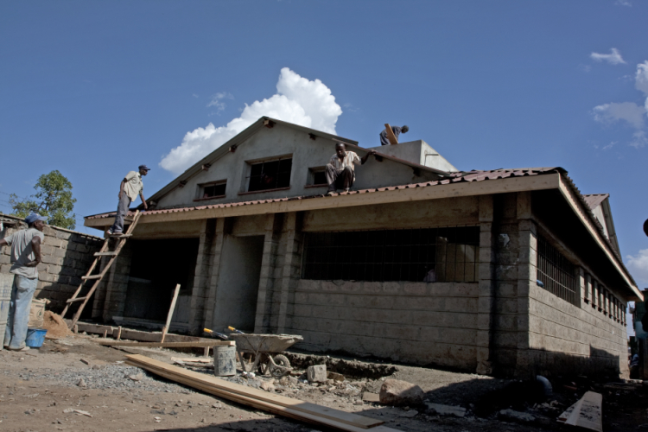

Jeremiah’s new loo block
Christian Aid came
to the rescue,
helping the village
to build a toilet and
shower block, which also gives clean, safe water.
Hooray!
Christian Aid/Antoinette Powell

Slide 17
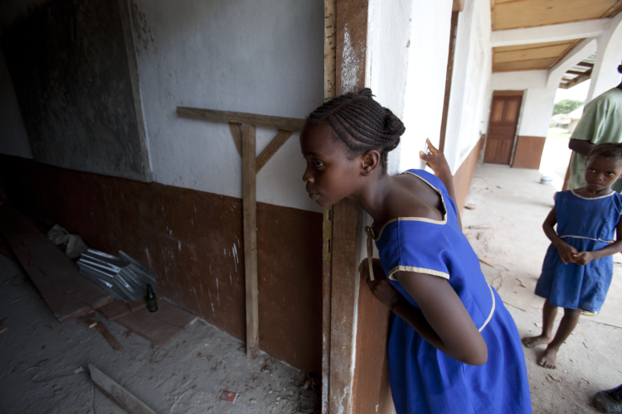
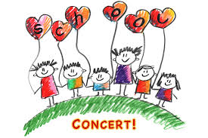
Did you know…
Our school concert last year raised money to make a school toilet in Malawi.
You can see the pictures on the loos around our school!
Hooray again!
Christian Aid/Heidi Bradner

Slide 18
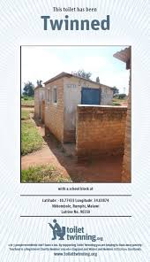


Slide 19
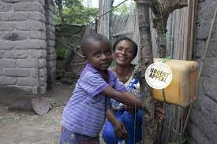
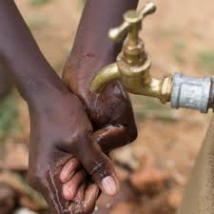
During the corona virus, many children cannot wash their hands to keep them safe.
Wouldn’t it be great to twin a tap as well as a loo?
Send ideas how we could do that to Mrs Torrens through school email.
Praying makes a big difference, like with Peter and John, so maybe you can
pray that all children would have a tap, clean water and a loo.

Slide 20
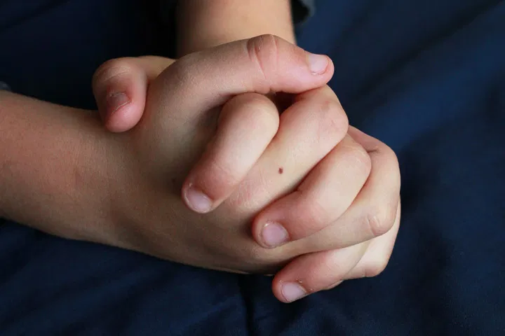

Let’s pray.
Thank you God for our toilets everywhere we go,
at home and at school, in parks and cafes, and even by the beach.
Help us to be grateful for what we have. Let us help bring changes in the lives of others who do not have important things like toilets and taps.
Amen.

