Slide 1

This slide is just for the leaders
to get the class or family worship ready
For this worship, you will need :
Song on youtube: The Way
https://www.youtube.com/watch?v=9zIdWUuesHk
Youtube story- The walk to Emmaus.
https://www.youtube.com/watch?v=ndtnZV-5QTo
For the ‘Would you rather?’ game, you can either look at the powerpoint,
Or each person draws an animal. Show your animal to a partner.
Ask them…Would you rather be a …. They show their picture and say… or a … Find another partner and do it again. Share reasons for choices.

Slide 2
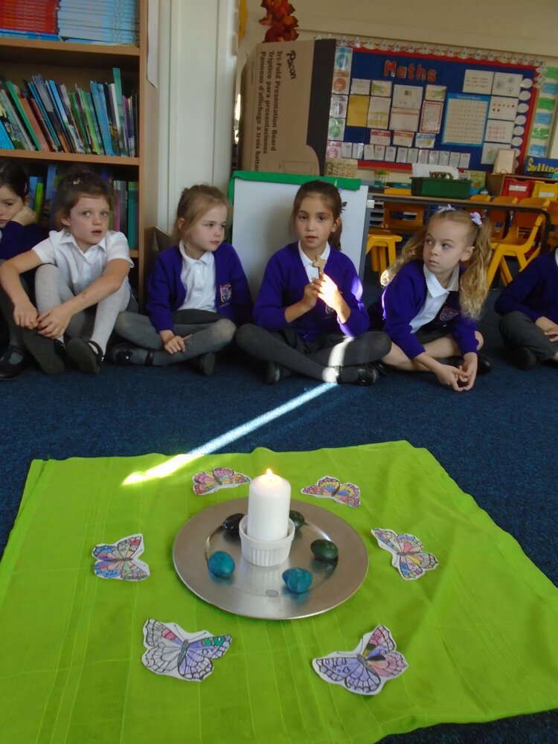

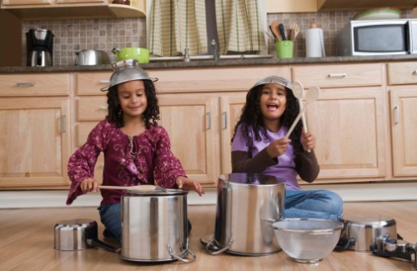
Welcome to our first Summer term
class or family worship time!
Let’s sing The Way!
https://www.youtube.com/watch?v=9zIdWUuesHk

Slide 3

Welcome to our class or family worship Summer term 1
This half term we are going to grow together
in our spirituality
through Bible stories & events after Easter
We will explore how Jesus’ friends told the good news
to the world.
This term we will be Curious and Reflective

Slide 4
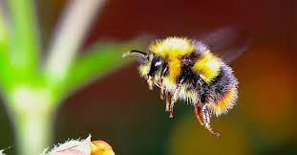
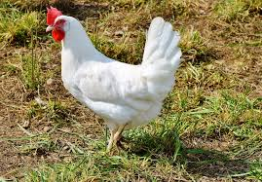
Here is a P4C game.
Would you rather be...
A bee… or a chicken? Give reasons for your choices.

Slide 5
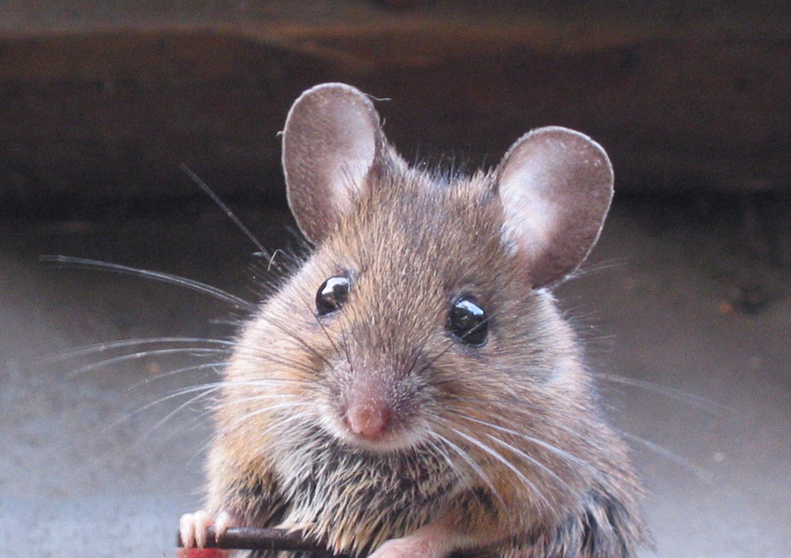
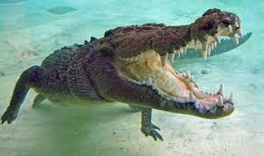
Would you rather be...

Slide 6
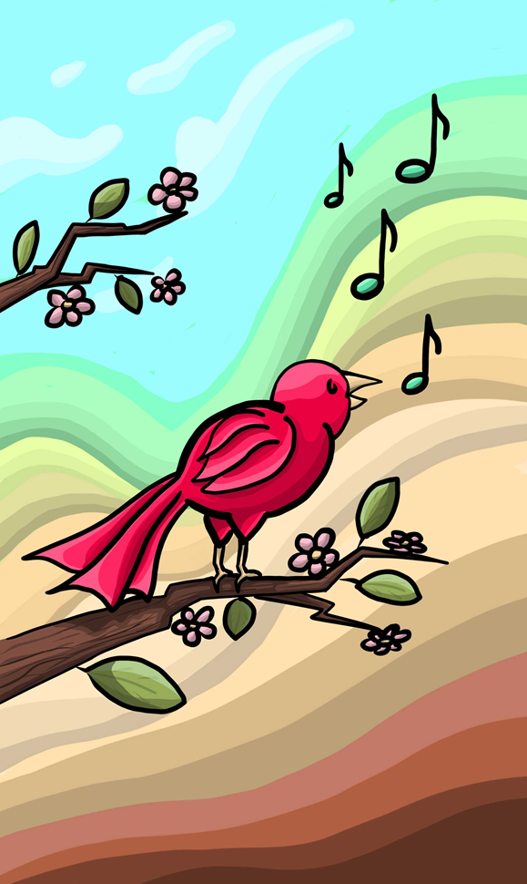
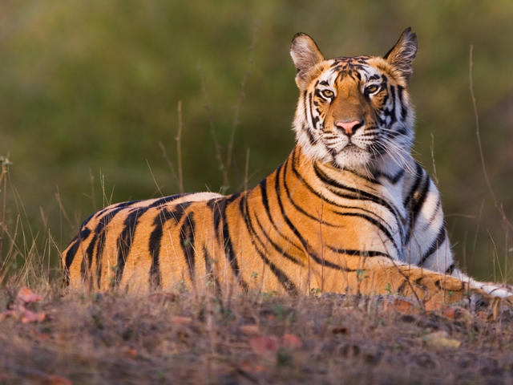
Would you rather be...
Give reasons for your choices. Make up two of your own…

Slide 7
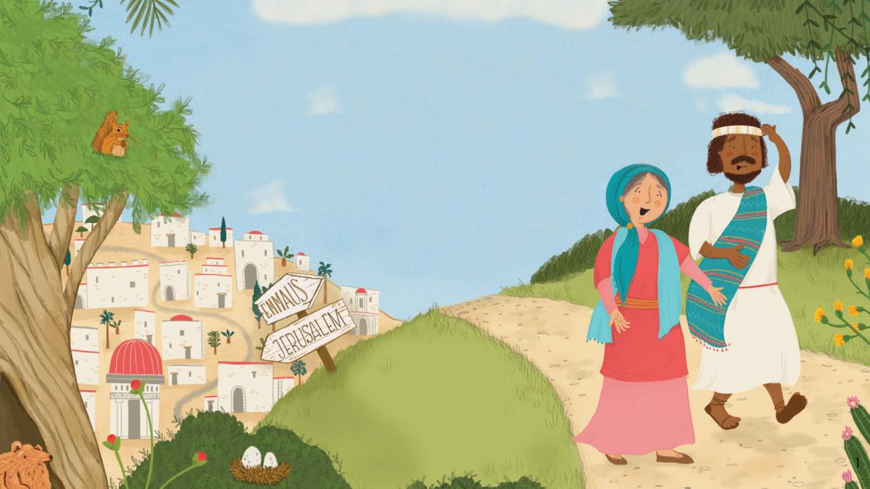
Let’s watch the surprising and curious story of the walk to Emmaus.
https://www.youtube.com/watch?v=ndtnZV-5QTo

Slide 8
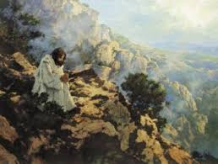
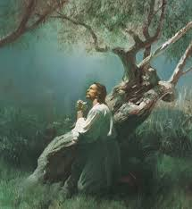
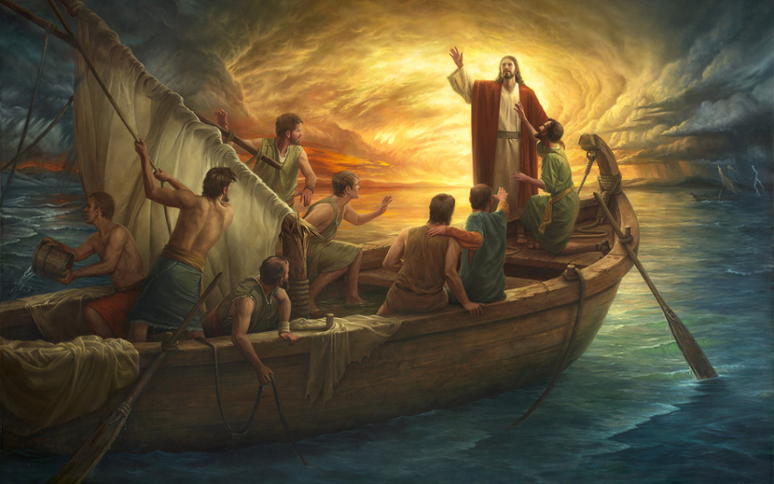

Where would you rather be?

Slide 9
Jesus went to mountains, gardens, deserts and boats to meet with his Father God alone.
If you wanted to meet Jesus, where would you go?
What would you be doing there? Walking, sitting, reading, drawing, creating or being in nature? Share ideas.

Slide 10
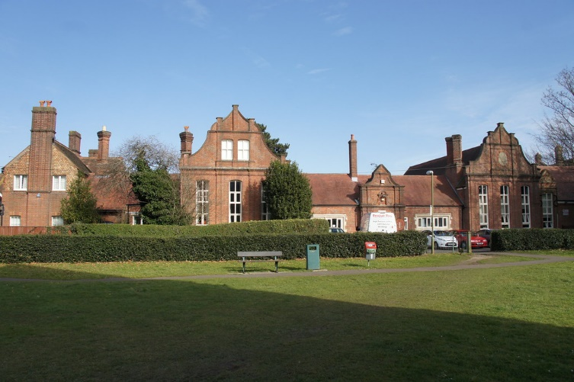
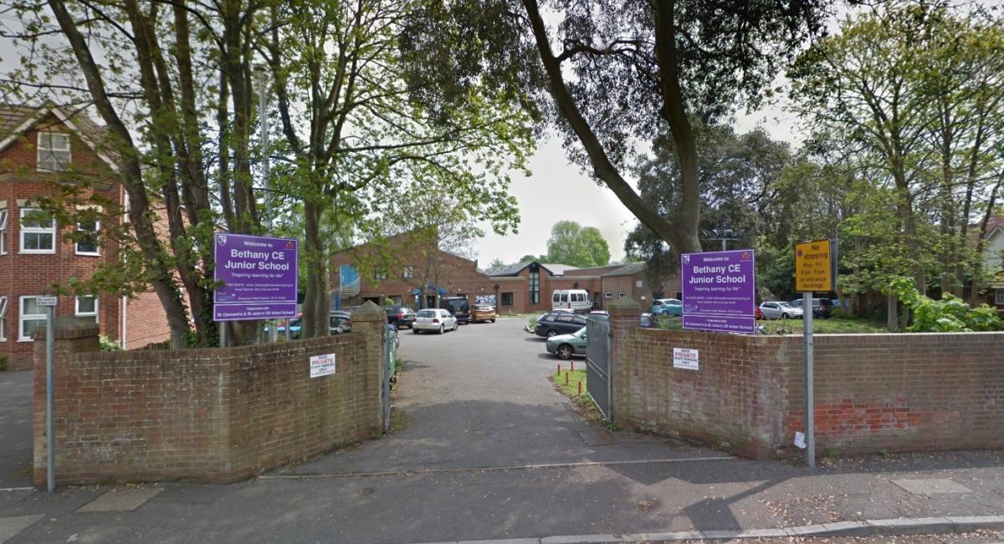
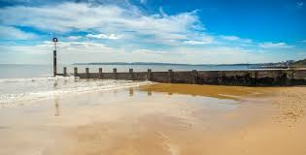

Choose people to pray:
For God’s love in our schools
For God’s love in our families and community
For God’s love in our world

