Slide 1
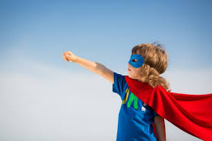
Corona time
Hero Rap by
St Clement’s
Children at school
April 2020

Slide 2
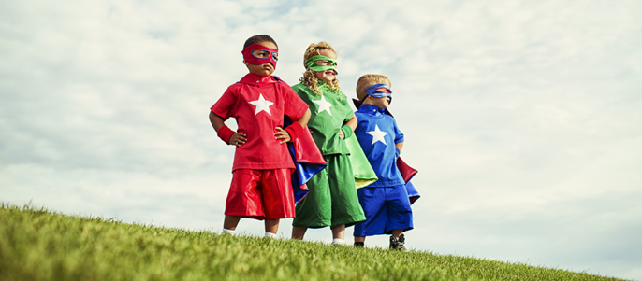
He can do it,
You can do it.
Gather around,
For our super-hero sound

Slide 3
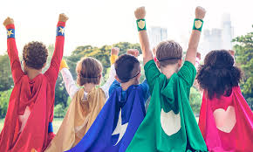
Inside of you.
Inside of me,
Are all the things
That we can be.
.

Slide 4
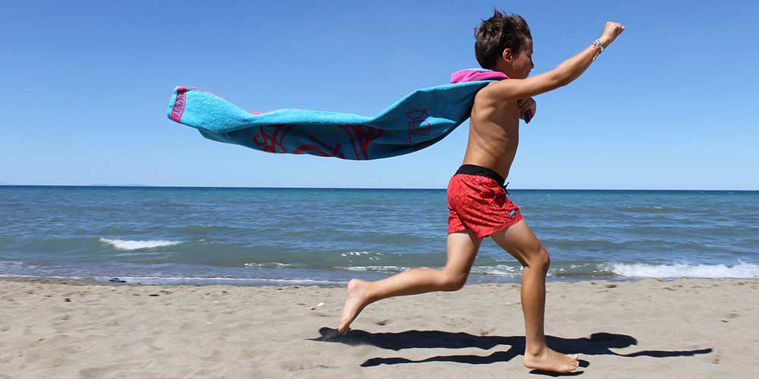
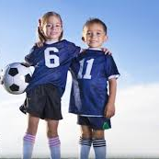
What does a hero need to be?
Compassionate,
Helpful,
Brave,
Fearless,
Determined and
Part of a team.

Slide 5

We don’t need superpowers
To become a hero,
Looking after everyone,
You’re a superhero.

Slide 6

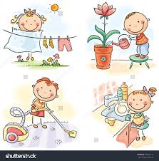
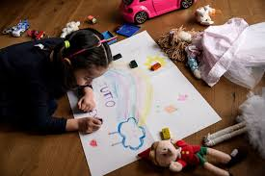
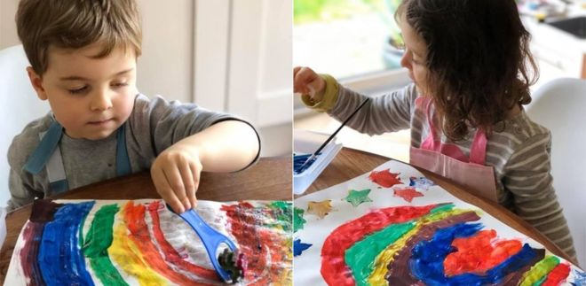
Super heroes, super brave,
The whole world, we can save!

